Slide 1
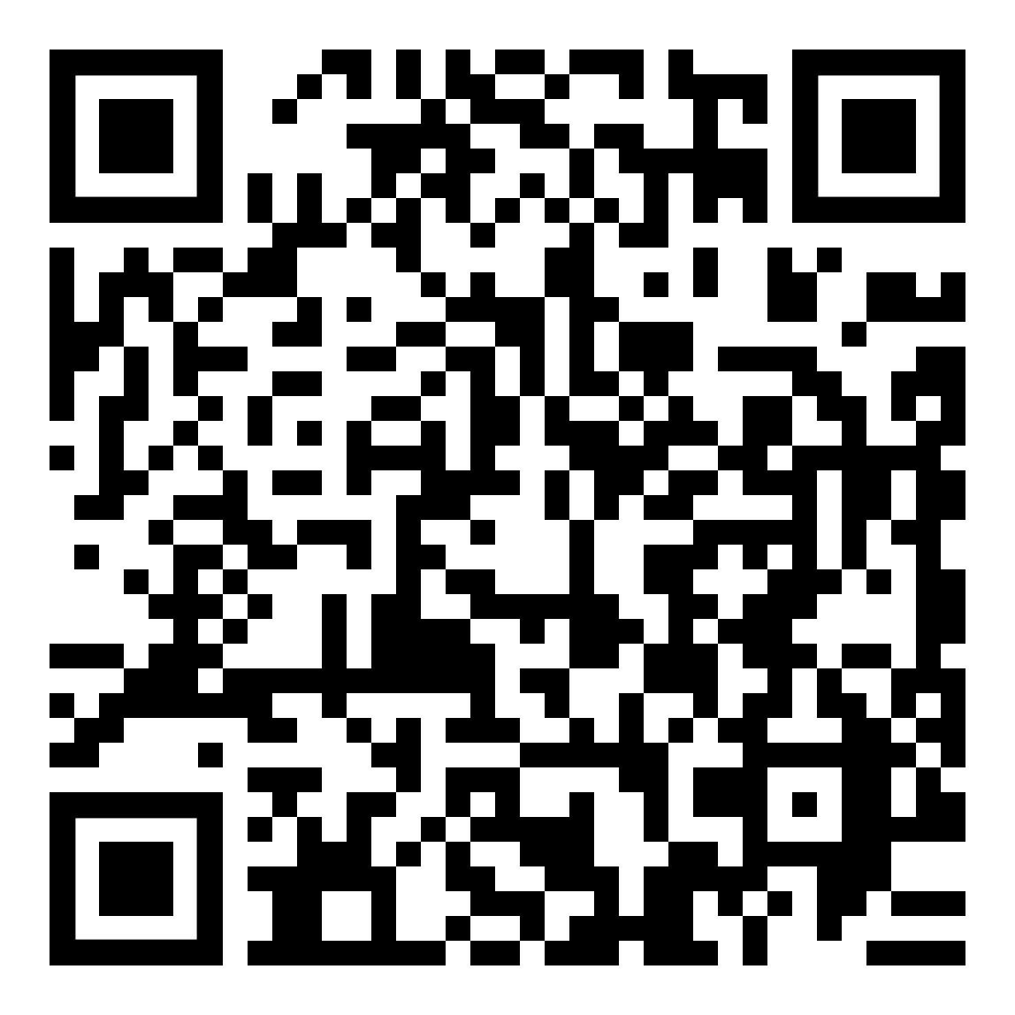
Patient goals of care statements during visits for chronic pain management
Cameron L. Clerkley,¹ Biftu M. Mume,¹ Ebere I. Sonoiki,¹ Stephen G. Henry^{1,2}
¹UC Davis School of Medicine; ²UC Davis Department of Internal Medicine
Background
Results
Results
State and national guidelines recommend that prescribing opioids for chronic pain should be based on patients’ progress towards mutually agreed on, objective treatment goals.
Physicians lack practical advice on discussing goals
We lack research on how, when, and why patients with chronic pain discuss treatment goals during clinic visits.
Definition of patient goal statement: Statement conveying the reason the patient wants pain treatment or (better) pain control. Goals must be something tangible that could be an answer to the questions “I want my pain treated because X” or “I want my pain treated so that Y”.
Transcripts contained a mean of 2.2 unique goal statements per visit (median 1, interquartile range 0-6). Nearly 30% of visits (n = 14) contained no patient goal statements
As shown in Table 1, the most common goals mentioned by patients were restoring physical function (44%), decreasing pain intensity (19%), enhancing overall life fulfillment (12%), and improving sleep quality (12%)
Most goal statements (73%) were made in response to physician questions: 9% in response to physicians asking specifically about patient’s pain treatment goals, 53% in response to other pain-related questions, and 11% in response to general questions not about pain (Figure 1)
Most goal statements (71%) function to advocate for a change in pain treatment: 43% indirectly (implicitly) and 28% directly (explicitly); 13% of goals function to resist a change in pain treatment suggested by the physician; and 16% function to express approval of satisfaction with the patient’s current pain treatment (Figure 2)
Table 1. Types of pain management goals expressed by patients (n=104)
Goal | Definition | Frequency | Examples
Physical function | Ability to perform daily activities | 46 (44%) | It’s hard to walk; I have to cook for myself
Pain Intensity | Reduce pain intensity exclusively | 20 (19%) | My back is hurting worse; I would like to have less pain
Sleep | More or better sleep | 12 (12%) | Help me to go to sleep; My sleeping is terrible
Fulfillment | Foster joy or fulfillment | 12 (12%) | Enjoy my life; Spending time with my family
Treatment / Procedure | Avoid (or quality for) a pain-related procedure | 8 (8%) | I couldn’t do the arm exercises; It’s gunna lead to another surgery
Social role | Perform duties as an employee, student, family member..etc. | 4 (4%) | I want to go back to school; Great grandkids to be around and enjoy
Mood | Improve mood | 2 (2%) | I’m just tired of it; It make me depressed
Research Questions
RQ1: How often and what kinds of goals for chronic pain management do patients express during primary care visits?
RQ2a: When are patients prompted to mention goals?
RQ2b: Why do patients mention goals?
Methods
Data sources
Transcripts of 48 primary care clinic visits collected for a pilot clinical trial in 2019 (NCT03629197)
Patients were adults taking opioids for chronic pain seen for routine pain-related visits at one of two primary care resident clinics
Patients completed surveys before their study visit; physicians completed surveys at enrollment
Analysis
Iteratively reviewed transcripts to develop a definition and codebook to identify patient goal statements
Revised codebook based on discussion until all authors could reliably code goal statements from transcripts
Three co-authors independently applied codebook to all transcripts; disagreements were resolved through discussion
Goal statements were reviewed and characterized according to the following:
a) type of goal
b) goal context (based on statements preceding
each patient goal statement)
c) goal’s communicative function in the visit
Figure 1: Patients mention goals when...
Figure 2: Patients mention goals in order to...
Discussion
Most of the pain management goals patients express during primary care visits relate to objective goals (e.g., physical function, sleep, social roles)
Patients almost always express goals in response to physician questions, though physicians rarely ask patients about their pain management goals directly
Patient statements about their goals for pain management usually function to advocate or express preferences for specific pain treatments, often in response to physicians’ treatment suggestions
Eliciting patients’ goals early in chronic pain treatment is a promising strategy for promoting guideline concordant chronic pain treatment
Example of a provider pain question: “What hurts when you try to take a shower?”
Example of a provider goal question: “So with the Norco… What are you hoping it will make it easier for you to do…around the house or things in your life?
Example of an indirect request to change pain regimen: “Only time….I take more than what I’m supposed to...it’s like when my back gives out on me.”
Example of a direct request to change pain regimen: “I feel that I need a stronger pain pill.”
Funding
Scan QR Code to see full breakdown of characteristics for Physicians (n=37) and Patients (n=48).
Definition of Pain Regimen: An integrated approach that addresses the interrelated biological, psychological, and social factors contributing to pain, with the aim to provide comprehensive and personalized treatment. Examples include, but aren’t limited to, pain medications, physical therapy, procedures, etc.
This work was funded by a grant from the UCD School of Medicine Office of Research. Data collection was funded by K23DA043052 and UCD Department of Internal Medicine. Authors have no conflicts of interest to declare.

