Slide 1
(In)cautious Stewardship of Library Collections
Creating Collections Where They Don’t Exist, Losing Collections Where They Do
Joshua Hutchinson University of California, Irvine
June 13, 2018
(Cover Page)

Slide 2
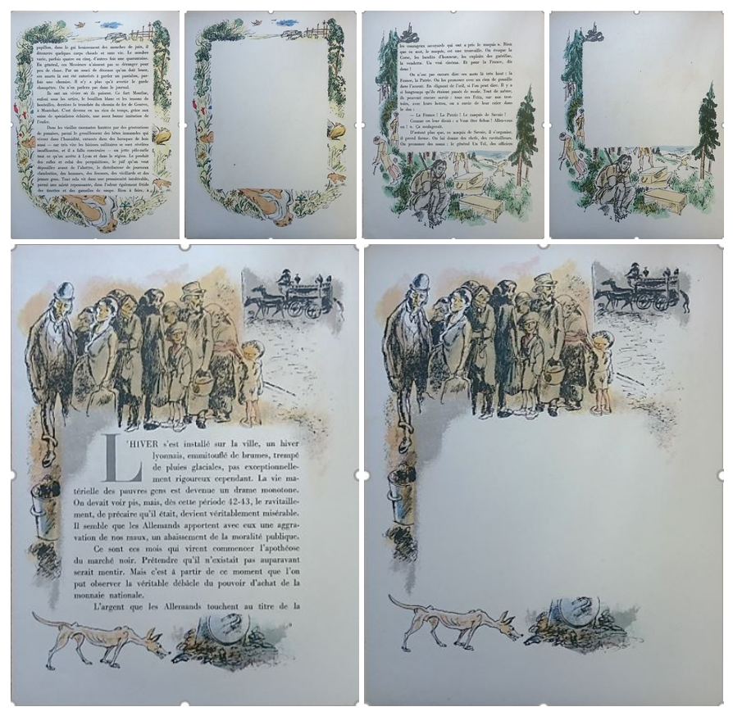
Contents
(In)cautious Stewardship of Library Collections
Introduction
Definitions and questions
Library policy and decision- making
Case studies
Bequest of Harold William Vazeille Temperley
French Plays ???
A.G. Parker Cinema Collection
bookplates of George Cukor
Derrida
Pages from Lyon dans les chaînes, part of the Chadwyck-Healey Liberation Collection at the Cambridge University Library
Notes:
Thank you.
This paper will examine the way in which libraries are stewards of collections—the ways in which they help maintain the integrity of a collection, preserve its existence, and to ensure that it is in some way made accessible to researchers. I’m going to talk about how libraries treat collections, and a little about why they do so. I will present four examples of collections that are held by libraries where I have worked, each of which fulfils a different definition of what a collection is and how it interacts with the larger library collection. For the most part, I will not be talking in generalities. All libraries– and all collections they contain—are different and serve different purposes. Therefore the potential range of treatment for collections within libraries is nearly infinite. The image on this slide is of two books held in the Chadwyck-Healey Liberation Collection at Cambridge University Library. This is an unusual collection in part because of its method of acquisition. Several years ago, the donor, Charles Chadwyck-Healey, became interested in books published during the occupation of Paris, and just subsequent to the liberation. He became interested in the variety of books published during the period, including a good number of very nice presentation editions, of which these are two. They are both published on nice paper, with gorgeous illustrations.

Slide 3
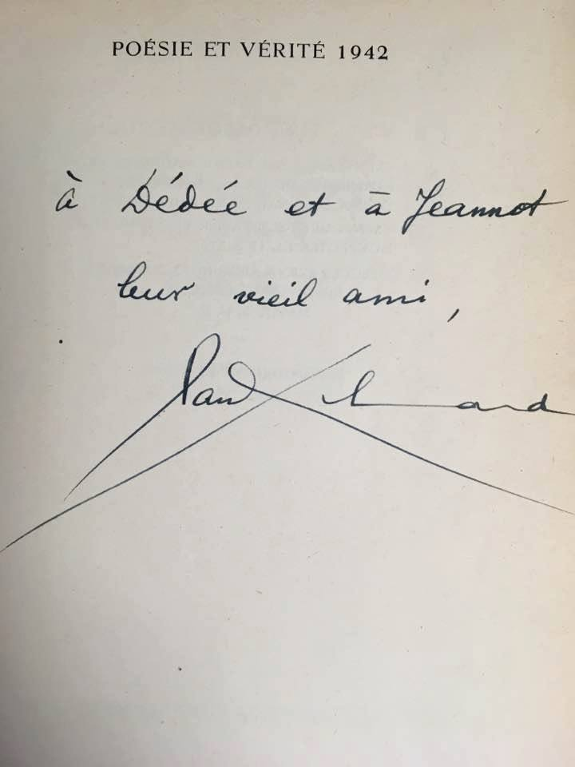
Notes:
One of the things that Chadwyck-Healey was first interested in was the paper– that Parisian printers in 1944 had expensive paper on which to print fine editions of their publications. This very much challenged the popular view of unrelenting austerity and poverty of the period. So this is a collection built on tactility– Chadwyck-Healey wants to feel the paper, wants to compare variant editions side-by-side, and he wants to see the bright colours of the printing.

Slide 4
Notes:
This is a collection that Chadwyck-Healey is still building. It’s very much an intentional collection, one in which he’s got an everyday role, both as a collector and a scholar. But it’s also a collection that’s held by the Cambridge University Library. It’s not on deposit. The process is this: Chadwyck-Healey buys the book, it spends some time in his study so he can look at it, and then it is shipped to the library where it is cataloged and assigned a place in the rare books stacks– theoretically, where it will stay for eternity. Once the book arrives in the library, it’s owned by the library.
But it’s a collection that’s never been together before it arrived in the library. It’s a growing collection, and one whose final size is not known. And it’s a collection that the library is dealing with the best it can.

Slide 5
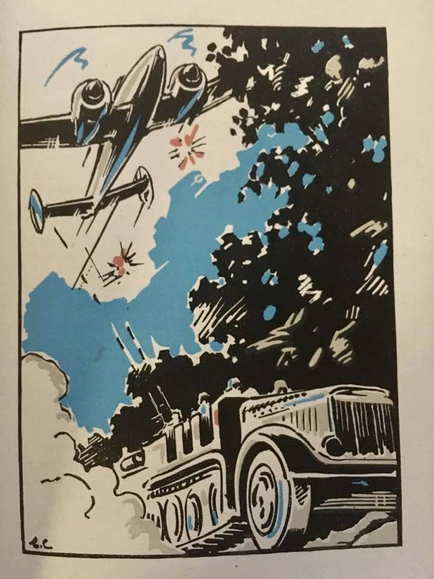
Notes:
You may have noticed based on my table of contents that I wasn’t planning on talking about this collection today. Following Jacqueline’s talk yesterday, I thought I’d add a couple of slides of images just to give a counterpoint to the children’s book collection that was held in Oxford. (There are, I should add, several collections in Cambridge that are deposited rather than owned, but unlike the Oxford example, I believe that they are all long term loans from membership organizations that no longer have the money or space to house the collections themselves. I’m not getting into whether the Oxford or Cambridge model is better). In a way, the model here is similar– and the donor’s goals are certainly similar, in terms of bringing the material to life and getting it outside of academia. But there the similarities end in terms of the method of collection, structure of ownership, etcetera.
(and to further clear up the institutional confusion, this collection is most definitely not held at UCI in California– I just didn’t want to change the template for my slides)

Slide 6
What is a ‘collection’ to a library?
(In)cautious Stewardship of Library Collections
The Library’s collection
Rare books collection
Jane Smith Aerospace Collection
Hilda Ess Literature Collection
Archival collections
Bob Frank papers
Notes:
Throughout this paper, reference will be made to a variety of collections in libraries where I’ve worked: Cambridge University Library in the UK and the University of California, Irvine, in California. These references are made not necessarily to illustrate best (or worst) practices, but to help to describe the difficulties that libraries sometimes encounter as stewards of collections. I want to ask several questions that I think about regularly as a librarian, chief amongst them, ‘when is a collection no longer a collection?’ I should note that the collections dealt with in this paper are primarily book collections.
Before moving too far into the examples and questions, it is important to tackle some definitions. In order to help with this, I drew a diagram.
What I’m trying to say with this is that within the context of a library, a ‘collection’ can refer to several different entities. This is not simply a definitional question but is important for contextualizing the different ways that libraries decide to understand and work with the collections in their care. Most broadly, all materials owned by a library can be referred to as its collection or collections. Most libraries have a collection development officer or a policy which is responsible for developing the entirety of the collection.
However, in the case of most institutions, this collection is not a discrete or intentional accretion of material that has been shaped and curated by one hand. Rather, it has been created, built, weeded and directed over a period of time (sometimes a very long period of time) by many people. Often, a library’s collection contains many ‘sub collections’ that have come to the library through a variety of means.
It is these sub collections with which this paper is concerned. That’s what we’re really talking about at this conference. In particular, I think the crux of the issue is how the smaller collection maintains its identity while also becoming part of the larger library collection. And if it doesn’t, why not. In general, these collections will arrive in libraries through either donations or outright purchases; in almost all cases, however, the character of a collection will change significantly once it becomes part of the library—it is impossible for it not to, as the purpose of the collection’s existence has undergone a significant and dramatic shift.

Slide 7
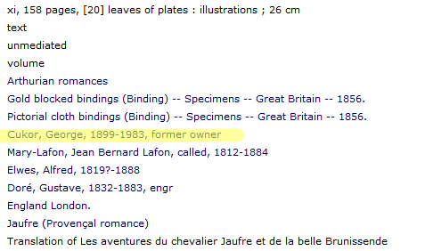
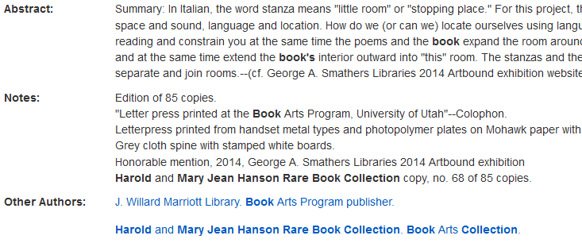
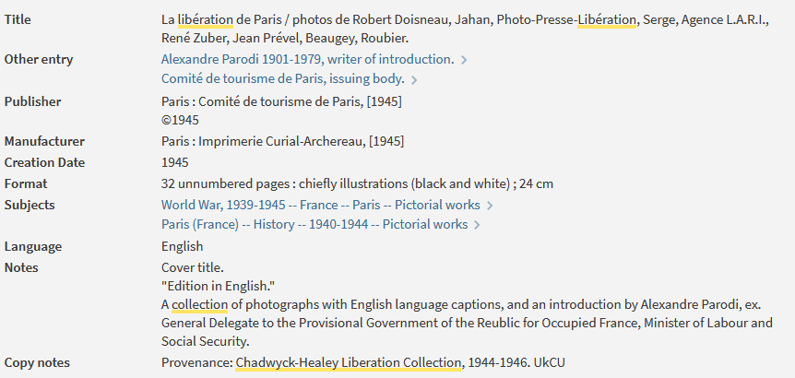
Libraries: making stuff easy to find!
(In)cautious Stewardship of Library Collections
Notes:
Once a library has decided to accept a collection, the existential nature of the collection will have been determined—will the collection continue to exist as itself, or will it become a part of a greater whole? There are direct physical and conceptual results to this and all subsequent decisions, which are predicated on this initial conceptual framework. These decisions will impact both how the existence of the collection is recorded and how it is physically stored.
The ways in which a librarian can record collection information varies significantly. At the most basic (but, some would say, most useful) is the simple action of recording provenance information in the library’s catalog record for a book. This can take a couple of forms such as a basic note reading “Provenance: Chadwyck-Healey Liberation Collection”, and can also include a field that allows a link to everything else that makes up part of the collection, or a link to all other books for which a person was a former owner, donor or inscriber.
Hopefully we’re all familiar with this sort of thing.

Slide 8
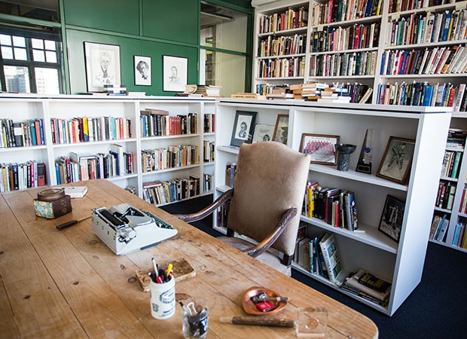
(In)cautious Stewardship of Library Collections
Notes:
In addition to this, it can be deemed important to physically keep a collection together—to make sure that it doesn’t get scattered throughout the larger collection. There are several ways that libraries can choose to do this: by assigning the material a collection-specific call number; giving it a unique collection within the library; or a variety of other methods that differ by local institutional practice. Sometimes this can extend to establishing an institution or dedicated infrastructure surrounding the collection.
Jason told us yesterday how important space considerations were with the Richler library.
Often, this is reliant not simply on the collection’s perceived importance, but also due to financial considerations—has the collector given the library a lot of money along with the books? Was the library able to complete significant fundraising on the back of this purchase? If so, the collection will be more likely to have a dedicated space or service within the library. Is there a lot of research interest? Often, that doesn’t really matter.
Libraries also install bookplates (both physical and digital) to create a permanent record of a book’s provenance. Sometimes they will also record the information elsewhere, such as in an acquisitions ledger or in the order records within the library catalog (but hidden from the public). We’ll see some examples of these in a moment.

Slide 9
Questions
(In)cautious Stewardship of Library Collections
What constitutes a collection?
What if nobody knows where the books came from?
What if nobody cares?
Does it remain a collection if it’s not kept together, and scattered throughout the library?
What if all the evidence is there (where it came from, why it’s there, which books constitute the collection) but it’s very hard to find?
Notes:
I want to use a couple of different case studies in order to help define what a collection within a large academic library might mean. I also hope that these examples will demonstrate how libraries can lose information, how they try to recreate it, and how information, while still extant and preserved, can be functionally lost. While using these examples, I hope to ask some questions—about both the way that libraries deal with collections, and more fundamentally, about what constitutes a collection:
Does a collection of books remain a discrete collection, even if it’s been incorporated into the broader library collection?
What about if the donation information is recorded somewhere, and there are bookplates in the books? I think this is a definite yes.
But… what if there are just bookplates in the books, and there’s no other record? In this case, there is no way of physically reconstituting the collection or studying it as a collection, so it is functionally lost to scholarship. In practical terms, this bookplate serves simply to memorialize a donation, rather than to connect it with other books that originate in the same collection.
If a collection exists in a library, but nobody knows where it came from, what connects the material, or why it’s in the library, is there any purpose in maintaining the fiction that it is a collection? Is it a collection?

Slide 10
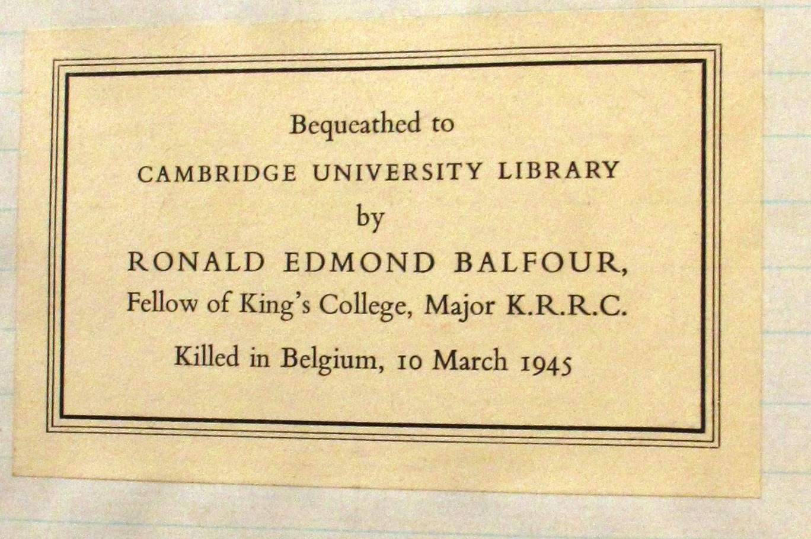
Decisions, decisions
(In)cautious Stewardship of Library Collections
Once a collection arrives in a library, a number of decisions need to be made
Where it will be kept
Whether the collection will remain complete and integral
How to record the provenance of the collection
How to catalog the material
How to record the provenance of the items
Notes:
[cut whole slide if after 10:00]
Some of the difficulties encountered by libraries when dealing with collections arise from the recurring problem that libraries (and donors) often encounter: a question of motivation and desire. Many libraries have implemented donations policies that make it clear that they will only accept a donation if it fits within their broader collection—ie, evaluating a donation not as a collection, but simply on the merits of its individual parts. Libraries want to be able to say ‘no’. But they also want to be given unique and valuable material. Most librarians will be able to give an example of a collection in their library that is 99% undesirable popular fiction but was accepted simply so the library could get its hands on the Gutenberg Bible or equivalent.
Following Linda’s keynote yesterday, I thought about vast quantities of un-accessioned donated materials that I came across once in Cambridge. I couldn’t work out what it was doing there. But it turned out that it had been donated, the library had chosen what they wanted, and they didn’t want to get rid of the rest of it because they were worried about somebody finding the books in a booksale somewhere and raising a stink. So it sat on shelves in a basement gathering dust until the imperatives of space outweighed the niceties of donor relations.
So much of the variability that we will now explore in the ways in which libraries deal with collections is due to how ‘valuable’ the collection is considered to be in terms of its relationship with the wider library collection. If it can be integrated into the broader library, this is often the desired course of action from the point of view of librarians, as it makes managing the collection significantly easier. But this obviously immediately dilutes (or even destroys) the collection’s identity.
In the ideal situation, a library will evaluate a collection before it ever physically comes to the institution in order to determine what the purpose of the collection will be, and how it can best be exploited in order to achieve that goal. This sort of determination can take into account the origin of the collection, its contents, the method of acquisition, subject matter, and how it came into existence. All of this needs to be evaluated based on the context of the institution in question: for instance, a large research library and specialist institution might treat the same collection very differently.
[14:30]

Slide 11
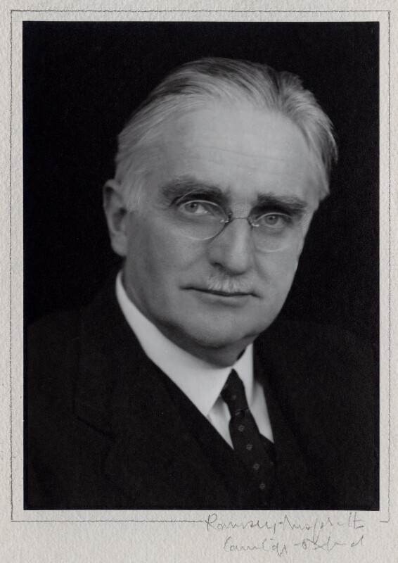
Harold William Vazeille Temperley
(In)cautious Stewardship of Library Collections
Diplomat, representative at the Paris Peace Conference in 1919
Specialist in Czechoslovakia and Poland – particularly diplomatic history
Died 1939, ‘Register of Donations’ entry dated 29 August-3 September 1939
Books scattered throughout library: rare books dept., open shelves, etc.
Provenance notes and bookplates
The collection tells a story– a snapshot in time of the interwar period, the intellectual pursuits of a diplomat and scholar
Portrait from the National Portrait Gallery
Notes:
My first example will be from where I used to work. We had a variety of donated collections stretching back hundreds of years, some of which formed the original basis of the library. That library is over 600 years old, and traces its founding to a chest of books that formed the initial ‘collection’ of the library. Perhaps apocryphally, only one book from that original collection apparently survives—demonstrating that libraries struggle to maintain the integrity of even their own collections. By the late 19th and early 20th centuries, the library began to receive donations, often as bequests. It often incorporated the volumes into the library’s main collection, scattering the volumes throughout the open and closed stacks, as well as the rare books department. The library had made the decision that for a variety of reasons these collections were more valuable as many individual volumes than as one distinct collection.
[cut if after 12:00] A few years ago, my then-boss was in the stage of his career that he was planning his retirement, he started to tackle projects that had been long-unfinished. One of those projects was to highlight collections (particularly donated collections) that were held by the library but were mostly hidden. The goals here were many, including: (1) my boss was one of the last remaining employees of his cohort who had the institutional memory to know of the existence or importance of the donations (he first worked in the library in the early 1970s and vividly remembers some colleagues from the pre-war era) ; and (2) highlighting unique and distinctive collections became somewhat of an institutional priority as the library encouraged new donations and adapted to meet the changing requirements of a large research library (which in part meant adapting to new areas of research interests).

Slide 12
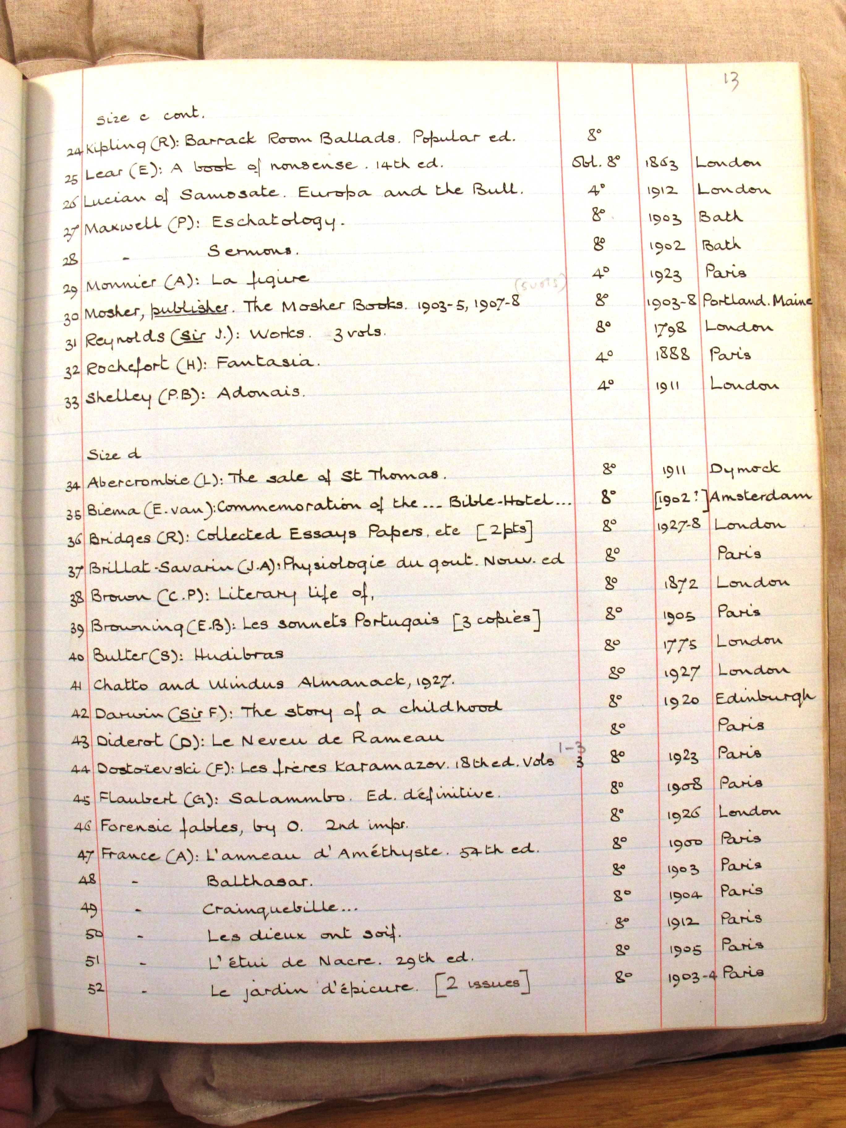
Harold William Vazeille Temperley
(In)cautious Stewardship of Library Collections
Diplomat, representative at the Paris Peace Conference in 1919
Specialist in Czechoslovakia and Poland – particularly diplomatic history
Died 1939, ‘Registry of Donations’ Received entry dated 29 August-3 September 1939
Books scattered throughout library: rare books dept., open shelves, etc.
Provenance notes and bookplates
The collection tells a story– a snapshot in time of the interwar period, the intellectual pursuits of a diplomat and scholar
Notes:
Upon his death, Harold William Vazeille Temperley (1879-1939) bequeathed some of his books to the University Library. Temperley was a professor of modern history and master of Peterhouse College, and he specialized in the diplomatic history of the early 20th century, with a particular emphasis on the diplomatic history of the First World War and the inter-war period. Temperley attended the Paris Peace Conference in 1919 and he wrote a significant amount about Polish and Czechoslovak history. He gave approximately 150 volumes to the library. He died in 1939, and the University Librarian dated his entry of the donation in the ‘Registry of Donations Received’ as 29th August-3rd September, 1939. This was a handwritten ledger in which all donated volumes were recorded. There was one ledger for individual volumes and one for collections. As a librarian using these registers several generations later, I can tell you that it’s sometimes difficult to know which to look in. Where’s the line between a few volumes from one person and a small collection from the next?
Anyway, Considering the focus of the collection and the date it arrived in the library, this is a spectacularly compelling tale, all of which is told in the bookplates and provenance notes that are used in the catalog records. But because the books are relatively disbursed throughout the library, they would not generally be considered a ‘collection’. Scholars cannot examine them in the same way they would a collection that had been kept physically intact. Other benefits have possibly accrued—library patrons have been able to consider these books on their own merits, rather than seeing them first and foremost as part of Temperley’s collection.

Slide 13
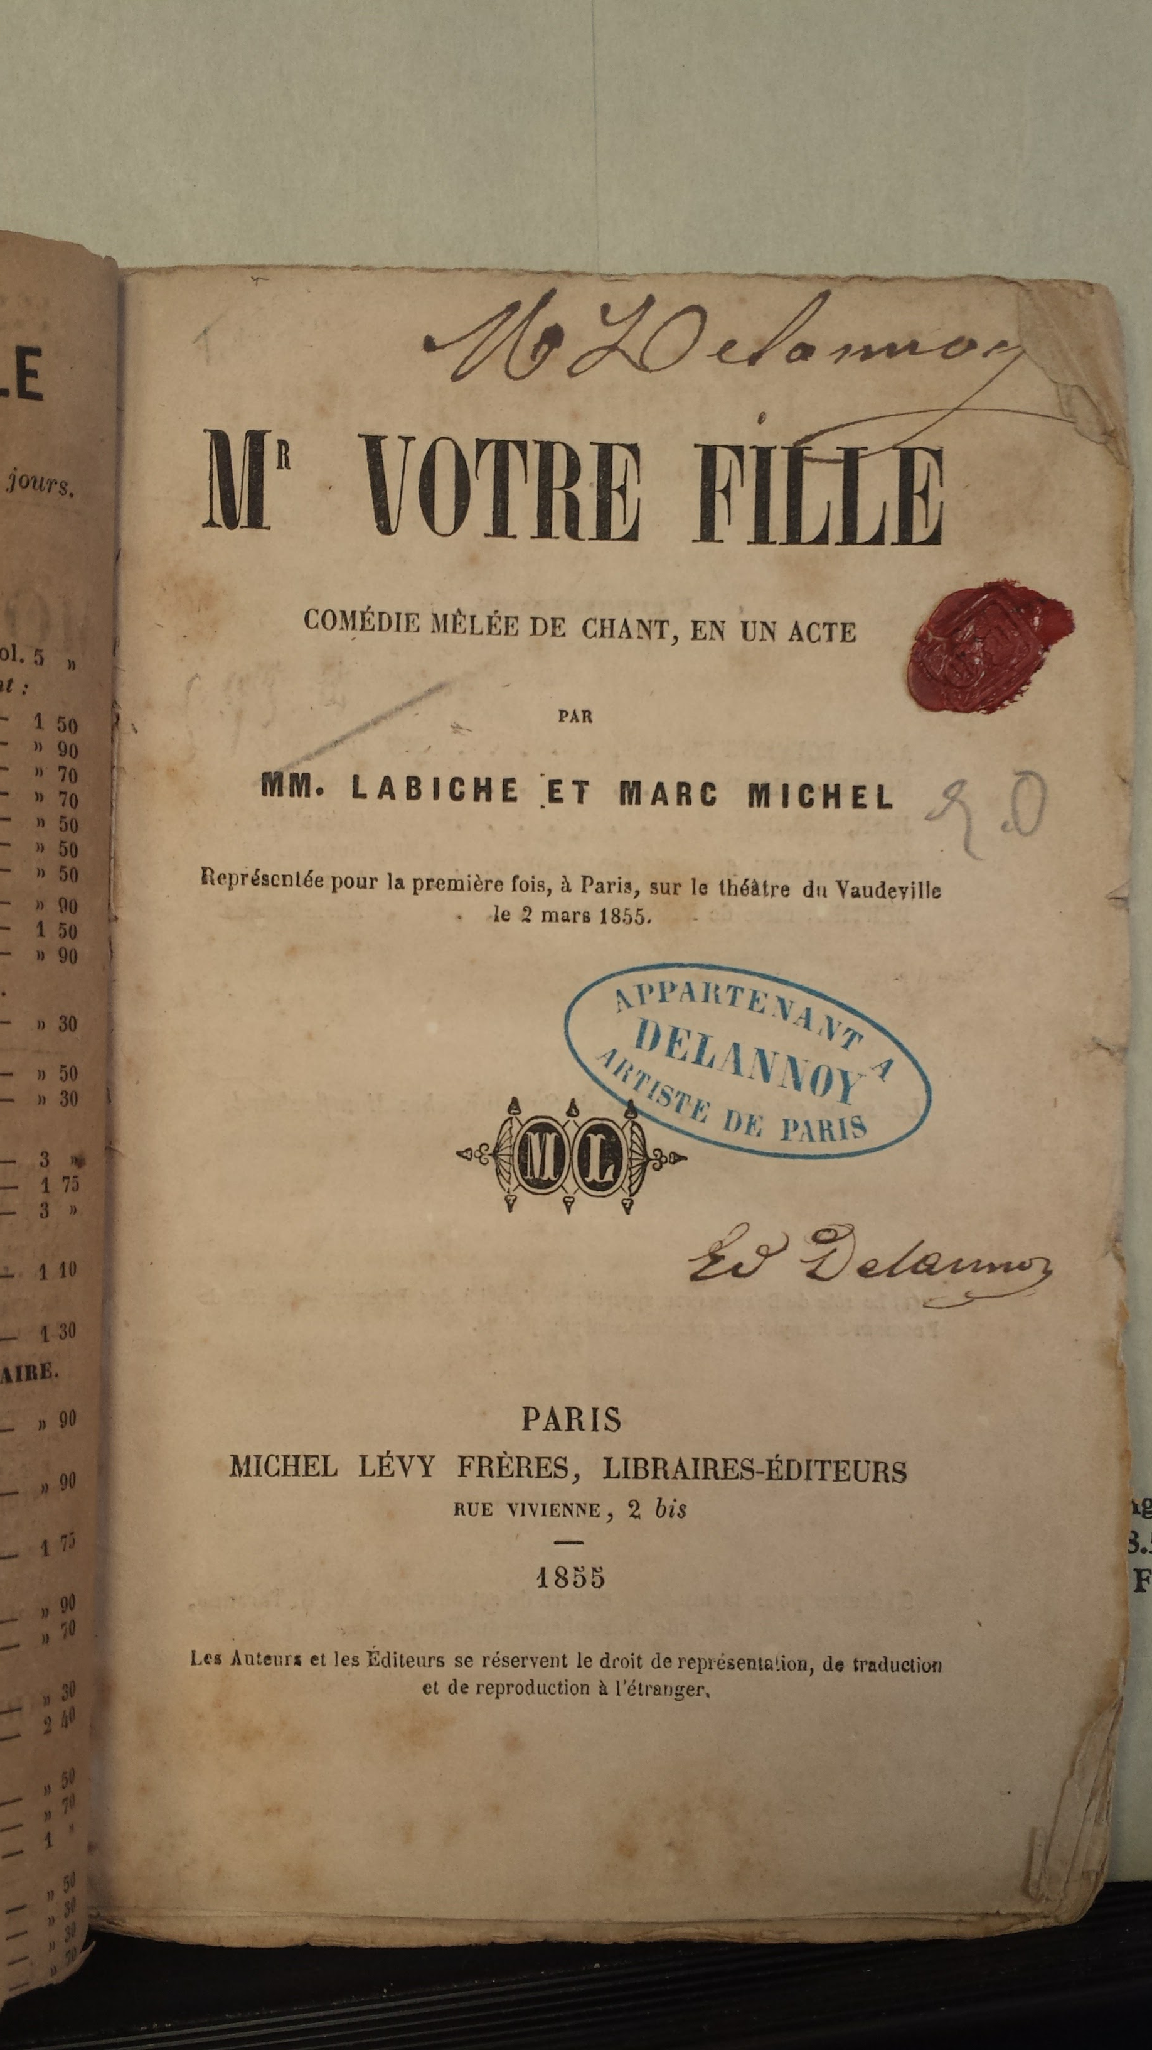
French Play Collection (unbound)
(In)cautious Stewardship of Library Collections
Found in envelopes– 20 boxes!
17th and 18th century plays published primarily in Britain and France
Many titles and authors; most of the plays are unbound or in later bindings.
Have they been disbound?
If so, why?
There’s significant provenance information on many of them… but what does it mean? Who are the people?
Notes:
My next example comes from my current employer. When I first started, I was walking through a special collections backlog room with a colleague from the special collections department (who was also new). There was a book truck which contained 25 boxes of material (which worked out to be about 400-500 plays), but about which nobody knows anything. The collection consists of several hundred plays in French and English, published in the 18th and 19th centuries.

Slide 14
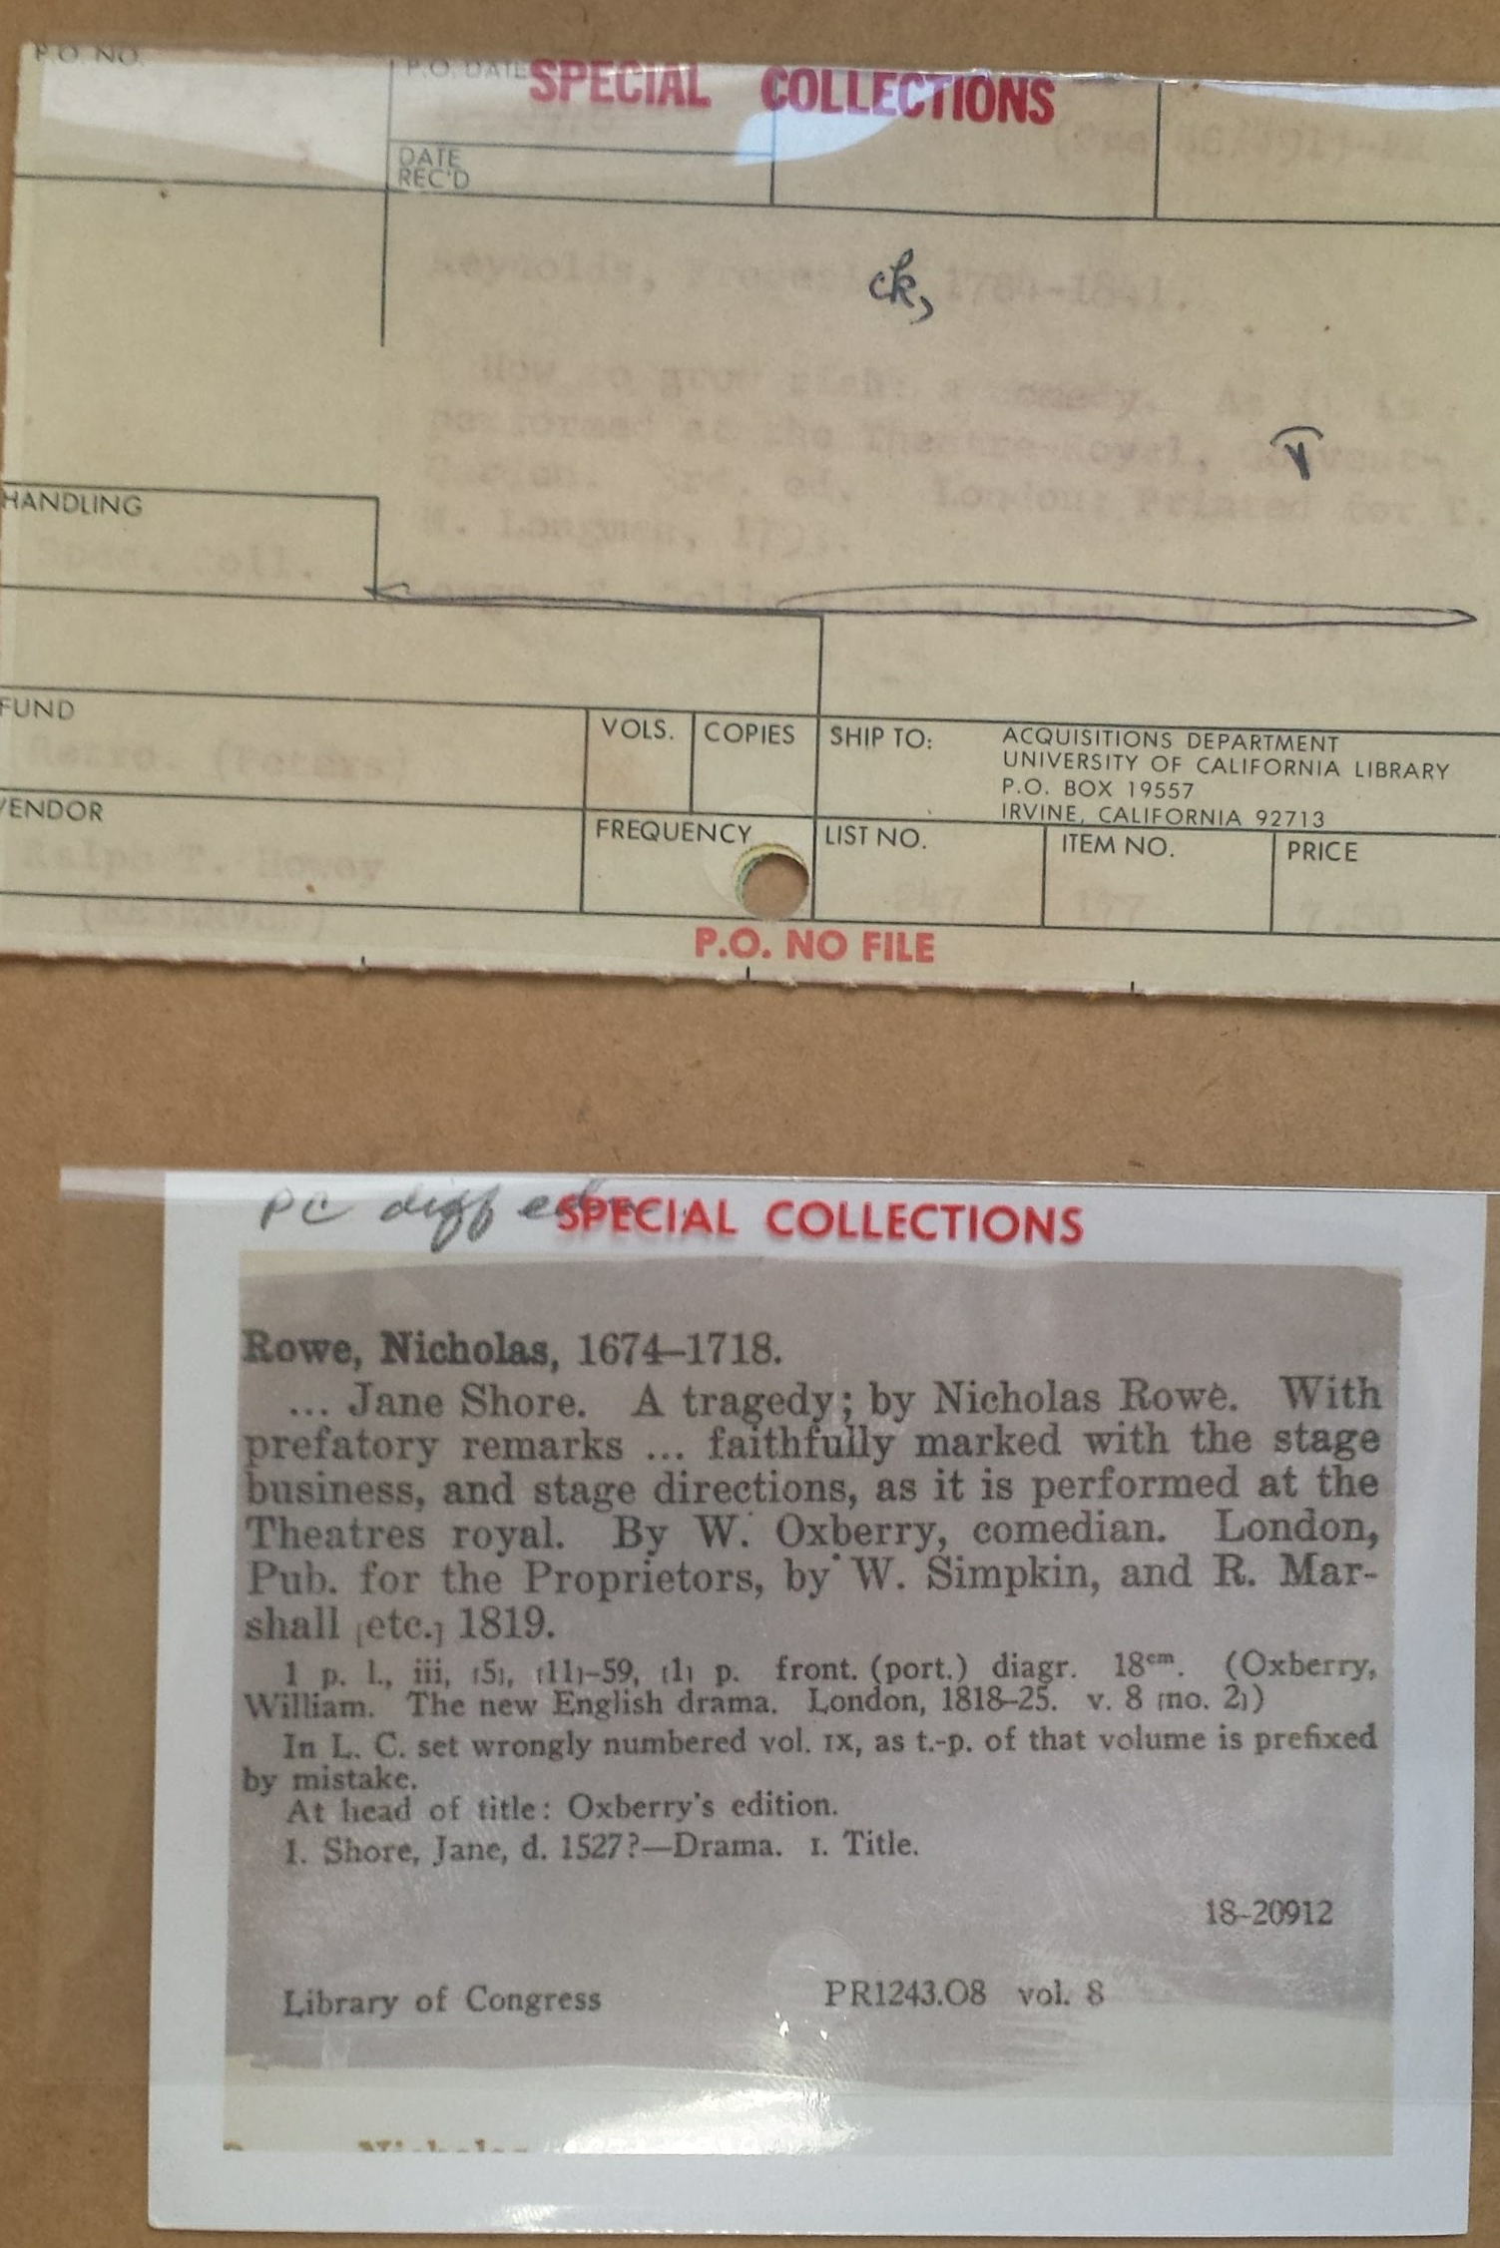
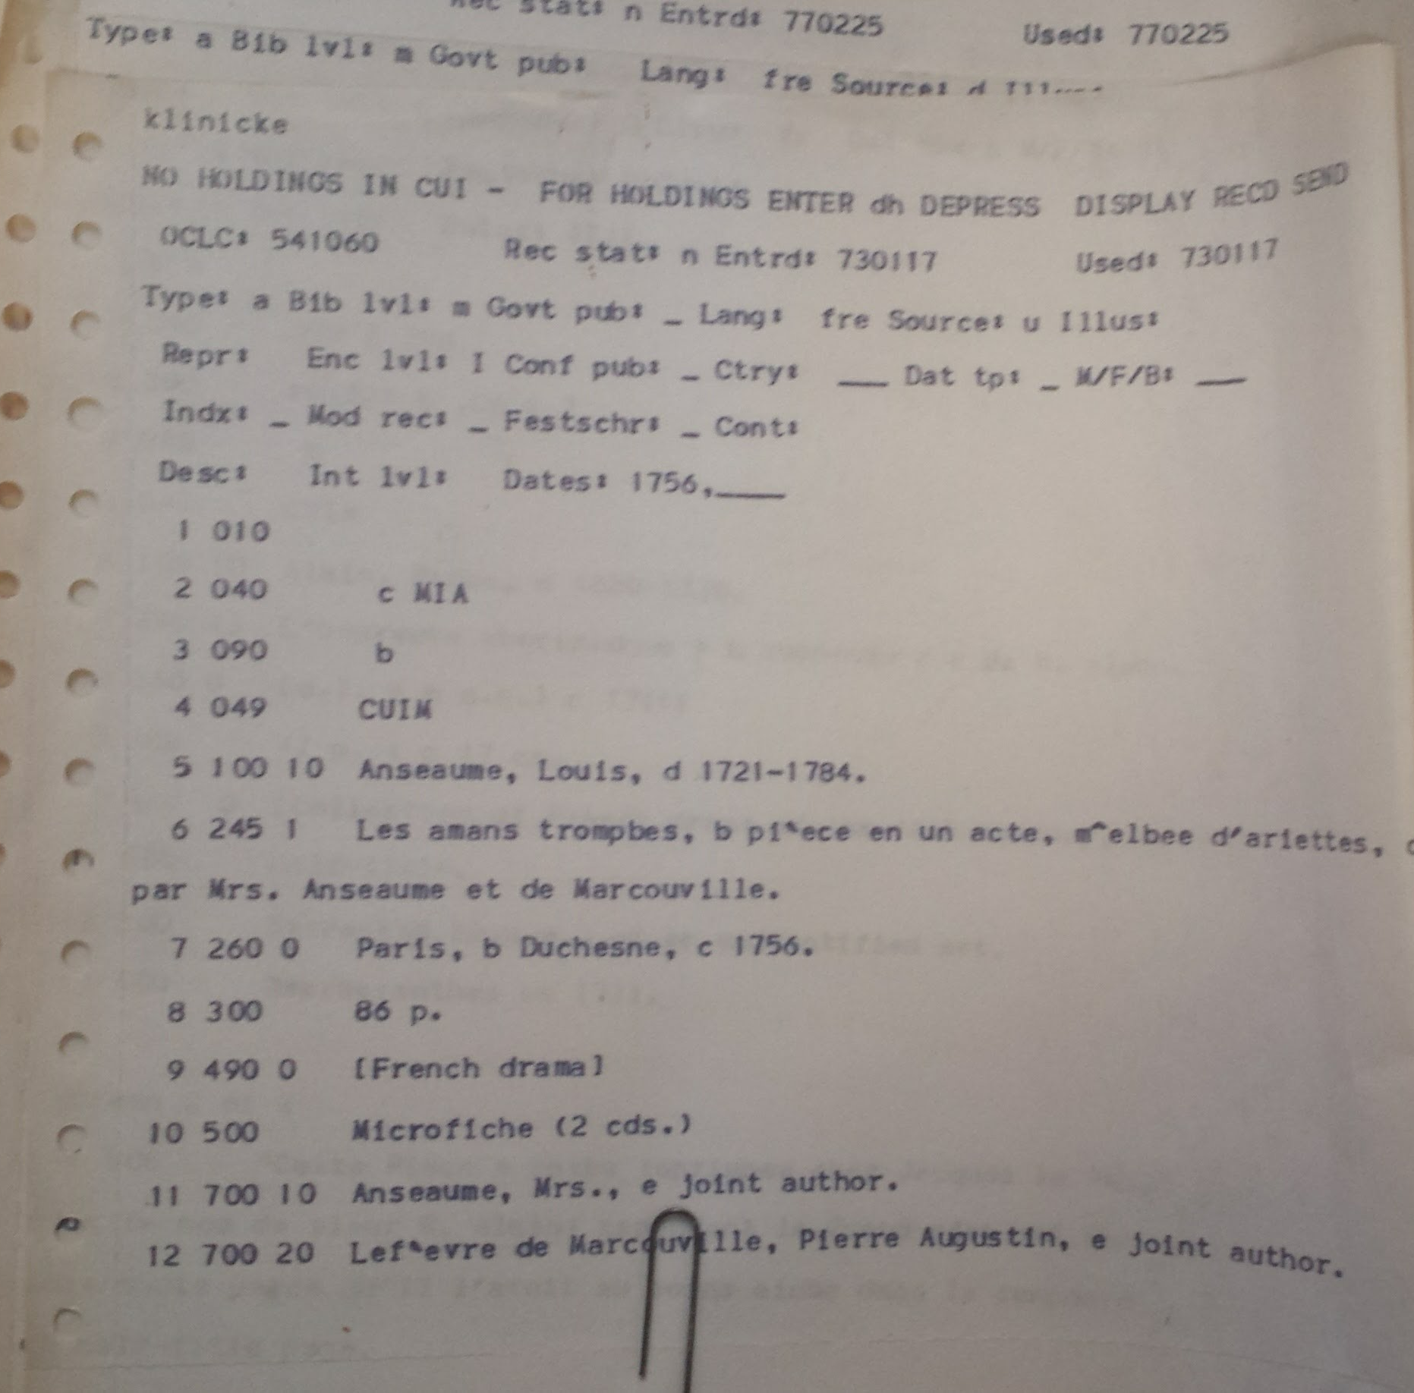
French Play Collection (unbound)
(In)cautious Stewardship of Library Collections
No information about why they’re here
Not in catalog, not recorded as a collection anywhere
Is this a collection?
If so… what?
Many seemingly disbound
They’ve been accessioned and processed by librarians who aren’t around anymore. They might have known. But they didn’t write it down anywhere.
So what is the collection?
Notes:
The collection had, at some point, been processed locally: each play was in an archive-quality envelope, with bibliographic information typed on the outside of the envelope (with a typewriter!). Attached (with a paperclip) to each envelope was a vendor-provided slip with some bibliographic and purchase information, and a printout from a dot-matrix printer. There was also a slip of paper accompanying each play that indicated that all had been searched in the local catalog at some point in time. Besides a field “Purchase Order date” on some of the vendor slips, there was no indication of when this material arrived at UCI. The P.O. date was 11-11-67– relatively soon after the university was founded. So, it appears that somebody bought this material a long time ago, but why? Was it for a specific pedagogical use? If so, the academic or researcher who was going to use it has almost certainly died now. But what about if somebody gave this material to the library, or gave us money specifically to buy it? We have no idea why it’s here or who encouraged its purchase.

Slide 15
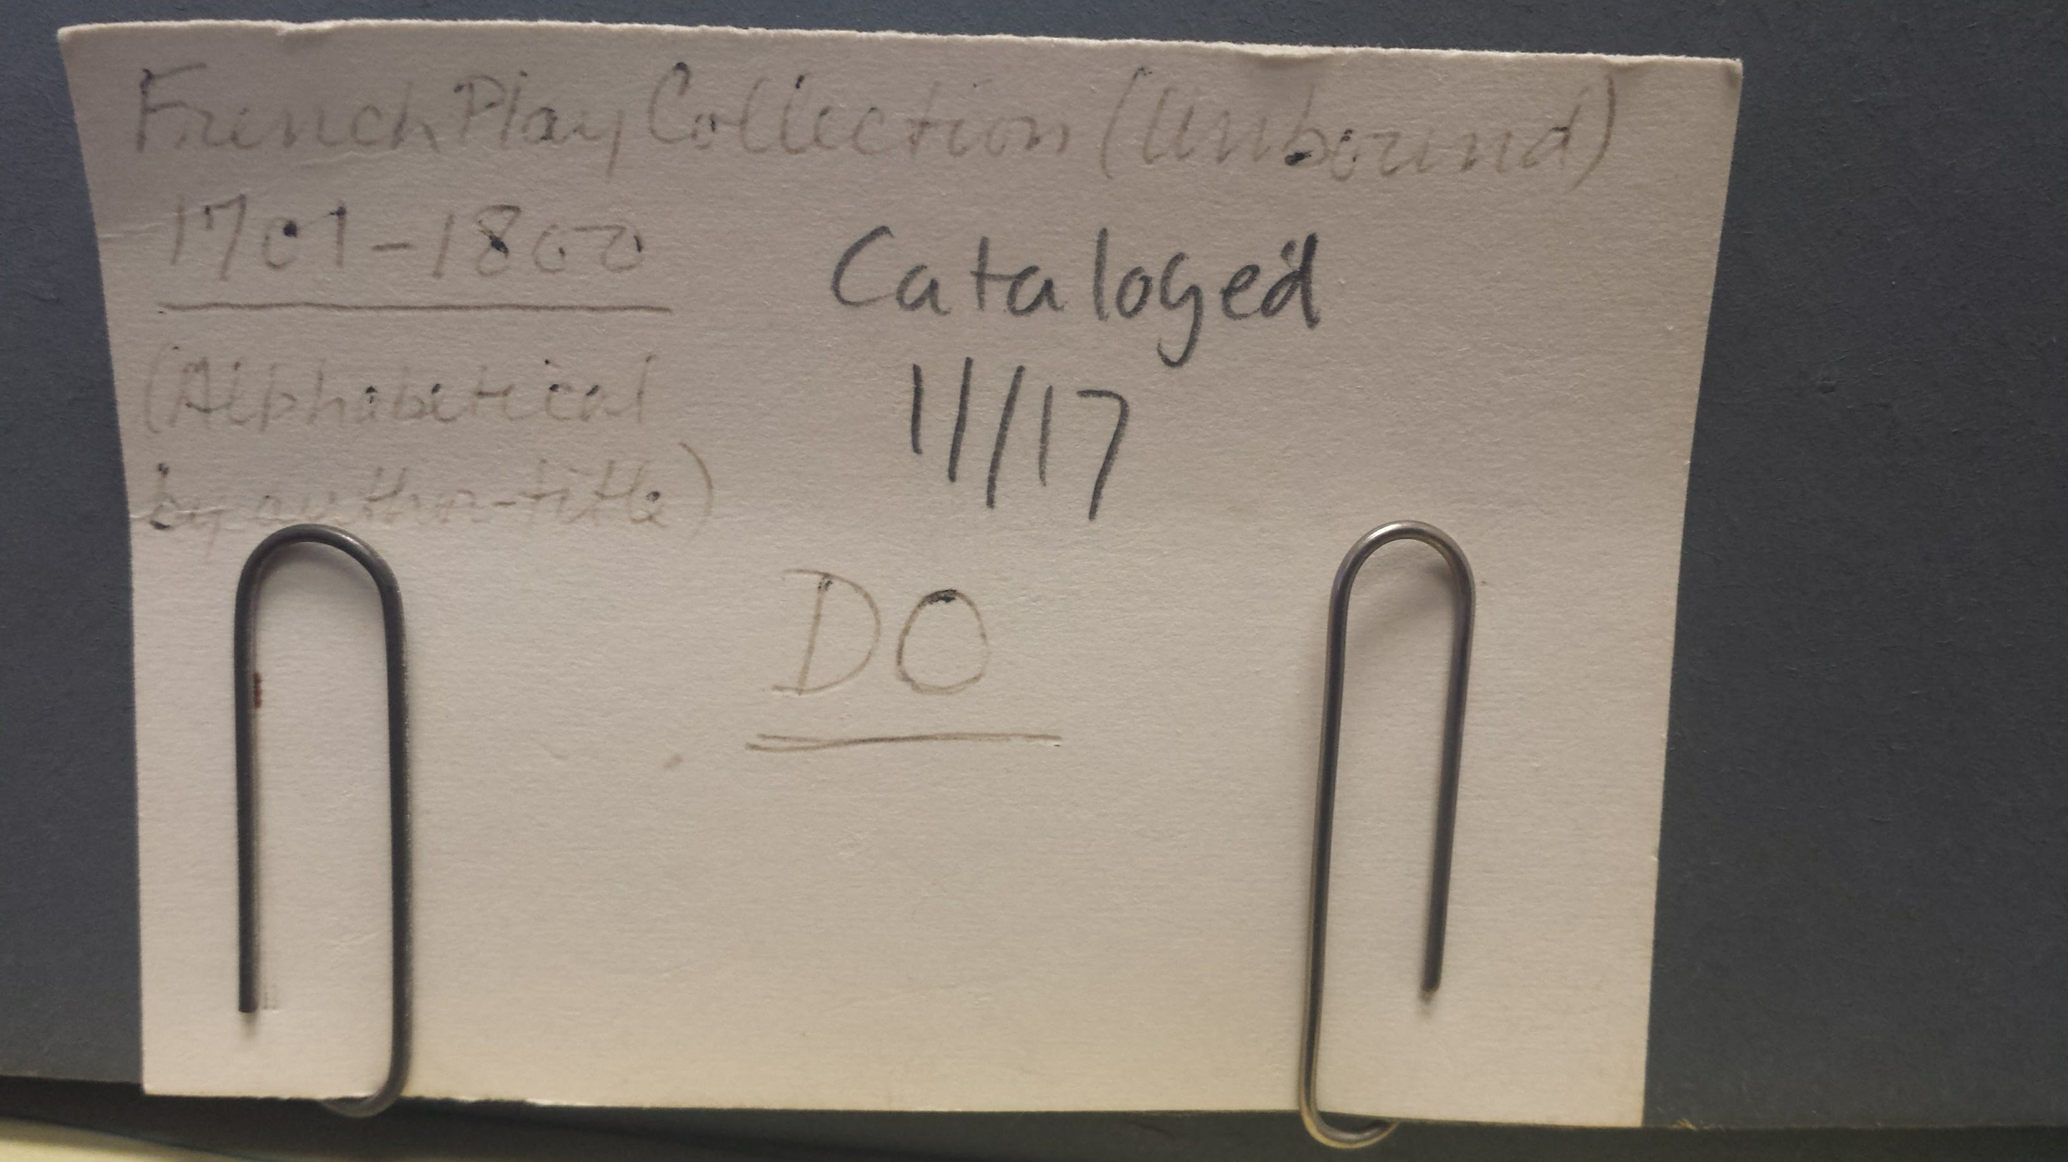
French Play Collection (unbound)
(In)cautious Stewardship of Library Collections
Found in envelopes– 20 boxes!
Some accession information, but… Where? Why? Who? When?
No information about why they’re here
Not in catalog, not recorded as a collection anywhere
Is this a collection?
If so… what?
Many seemingly disbound
They’ve been accessioned and processed by librarians who aren’t around anymore. They might have known. But they didn’t write it down anywhere.
So what is the collection?
Notes:
Should we endeavor to keep it together? When we cataloged it, we assigned it a local field in the catalog record that means that they are all browseable (we gave it a local title, the “French play collection (unbound)”– we took this from the labels on some of the boxes). But it’s uncertain what that achieves. For us (the people who saw the book truck in the backlog room) that means something. But for others, it’s a meaningless title for a collection that may have meaning, or may not. At this stage, nobody knows. If it did have meaning, that information has been well and truly lost by the library. So is this still a collection? I would venture to say no. But maybe a rare books scholar would be able to make a compelling case that it is.
Consider the examples of Temperley’s collection and the French play collection. Temperley’s collection was almost certainly curated before it was accessioned into the library—he probably owned more books that either were not offered to the library or were not accepted if they were. Once it was received, it was recorded in a list, a bookplate was attached to each book, and then it was treated almost exactly like any other newly acquired book. This French Play Collection exhibits some of the same characteristics, but to what extent is uncertain: it was certainly curated but using what criteria or by whom is uncertain. It too has been dispersed, but only within the Rare Books collection, and so remains essentially intact.
Once it arrived in the library, it was treated very differently from Temperley’s, which was integrated into the broader library collection for use by students and researchers. In fact, the plays were treated so differently that they were hidden away with no access whatsoever for at least several decades.
[21:00]

Slide 16
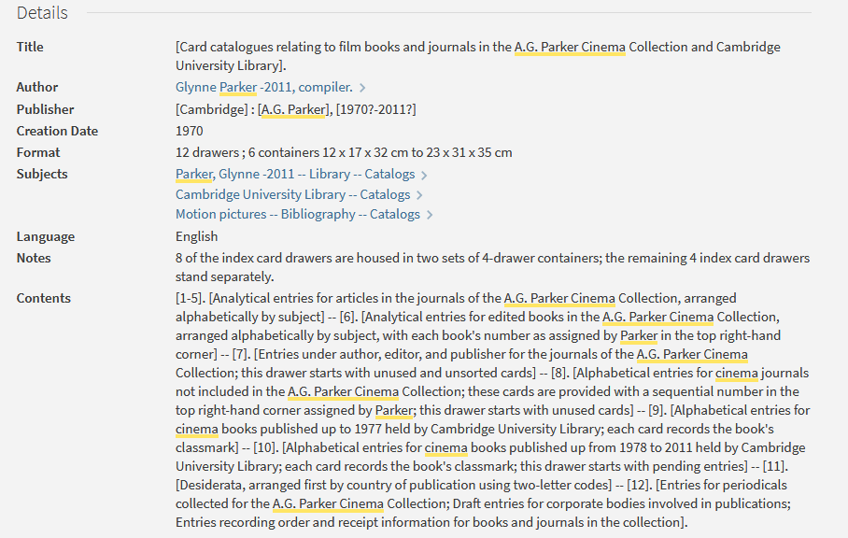
Books from the film history collection of A.G. Parker, University Library 1948-1991
(In)cautious Stewardship of Library Collections
Collection comprises of 2774 books
Book 1 in the sequence was Roger Manvell’s Film from 1944 (CCD.56.64),
Book 2774 was René Prédal’s 1985 La photo de cinéma (CCC.56.1018), acquired by Glynne on the 24th of March 2011.
Concentrated on American, British, and European cinema; chiefly in English, French, and Italian. Parker’s great interest was in silent cinema
Purchased with the intent of giving to the library– when the library didn’t buy a book, Parker added it to his list
A demonstration of the potentially recursive nature of cataloging
Notes:
One of the first big collections that I dealt with in a library had a really interesting dual purpose which I think does an excellent job of highlighting the different roles of a collection within a library.
The A.G. Parker Cinema Collection was given to the Cambridge University Library upon the death of A.G. Parker. It contains books about cinema—often rare, in several languages, and runs of periodicals as well. I went out with the library van to pick up the collection. We packed it up into 40 or 50 boxes and cleared it out of Mrs Parker’s house. She was very friendly while we were doing this, and I spoke to her after we finished packing up. The conversation went something like this:
Me: You must be sad to see all of these books go. (I was thinking: this collection was one of your husband’s projects, so seeing that leave the house must be another reminder of the finality of death. Maybe I should reassure you that the library will treat the books well and manage the collection in his name.)
Her: No, not at all. I’m glad to have my guest bedroom back.
It was once I got back to the library and the books began to be processed into a collection in the rare books department that I understood the full story of the collection, and how unique it is. Many collections reflect the passions and interests of the collector, and one of the reasons that we wish to preserve collection information is to provide a context to their intellectual development and thought. And in a way that’s true with this collection as well.
A.G. Parker was for many years the head of acquisitions at the library. He was in charge of buying books. He was also passionate about cinema, and especially silent cinema. Apparently, over the course of his many decades working at the library, whenever the title of a book crossed his desk that he thought would be useful for the library, but a purchase couldn’t quite be justified, he purchased the book himself. His goal for the project was to donate all the books to the library at some point. He cataloged the books, labelled them, and also donated a card catalog of his own creation. He was a true librarian.

Slide 17
Notes:
Glynn was a true librarian. He demonstrated his passion for cinema by handwriting an alphabetical list with classmarks or call numbers of synopses and popular book versions of films produced between 1928 and 1955. Cinema was truly something of value to him– so, too, was the University Library to which he’d dedicated almost his entire working life.
The introduction for this conference states, “Collections of all kinds and scales are created, held, contained, preserved, stored, and consequently record the instantiation of something of value to an individual or a community.” The A.G. Parker Cinema Collection asks several pertinent questions about the value of a collection when it was never collected to be a distinct collection. What is this collection truly about? Is it cinema, or is it the library?

Slide 18
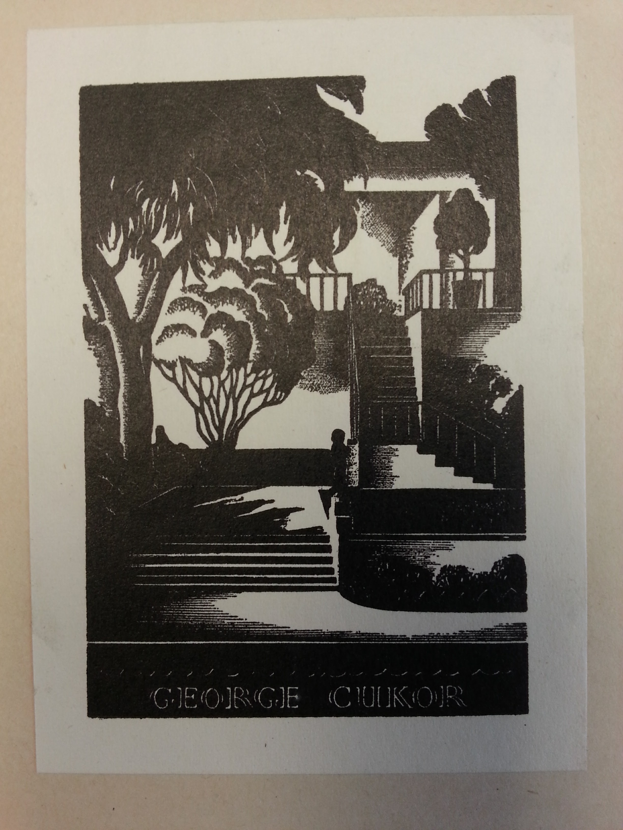
George Cukor books
(In)cautious Stewardship of Library Collections
Cataloging Special Collections backlog…
…noticed bookplate
Researched Cukor (ignorant!)
He’s important!
Not a collection…
… but it exhibits many of the same traits as a collection:
Useful for researchers in a variety of disciplines
Collection (or individual parts) demonstrate clear impact on his work
Tells us about Cukor’s intellectual activity surrounding his movies
Library has been completely inconsistent, so the ‘collection’ (such as it is) is completely hidden or even lost
Notes:
As my final case study I would like to talk about books in the collection at UCI that have a bookplate from George Cukor. UCI is based in Irvine, California—the heart of Orange County which is adjacent to Los Angeles County. Probably as a result of this, the special collections department at UCI has some books that were formerly owned by well-known Hollywood figures.
George Cukor (1899-1983) was a director of many films, primarily at RKO and MGM. He was active from 1930-1981 and directed many of the biggest stars of the day.
[In the interests of time, I’m going to cut the next couple of paragraphs of biographical information about Cukor– you can all read his Wikipedia page as well as I did. Suffice it to say, he was major-major] His Wikipedia page is fascinating—he directed A Star is Born, My Fair Lady, Something’s Got to Give and Let’s Make Love, Adam’s Rib, etc—Kathrine Hepburn, Greta Garbo, Vivien Leigh, Clark Gable, Spencer Tracy, Ingrid Bergman, Ginger Rogers, Audrey Hepburn, Maggie Smith, Elizabeth Taylor, etc. Incredible. He was nominated for 5 Academy Awards (won one, and lost to John Ford and Elia Kazan among others) and 3 Golden Globes (won 1, and lost to Billy Wilder and David Lean).
[Cut this as well] Cukor was also gay—Wikipedia describes it as “an open secret” at the time, and also says that he was “an unofficial head of Hollywood’s gay subculture”. He held parties at his “luxurious home” which were “attended by closeted celebrities and the attractive young men they met in bars and gyms”. In addition, he hosted many friends at his house including Bacall and Bogard, Marlene Dietrich, Laurence Olivier, Vivien Leigh, Noel Coward, Cole Porter, Sinclair Lewis, Hugh Walpole, Aldous Huxley, Somerset Maugham, etc.
I was cataloging a book one day and came across one of Cukor’s bookplates.
And I ignored it because I didn’t know who he was. But then I saw another and I googled him, because the bookplate is gorgeous. And I was interested. So I put a provenance note in that record. And I did for the subsequent few books that I came across as I was cataloging our backlog. But… there may be many more books that were already cataloged by people who aren’t quite so interested in gay icons of the 1930s and 1940s that have no notes in the record and are thus completely lost in our special collections. Nobody at UCI knows why we have these books, where they came from or how many we have. But given UCI’s location (40 miles from Hollywood) and current research interests (such as LGBTQ history, cinema studies, etc), it is entirely conceivable that a researcher might want to know what books Cukor had in his library.
But we haven’t been consistent about adding provenance notes for Cukor, so even as books are going through the catalogers now, they might see a bookplate but not record it. And in a way, rightly so: this is not a collection at UCI. However we got this material it is here now and mixed into our general Special Collections holdings. I don’t want to say that Cukor’s library is therefore lost, but… it’s very hard to find. I hesitate to say ‘never’, but UCI will probably never know how many Cukor books we have, and we will not be able to connect them to films he worked on, authors he knew, or the intellectual process he went through in working with actors.

Slide 19
Derrida
(In)cautious Stewardship of Library Collections
Princeton University Library’s Derrida project
Making a Library’s collection of inscriptions linked-data enabled
Notes:
Finally, I just want to flag up the Derrida project that’s happening at Princeton. I know next to nothing about it except that it’s really cool and it’s relevant to this conference… and I didn’t see that anybody else here is talking about it. This is either going to be the future in how libraries deal with authors’ libraries, or it will be a damp squib, but either way I think it’s something we should be paying attention to.
Princeton University Library has Derrida’s library (UCI has most of his archives). His library is filled with dedications and inscriptions– the project is working to make these inscriptions linked-data enabled, which should make connections between the books easier to find; intellectual background and influence clearer; and it should make it simpler to follow the creation and development of Derrida’s library.
Most collections that we have in libraries are snapshots in time: they are the library as it existed upon the author’s death (or at the moment of donation). It’s hard to see the development of these libraries… this project might help.
[30:00]

Slide 20
Conclusion
(In)cautious Stewardship of Library Collections
The Library
TemperleyBequest
TemperleyBequest
Rare books collection
n
A.G. Parker Cinema Collection
Some random unbound French plays
TemperleyBequest
A few books (but not many?) that George Cukor once owned
Notes:
So what I’ve been talking about can be considered to be four discrete collections of books. They each have a permanent place in a research library. But equally, they each have reasons to not be considered as collections: because of the intentions of the collector, the incomplete nature of the collection, or simply the completely unknown nature of what connects the material.
A collection is by definition an artificial construct– it is a grouping of material at a certain point in time, and cannot fully reflect the collector’s intellectual evolution. Each one of these collections that I have described meets some definitions of a collection, but equally misses on others. I would argue that all collections to some extent lack crucial pieces of context that make them fully useful to a researcher.
I’ve edited my diagram just a bit, to add a further level of confusion.

Slide 21
Conclusion
(In)cautious Stewardship of Library Collections
Back to the questions:
What constitutes a collection?
What if nobody knows where the books came from?
What if nobody cares?
Does it remain a collection if it’s not kept together, and scattered throughout the library?
What if all the evidence is there (where it came from, why it’s there, which books constitute the collection) but they’re very hard to find?
Notes:
I’d like to return to the questions that I put up at the beginning. These are questions that I, as a librarian, think about all the time when dealing with a collection of material– and simply when dealing with one book with some provenance information in it. And broadly speaking, these questions are the intellectual underpinning to two fundamental questions:

Slide 22
Conclusion
(In)cautious Stewardship of Library Collections
Back to the questions:
What constitutes a collection?
What if nobody knows where the books came from?
What if nobody cares?
Does it remain a collection if it’s not kept together, and scattered throughout the library?
What if all the evidence is there (where it came from, why it’s there, which books constitute the collection) but they’re very hard to find?
Is it worth my time?
Will a researcher find this useful?
Notes:
Is it worth my time as a librarian to record this information? If I do so, will anybody ever make use of it? Often, I have to admit, my answer to the second question is ‘probably not’, which leads me to answer the first question with a ‘no’. I often feel bad about that (who knows something’s useful until it is!) but these decisions need to be made every day. In a way, I think one of the reasons I wanted to come to this conference was to see that the answer to both questions can, in fact, be a resounding yes.
And so far, it’s proving to be so!
Thank you.

