Slide 1
Hybrid Hype: Maximizing your Impact with Multimodal Learning
Wynn Tranfield, Maya Hobscheid, Naomi Binnie, Sheila Garcia Mazari
Notes:
Sheila - Introduction
Welcome everyone to our session, Hybrid Hype: Maximizing your Impact with Multimodal Learning.
Just so you all know, this session is being live streamed. Thank you for waking up so early on a Friday to join us, we have strong coffee, courtesy of ACRL so we’re going to get hype and to launch right into into it.

Slide 2
Overview
Introduction
Trends in Online Learning
Themes
  Challenging Assumptions
  Generating Buy-In
  Assessment
  Maintenance as Invisible Labor
Scenario Exercises
Questions
Notes:
Sheila:
Quick overview of our session today
We’ll start with introductions of all of the panelists
before delving into trends in online learning which set the context of our talk today.
We’ll then focus on several key themes including: assumption in online learning, strategies for generating buy-in, assessment methods, and the role of maintenance as invisible labor.
To wrap up the session, we’ll have a few scenario exercises for you all to work through and apply the content of the presentation today
we’ll have about 10 minutes left for questions at the end.

Slide 3



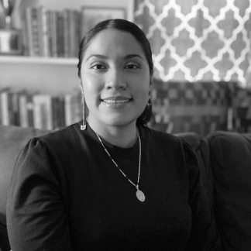
Curricular Support
Our Experience with Hybrid Instruction
Naomi Binnie
Digital Education & Engagement Librarian, U-M Ann Arbor
Wynn Tranfield
STEM Librarian, UCSC
Advocacy
Planning and
Creation
Maya Hobscheid
Instructional Design Librarian, GVSU
Sheila Garcia Mazari
Online Learning Librarian,
UCSC
Programmatic Support
Notes:
Who We Are (Each introduce themselves. Sheila can start by providing definitions):
Hybrid Instruction - instruction that has both an in-person or synchronous component in addition to having an online/asynchronous component.
Curricular support includes working closely with faculty to develop content that supports their curriculum usually in specific classes.
Programmatic support is more of a high-level relationship where you may be developing content for several courses or through a course-neutral approach.
Advocacy refers to meeting with stakeholders to explain the value found in hybrid learning and generating buy-in.
Planning and Creation would entail storyboarding, scripting, and creating hybrid content directly.
Introduction will be name, institution, and experience with hybrid instruction

Slide 4



Do not edit
How to change the design
What is your relationship to hybrid learning? (1-2 word answers)
Presenting with animations, GIFs or speaker notes? Enable our Chrome extension
Notes:
Maya
📣 This is Slido interaction slide, please don't delete it.
✅ Click on 'Present with Slido' and the poll will launch automatically when you get to this slide.

Slide 5
Trends in Online Learning
Higher Education & the Online Space
Notes:
Sheila

Slide 6
“Post-Pandemic” Online Learning Trends
Variety of Institutional Programmatic Approaches
  Increasingly defaulting to hybrid instruction (GVSU)
  Exploration of Online Learning as Income Generation (UCs)
  Larger classes, fewer faculty
Move toward Critical Digital Literacies
  AI information literacy
  Differences in Search Algorithms
Notes:
Sheila:
COVID-19 brought a rapid shift to online remote learning as the default for institutions.
Some institutions handles it well. While other institutions scrambled to get content online, resulting in the creation of largely long videos that did not meet baseline accessibility standards.
In many cases, libraries were well equipped for this shift as they have been operating in the online space for a long time, especially as most materials are accessed online.
There have been a range of responses from libraries since the return to in-person instruction. For institutions such as Grand Valley State University and University of Michigan, they have moved toward defaulting to hybrid instruction, making greater use of online learning objects to compliment in-person instruction. The UC system has been exploring online learning as a whole to generate additional income. Traditionally, programs at the UCSC have been focused on in-person instruction, with little remote or online learning opportunities. The move to online helps recruit students that may find cost of living too high or simply, cannot find housing as UC Santa Cruz has limited housing available.
Flipped classroom approach: making sure all students have a baseline understanding of a topic, prior to the in-person component to allow for in-depth exploration of a topic and/or applying what they learned directly to an assignment. Programmatically, the library is exploring a scaffolded approach for first and second year students, whereby a series of course neutral information literacy online modules provide a baseline for all students. This is then complimented with hybrid support for more complex, or disciplinary-specific topics.
Finally, larger classes and fewer faculty is also something that various institutions face, leading to a greater need for hybrid instruction to supplement the limited time instructors spend in the classroom. This is especially true for one-shot information literacy classes.
These trends are further evolving as libraries move toward a critical digital literacy approach, integrating AI information literacy, as well as meeting students where they are in terms of search behavior. We know that, students for example, use tik tok as a search engine, so this results in the need to speak to how search algorithms may work across not only across search engines, but social media platforms as well.

Slide 7
Inclusivity of Online Content
Several factors should be considered when building inclusive tutorials:
Discovery + Navigation
Synchronized Captions + Transcripts
Currency
Include non-majority identities and experiences
Anti-deficit narratives
Cahall, C., Mitola, R., Heinbach, C., & Sewell, A. (2023). Inclusive Or Harmful? A Critical Content Analysis of Tutorial Offerings from R1 Academic Libraries. Association of College and Research Libraries 2023 Conference.
Notes:
Sheila:
So in this slide, we are highlighting the work of Carrieann Cahall, Rosan Mitola, Chelsea Heinbach, and Amber Sewell who assessed the inclusivity of online content in their 2023 paper Inclusive or Harmful? A Critical Content Analysis of Tutorial Offerings from R1 Academic Libraries. This was a mixed methods study that examined video tutorials created by R1 institutions and their levels of inclusivity over the prior decade. The authors found that approximately 95% of video tutorials offered some type of captions with 76% of these being accurate and synchronized with the narration. 70% if videos provided transcripts, but these were not always easily universally accessible as sometimes the host website had a transcript available, but in a libguide where the video was embedded, the transcript was not available. This means that discoverability and navigation of content are both important considerations to building inclusive online content.
In addition, tutorials must be regularly iterated upon in order to ensure that they are in line with current practice. There should be a sustainable plan for iteration, which can often clash with workload and sustainability of content. For example, I created a tutorial that showcased results on tik tok for a topic, to reflect students lived experiences of using this as a research tool. During the “tik tok is banned” and then “nevermind it’s not banned” fiasco, I had to and continue to have to remain attuned to these changes to ensure that I’m providing content that uses current examples with tools that students do have access to.
The Inclusive or Harmful paper also touches upon visual representation in tutorials, noting that 49% of tutorials included non-white characters and 22% included female presenting characters in positions of authority. Including non-majority identities and experiences is vital to creating inclusive content which can happen through the integration of non white characters, but also by using examples and information tools outside of the majority culture.
Finally, anti-deficit narratives were also examined in this report, as they help build more inclusive and culturally sustaining content. 8% of tutorials honored the students’ prior knowledge and 3% decentered classroom learning. Curbing anti-deficit narratives often requires a culture shift and one of the ways that this can happen is by including students in the creation of content. One way to do this, is to pilot content with a small group of students, gather targeted feedback and adjust content accordingly. Another way, is to include students in the process of brainstorming content and deciding how to design it. This requires a much heavier lift, but can provide valuable experiential learning opportunities for students, if you’re able to secure funding to start a program like this. Grand Valley State University for example, engages their peer research consultants in discussions on areas where students need further support and what type of online content could help them develop the skills needed to address their needs.

Slide 8
Theme: Challenging Assumptions
How students use online tools evolve rapidly and may not align with what we expect:
“Digital native” mentality obscures the varying experiences students have with digital literacy
  The more tools we use, the more students have to learn.
Use of social media as a search engine
ChatGPT and other AI tools as search engines
Use of discord servers as community building hubs
Notes:
WT:
Technology as a mediator is a central theme of the shift toward online and hybrid modalities of teaching and learning. How students use websites and tools may not actually align with what we expect. Each campus serves a distinct community and their needs will differ from those of other student bodies.
When we consider online and remote learning, there continues to be a general assumption around “digital natives.” This mentality unfortunately obscures the varying experiences that students have with digital literacy, and ignores the very real impacts of the digital divide in our societies.
Students routinely use their phone to access most content, including writing papers on phones and working through any library modules or tutorials on phone and/or tablets. The default of each student having their own computer or laptop is not the lived reality for many of our students. In addition to access, we also have to consider the learning curve for students in using new and unfamiliar tools.
Learning new user interfaces is an added factor that can affect the cognitive load for students. Being aware of what students want or need and seeking to build content that doesn’t require the learning of new tools altogether can help create a better experience for students. This includes approaches such as embedding content into LMS’s when possible, and/or created shared guidelines for content creation.
While students may have varying experience with different types of technology, they may also shift to using newer technologies in ways that we perhaps we may not be aware of or expect. At UCSC, we conduct listening tours with our student body and have learned that students use tools such as social media as search engines to figure out a problem. Similar to how you may got to YouTube to find a tutorial on how DIY a home project, students use social media as a search engine to help them answer a query. Newer tools such as ChatGPT and other generative AI tools such as DeepSeek, are also used as search engines. This requires us as librarians to shift how we’re teaching these tools, acknowledging how they’re being use, how their search algorithms may differ from other search engines, and any potential pitfalls that may arise. Most notably, search algorithms, such as those used on Tik Tok, have a search algorithm that shows results based on previously liked content, which can in turn create an echo chamber, presenting the user with only those results that seem relevant for them based on prior use of the tool, rather than a wide scope of what is available.
Finally, discord servers and other tools where students can connect with one another, can serve as community building hubs, as well as communication tools. At UCSC, librarians have found that students use discord servers to share information and tools, often in regards to helping make courses more accessible, such as sharing course materials that can be costly for students.

Slide 9
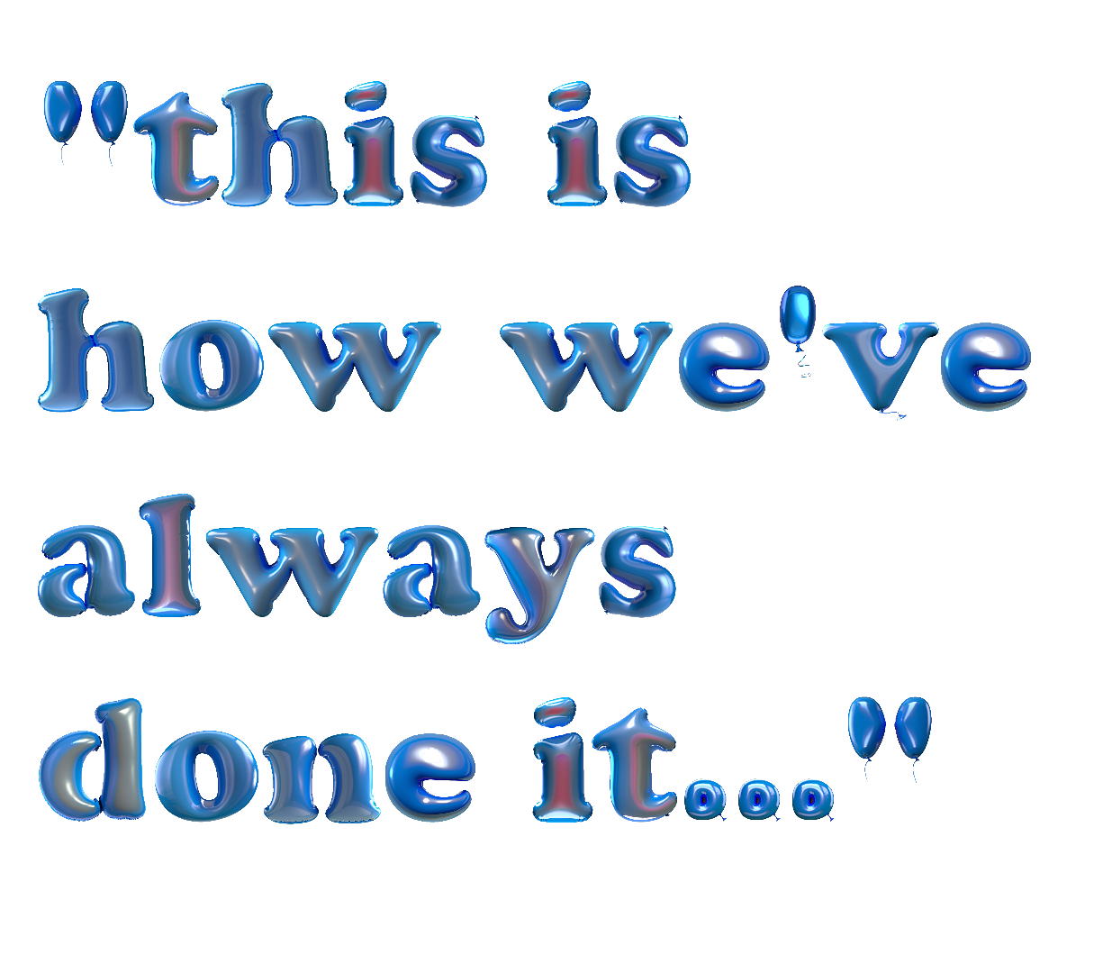
Theme: Generating Buy-in
for library instruction
Institution specific, program specific, class specific
It’s a long game
One-offs vs. programmatic approach
  What makes the most sense for the class/assignment
Notes:
Wynn:
For many of you, a hybrid learning model - that is, a model that may incorporate fully or partially asynchronous classes, online classes, or flipped classes into a scaffolded series as well as one that incorporates online prework components – is not the way you have always done it. As a departure from the status quo, this will necessitate buy in from colleagues, supervisors, and instructors you’re working with.
Every part of a programmatic approach is a lot of administrative work, and takes time. Curricular support involves curriculum mapping and building a deep understanding of divisions. In my case, I liaise to a division. I focused my energy on that division’s core classes. The hybridization approach works well for these core classes because I teach them regularly, and get a lot of mileage out of the online learning objects. I can make them class specific so students can see how their learning will benefit them and their long term goals.
This is a long game. What this looks like will be institution specific, program specific, and class specific. The readiness of your institution to accept change may in part connect to the availability and universality of Learning Management Software, lecture recording, or simply the associated instructors of record in the class. Budgetary changes could be a catalyst. In some cases, you may have to lobby IT to even get access to your campus’ learning management software as it isn’t automatically given to librarians. Ask for a sandbox. I started with google forms as a proof of concept, and eventually transitioned to canvas
Integrating an online module takes a good deal of time upfront, but the hope is the librarian will be able to provide higher quality support to more students over the long term. One offs can be an opportunity to get creative and learn a tool. By one offs i mean specialized advanced classes or topic workshops like evidence synthesis or ai. In that case, it’s math problem. Will this save you time, will this improve the instruction, can the material be delivered in a way that makes it more accessible to more students.
Of course: Faculty, graduate students, and adjunct instructors may all have preconceived notions of what library instruction ought to entail. Increasingly, adjunct models make it difficult for librarians to form working relationships with instructors and build trust in approaches that might be new. You have to adjust the elevator speech.
Classes that have new instructors every few years require additional labor for librarian to liaise with the faculty, introduce the library and our pedagogical approach, and align with new assignments.
Faculty who have asks: “we want a video.” Logistically, that’s the worst to keep up to date.
BRANDING - capitalist hangover. Influences what content you use or feel comfortable reusing. Can impact the buy in of instructors.
Time as a resource. It takes time to build a module and integrate into instruction.

Slide 10
Theme: Assessment
There’s a shift in how we collect data. How do we explain impact?
How do we measure and communicate our impact?
How does it fit into the larger story?
How can we develop assessment proactively?
Notes:
Maya
Another important aspect of hybrid learning is assessment.
There needs to be a shift in what impact looks like in learning objects
The metrics we use need to change to accommodate new modes of instruction
Need to prioritize the privacy of our users in online spaces when we consider what metrics to use
It can also be helpful to consider the data we are gathering and the story behind the data
Qualitative aspects of assessment takes more time but will usually be more meaningful
Numbers can only tell us so much. They give us the what but not the why.
This can be challenging because quantitative data can be easier and quicker to gather. They are also sometimes more desirable to administrators
Also consider quantity vs quality and how not to use quantity as a main metric
For example, Instead of number of users or number of tutorials created, consider more meaningful metrics like student learning outcomes
One the topic of buy in, it can be valuable to consider how your learning objects fit into the larger library or university story
By aligning it to the mission, vision, goals, and benchmarks you can provide administrators with a better understanding of the impact
We do also want to acknowledge that there is a tension between metrics that the institution prioritizes and those that we value as educators
This sometimes can come down to student success vs. student learning, but It doesn’t have to be one or the other
Finally, think about assessment as you’re developing the materials
Use backward design when developing content in order to avoid retrofitting assessment
Consider how to assess course neutral content (material that was not designed for one specific course)

Slide 11
Theme: Maintenance As Invisible Labor
Not one and done
  How will you manage updates?
  Accessibility
Transition plans
Storage & Archiving
  Does your organization have guidelines for building and maintaining learning objects?
Sunsetting
Notes:
Maya:
The last theme is maintenance as invisible labor
As our society and information access evolve, so will guidelines and best practices for online and hybrid learning. This requires strategically considering upkeep and maintenance of learning objects. Not only can creating a tutorial or video take a lot of time, but it may need to be regularly review and updated, whether because the examples are out of date, the interfaces have changed, or students are using different tools for research. This is labor that is often overlooked and can be hard to quantify.
Another aspect of invisible labor is in creating content that resonates with students and speaks to their lived experiences. A culturally sustaining approach to hybrid learning will change over time and may also require a lot of work to generate buy-in. It is vital therefore to have a maintenance plan and to use programs that are relatively stable for regular upkeep.
Some things to consider when developing a maintenance plan include:
Transition - will your work be transferable to another librarian if you leave?
Storage - How and where will you store your original content
Accessibility - retroactive accessibility takes time so how can you proactively build accessible content
Sunsetting - how long will you maintain a learning object? What is the long term plan?
Remember that this is new. Individual libraries don’t always have guidelines for building and maintaining learning objects. Part of the work now is creating new workflows. This is something we are working on right now at GVSU. We have had an explosion of new online and hybrid content in the last few years and it has definitely outpaced our maintenance plans. I have been working to retrogit maintenance plans to our current learning objects. Buy in and workflow

Slide 12
Scenario
Exercises

Slide 13
You’re teaching a one-shot in your liaison area’s intro level class. You want students to experiment with database searching, but also save time for discussion. The class is short, so you want to assign pre-work to students so you can maximize class time.
Questions to Consider:
How could you approach the instructor?
How does you approach change with your relationship to the instructor?
How could you align the pre work with your learning objectives?
Notes:
Slido
Wt
If you already have a relationship with the instructor – evidence based decision making is really helpful. When I began this transition, it was following a study of their final research papers where we
I want to pilot something
Starting small makes things more sustainable

Slide 14

Do not edit
How to change the design
Strategies for scenario 1
Presenting with animations, GIFs or speaker notes? Enable our Chrome extension
Notes:
📣 This is Slido interaction slide, please don't delete it.
✅ Click on 'Present with Slido' and the poll will launch automatically when you get to this slide.

Slide 15
Your team has been teaching entry-level writing classes for years, but as classes grow the workload is becoming unsustainable.
Questions to Consider:
Could online components help librarians maintain quality instruction?
What are some strategies to get the writing instructional team on board?
What are some strategies to build administrative support for a new approach?
Notes:
Slido
Sheila
So for me, I came into an institution that had already decided that they would need to make the shift to online and asynchronous content creating to support entry-level writing classes. This is where my role of Online learning Librarian was created. My context was that the pandemic was a disrupter on campus and reset many expectations. Regardless, it is a culture shift, one that I continue to navigate myself and one where I generate buy-in in community building and and collaborative efforts with faculty.

Slide 16
Do not edit
How to change the design
Strategies for scenario 2
Presenting with animations, GIFs or speaker notes? Enable our Chrome extension
Notes:
📣 This is Slido interaction slide, please don't delete it.
✅ Click on 'Present with Slido' and the poll will launch automatically when you get to this slide.

Slide 17
You created an online learning module. It took dozens of hours. Hundreds of students have used it. How could you explain its impact to your supervisor?
Questions to Consider:
What is the story you are trying to tell?
How might you demonstrate student learning?
What are the next steps for that module?
Notes:
Slido
Maya
While I haven’t experienced this exact scenario, I do create and maintain lots of learning objects and I’m always thinking about if I’m demonstrating impact in the most effective way. One thing I always do is connect learning objects back to our library student learning outcomes. This helps tell a clear story across all learning objects, connects it to other forms of learning like face to face instruction and research consultations, and creates a sustainable form of assessment that could be passed on to another librarian.

Slide 18
Do not edit
How to change the design
Strategies for scenario 3
Presenting with animations, GIFs or speaker notes? Enable our Chrome extension
Notes:
📣 This is Slido interaction slide, please don't delete it.
✅ Click on 'Present with Slido' and the poll will launch automatically when you get to this slide.

Slide 19

Reading List
Zotero Library:
qr.codes/1g8tPm
Notes:
wynn

Slide 20
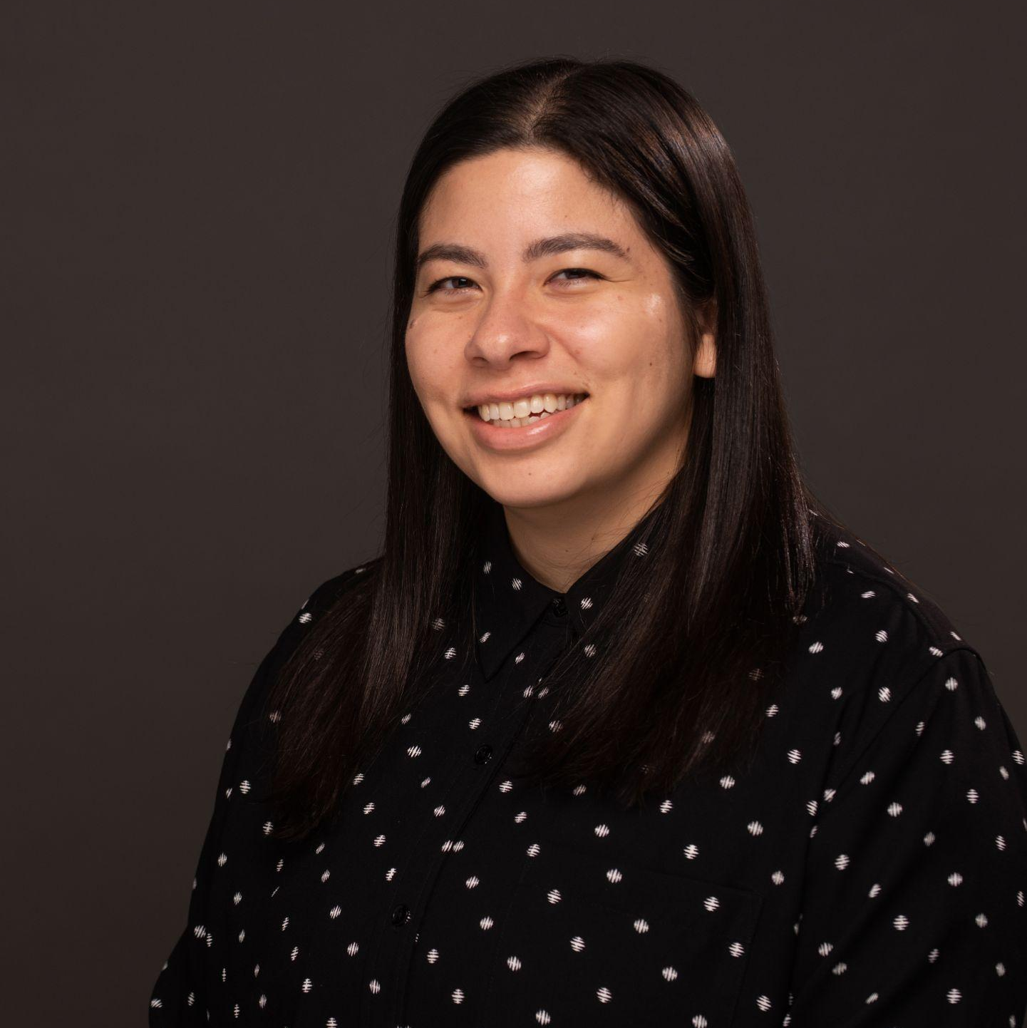

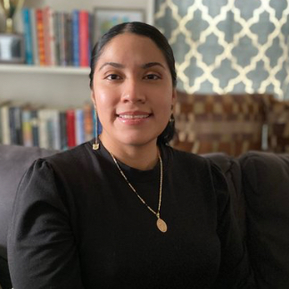
Panelist Contact Information
Maya Hobscheid
Wynn Tranfield
Naomi Binnie
Sheila Garcia Mazari
Instructional Design Librarian
hobschem@gvsu.edu
STEM Librarian
wynntranfield@ucsc.edu
Digital Education & Engagement Librarian
nbinnie@umich.edu
Online Learning Librarian
shargarc@ucsc.edu

Slide 21
Thanks!
Do you have any questions?
Please keep this slide for attribution
Notes:
Slido

