Slide 1
Cost Benefit Analysis Applied to Behavioral and Engineering Safety Countermeasures in San Francisco, California Ryan Greene-Roesel San Francisco County Transportation Planning Authority December 2013 Note: Research funded by the Transportation Research Board under NCHRP 17-46 and completed while at Cambridge Systematics

Slide 2
Education
Engineering
Enforcement
Emergency

Slide 3
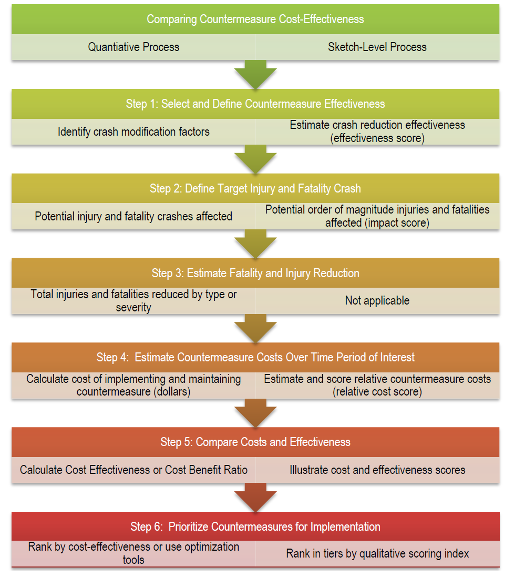
Methodology

Slide 6
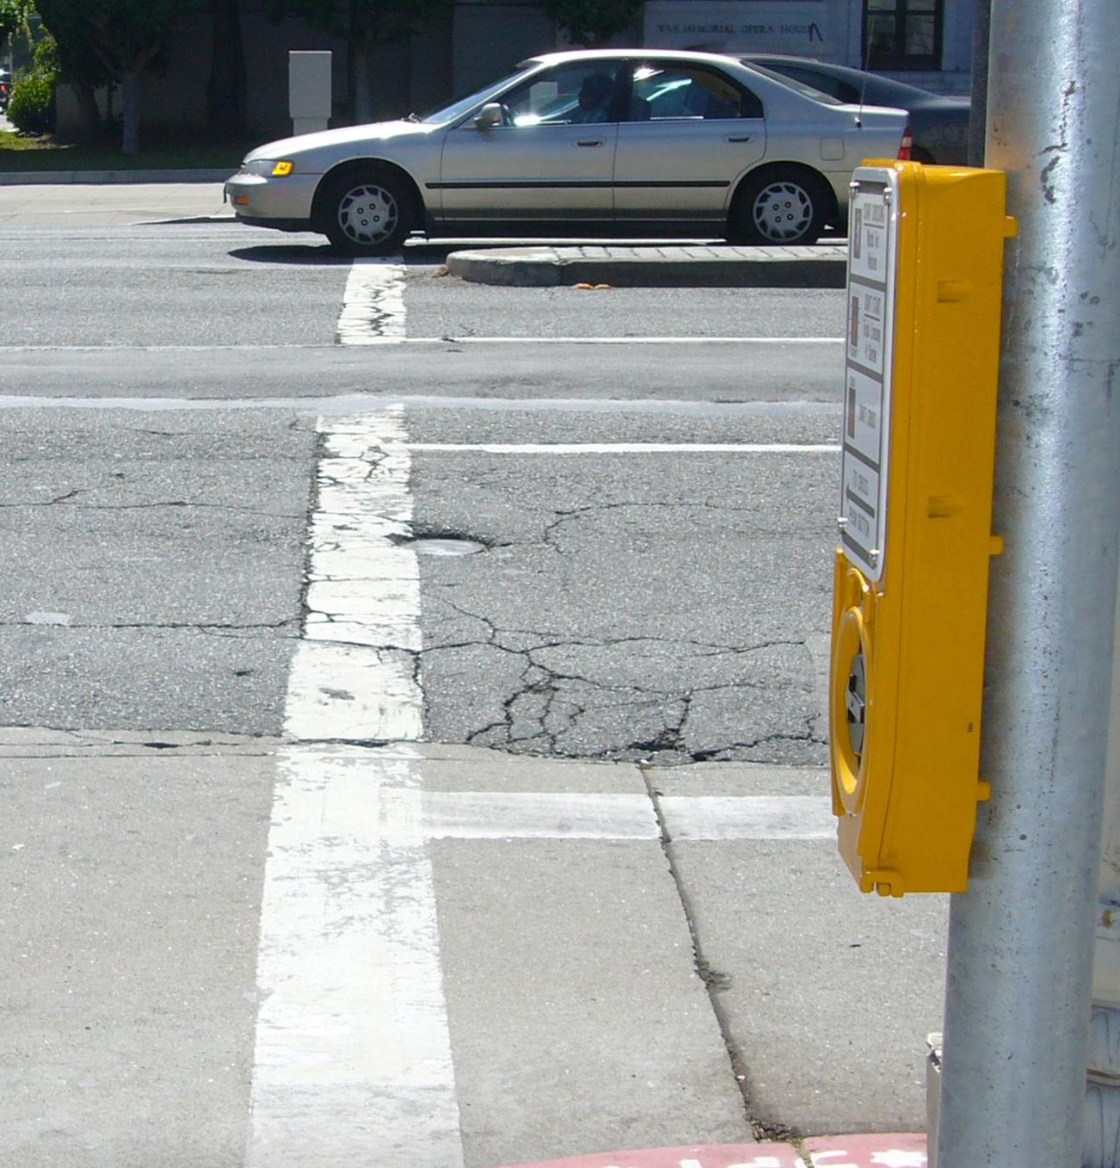
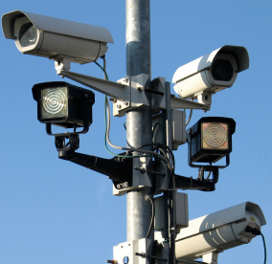
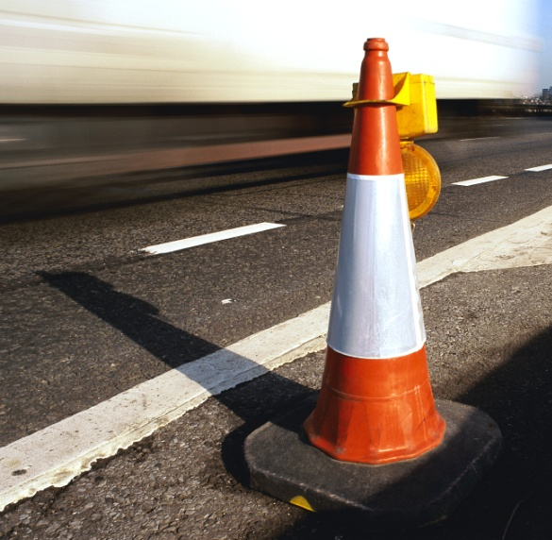
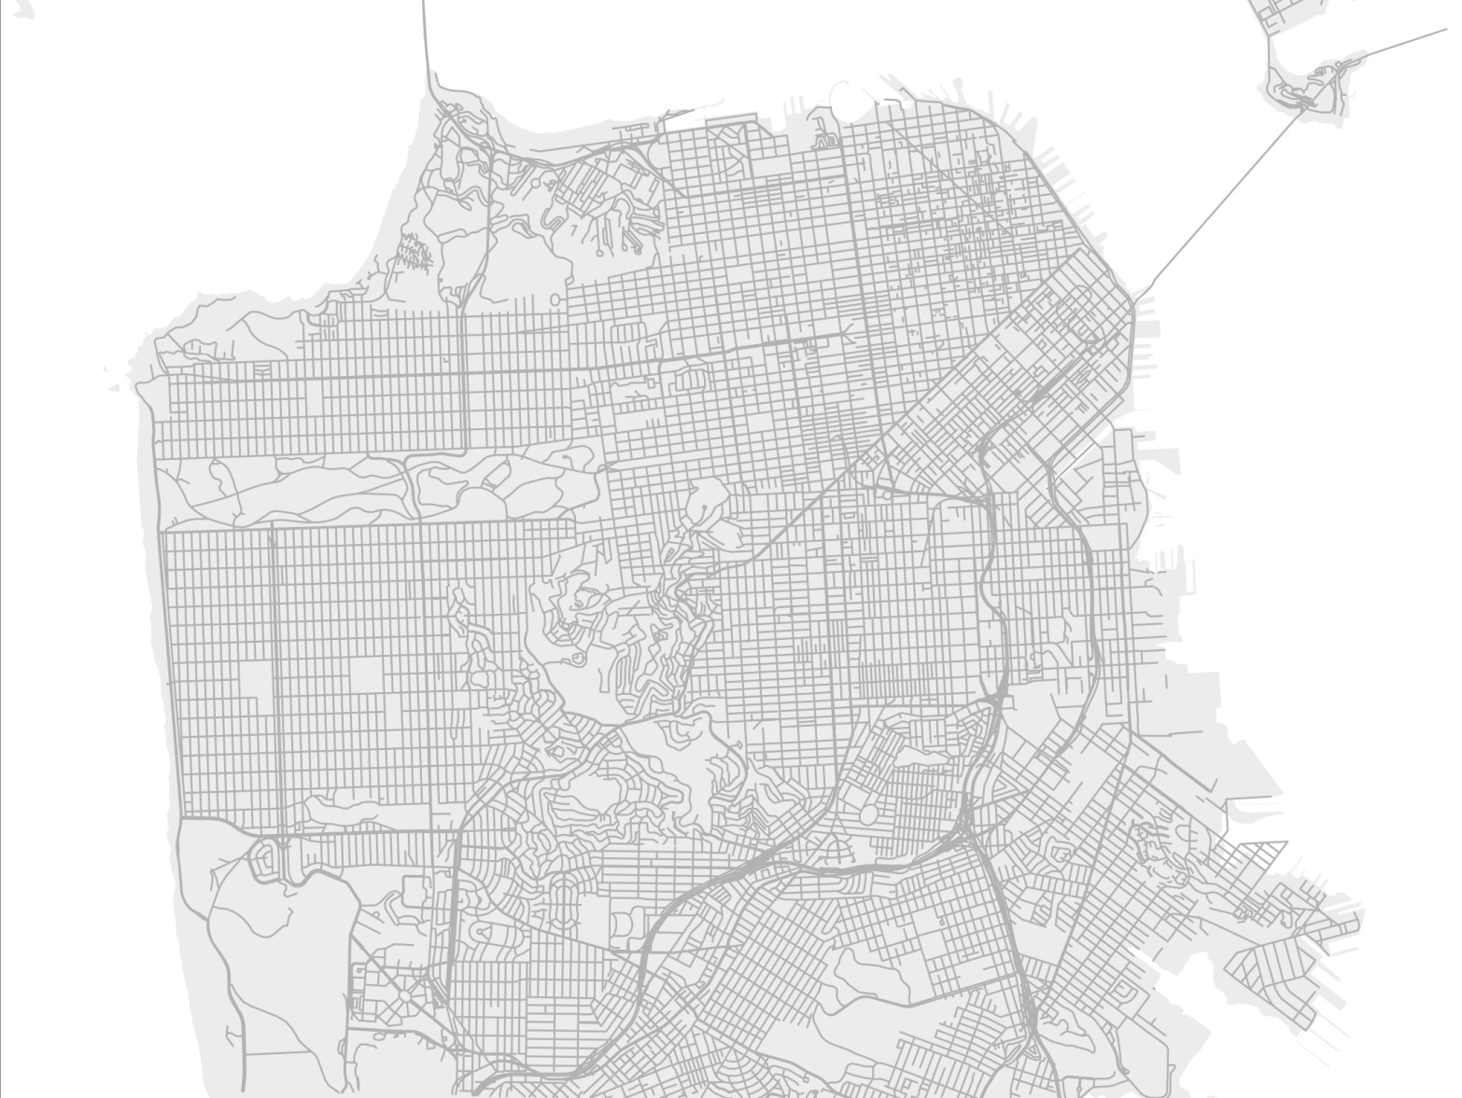
1. Pedestrian Median Extension
1
2. Automated Speed Enforcement Buffer
2
Countywide Implementation
3. Child Pedestrian Safety Training
4. DUI Sobriety Check Points
3

Slide 7
1. Pedestrian Median Extension
1
2. Automated Speed Enforcement Buffer
2
Countywide Implementation
3. Child Pedestrian Safety Training
4. DUI Sobriety Check Points
3
4

Slide 8
School Pedestrian Training Programs
Sobriety Checkpoints
Speed Cameras
Pedestrian Median Extensions

