Slide 1
Where do all those drinking drivers come from?
An assessment of drinking and driving risks across
50 California cities
and . . .
An intervention to reduce alcohol problems across
24 cities in California
Paul J. Gruenewald
with many thanks to . . .
Bob Saltz
M.J. Paschall
Prevention Research Center
Pacific Institute for Research and Evaluation
180 Grand Avenue, Suite 1200
Oakland, CA 94612

Slide 2
Factoids about drinking and drunken driving
(California, 2009)
In each community of 100,000 people each year we estimate:
53,100 persons will drink at least once,
18,213 persons will drive after some drinking, producing . . .
2,352,000 driving after drinking events,
11,700 occasions when driving after drinking “too much,”
4,200 arrests for driving while intoxicated,
1,800 “had been drinking” (HBD) motor vehicle crashes,
1,300 “driving while intoxicated” (DUI) crashes, and
1,300 “single vehicle night time” (SVN) crashes.
Drinking and drunken driving continues to be a major source of injury
and death across cities in California.

Slide 3
Factoids about drinking and drunken driving
(California, 2009)
In each community of 100,000 people each year we estimate:
53,100 persons will drink at least once,
18,213 persons will drive after some drinking, producing . . .
2,352,000 driving after drinking events,
11,700 occasions when driving after drinking “too much,”
4,200 arrests for driving while intoxicated,
1,800 “had been drinking” (HBD) motor vehicle crashes,
1,300 “driving while intoxicated” (DUI) crashes, and
1,300 “single vehicle night time” (SVN) crashes.
If we can determine where these drinkers use alcohol before they drink and drive, then we can design preventive intervention suitable for those drinking contexts.

Slide 4
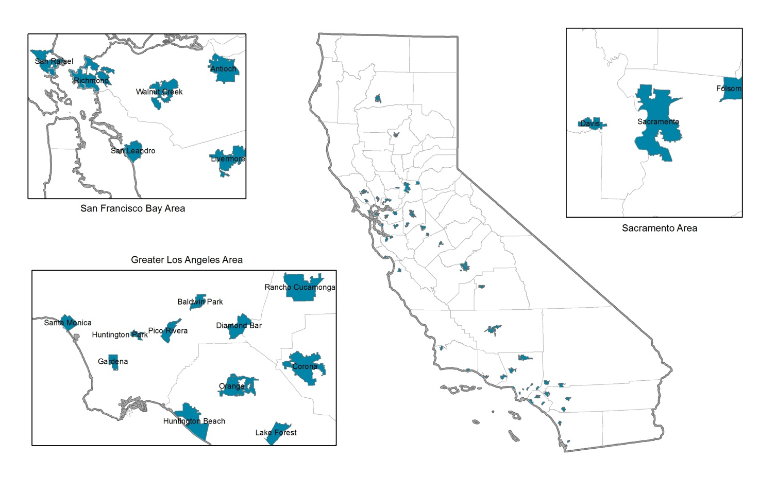
An Analysis of Drinking Agents and Drinking Places: The California 50 City Study
Use of Drinking Contexts in an Adult Population Sample:
Random sample of 50 cities in California with between 50,000 and 500,000 persons.
An ecological sample, so all cities were spatially distinct from one another.
About 9000 adult population surveys conducted across cities with about 5000 drinkers.
Collected demographic and personality characteristics, frequencies and quantities of alcohol used, and frequencies of drinking in different contexts.

Slide 5
Individual Level Analyses of Characteristics Related to Venue Use
Personal
Characteristics:
Drinking
Characteristics:
Venue
Use:
Restaurants
Impulsivity
Drinking
Frequency
Parties
Risky Driving
Drinking
Quantity
Own Home
Tolerance
of Deviance
Heavy
Drinking
Other’s Home
DUI
Networks
Bars
Gruenewald, P.J., Remer, L.R. The social ecology of alcohol use: The California 50 city study. In press, Addiction, 2015.

Slide 6
Individual Level Analyses of Characteristics Related to Venue Use
Personal
Characteristics:
Drinking
Characteristics:
Venue
Use:
Restaurants
Impulsivity
Parties
Risky Driving
Own Home
Tolerance
of Deviance
Other’s Home
DUI
Networks
Bars
Gruenewald, P.J., Remer, L.R. The social ecology of alcohol use: The California 50 city study. In press, Addiction, 2015.

Slide 7
Risk Exposures for Drinking and Drunken Driving
(6 months, all other things being equal . . . )
Venue
Used:
Drinking
Events:
Driving after
Drinking Events:
Driving after
Drinking “Too Much”:
Own Home
1,259,798
68,243
1,411
Bars
97,226
5,250
108
7.6%
0.2%
Restaurants
151,866
8,186
169
Parties
99,085
5,338
111
(City with population of 100,000 with 53,100 drinkers.)
Gruenewald, P.J., Remer, L.R. The social ecology of dinking and drunken driving. In preparation, Addiction, 2015.

Slide 8
Individual Characteristics Related to Driving After Drinking
(Exposure: Drinking Frequency)
Context Specific
Drinking
Characteristics:
Venue
Used:
Restaurants
F
Bars
Driving after Drinking
(4 Hours)
V_{h}
Own Home
Parties
Personal
Characteristics:
DUI
Networks
Tolerance
of Deviance
Risky Driving
Impulsivity
Gruenewald, P.J., Remer, L.R. The social ecology of dinking and drunken driving. In preparation, Addiction, 2015.

Slide 9
Individual Characteristics Related to Drunken Driving
(Exposure: Frequency of Driving After Drinking)
Context Specific
Drinking
Characteristics:
Venue
Used:
-
Restaurants
F
Bars
Driving after Drinking
“Too Much”
V_{h}
Own Home
Parties
Personal
Characteristics:
DUI
Networks
Tolerance
of Deviance
Risky Driving
Impulsivity
Gruenewald, P.J., Remer, L.R. The social ecology of dinking and drunken driving. In preparation, Addiction, 2015.

Slide 10
Risk Exposures for Drinking and Drunken Driving
(6 months, all other things being equal . . . )
Venue
Used:
Drinking
Events:
Driving after
Drinking Events:
Driving after
Drinking “Too Much”:
Own Home
1,259,798
68,243
(11,123)
57,120
1,411
(155)
1,256
Total
(Context)
Exposure
Bars
97,226
5,250
(320)
4,930
108
(0)
108
Restaurants
151,866
8,186
(2,996)
5,190
169
(-46)
215
Parties
99,085
5,338
(1,932)
3,406
111
(0)
111
(City with population of 100,000 with 53,100 drinkers.)
Gruenewald, P.J., Remer, L.R. The social ecology of dinking and drunken driving. In preparation, Addiction, 2015.

Slide 11
Risk Exposures for Drinking and Drunken Driving
(6 months, all other things being equal . . . )
Venue
Used:
DAD:
Dtoo:
Premises:
DAD/P:
Dtoo/P:
Own Home
68,243
(11,123)
57,120
1,411
(155)
1,256
18,683
3.65
0.08
(~100x)
Bars
5,250
(320)
4,930
108
(0)
108
15
356.67
7.20
Restaurants
8,186
(2,996)
5,190
169
(-46)
215
102
80.25
1.66
Parties
5,338
(1,932)
3,406
111
(0)
111
---
---
---
(City with population of 100,000 with 53,100 drinkers.)
Gruenewald, P.J., Remer, L.R. The social ecology of dinking and drunken driving. In preparation, Addiction, 2015.

Slide 12
Some Conclusions
Drinking and drunken driving events are differentially associated with drinking contexts.
They are:
Broadly distributed with respect to households (low numbers per household, many households)
Sharply focused with respect to bars (high numbers per bar, few bars)
Drinking in the home appears to be associated with the greatest number of drinking and drunken driving events.
Is this for real?
Well . . . Geospatial models of alcohol related crashes seem to indicate that this is so.

Slide 13
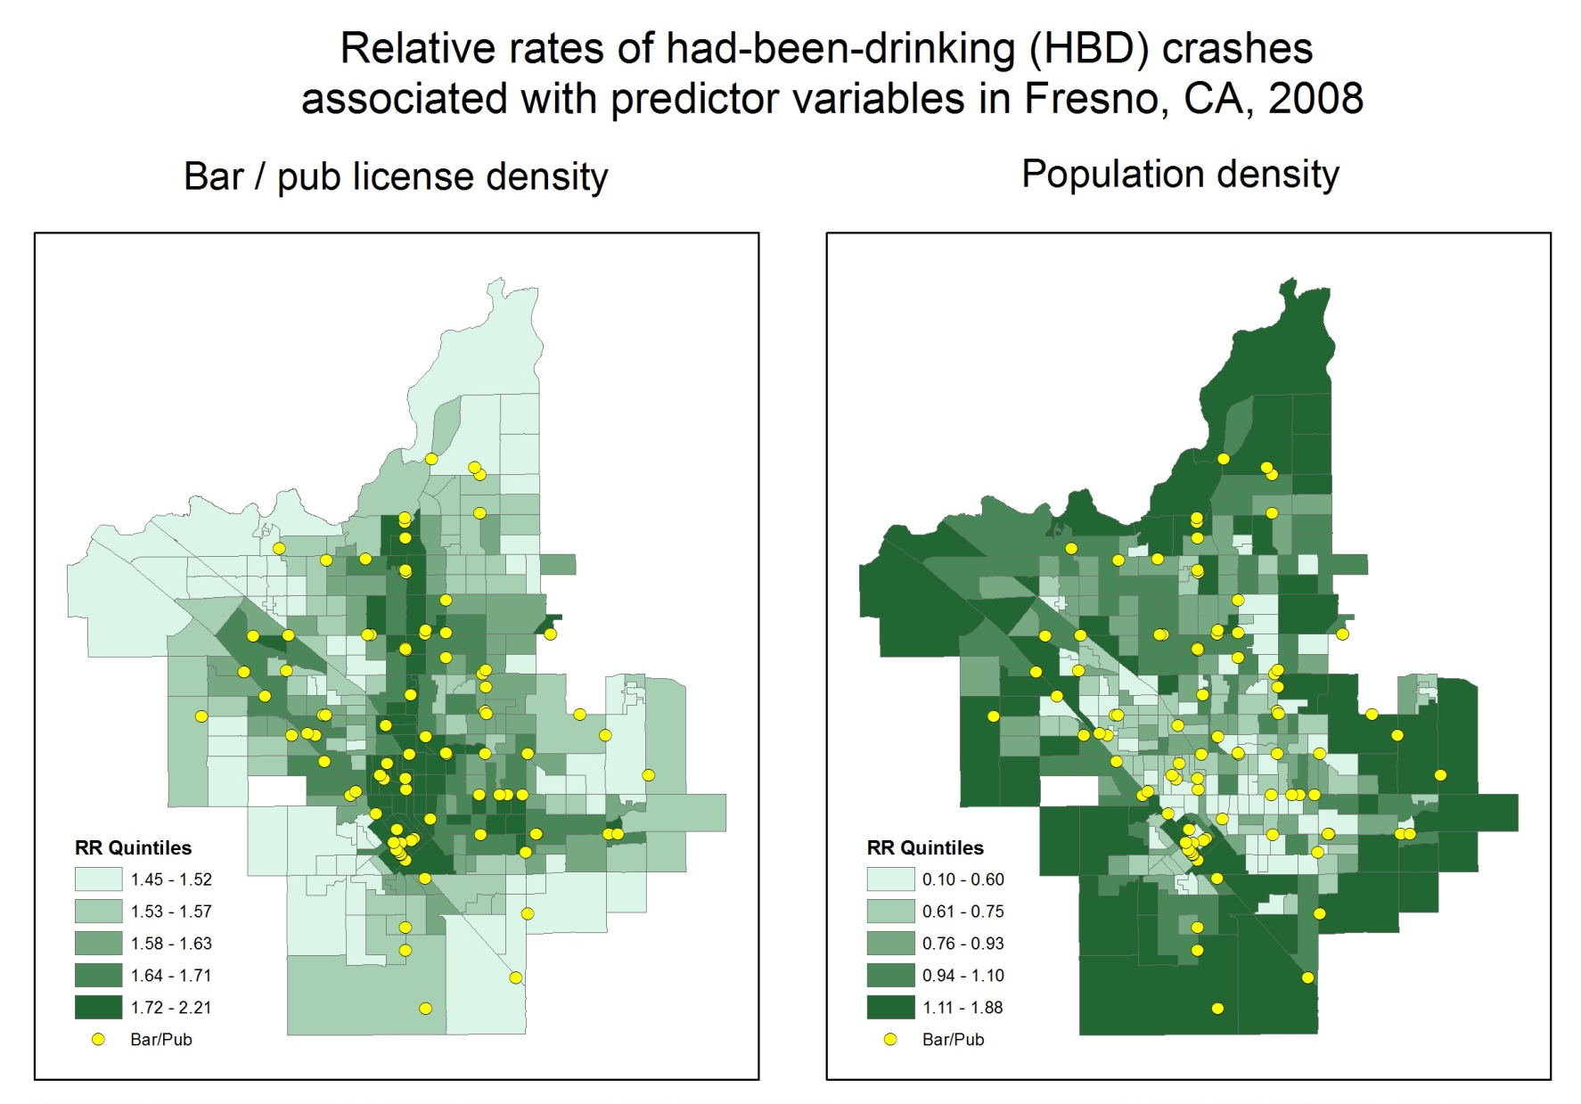
Posteriors from Bayesian space-time analyses of 50 cities CBG crash data
Lipton, R., Gruenewald, P.J., Ponicki, W.R., Remer, L.R. Explaining ecological distributions of crash risks related to alcohol outlets. In preparation, Journal of Studies on Alcohol and Drugs, 2015.

Slide 14
Analyses of Place of Last Drink (POLD) data
also support these observations
The county of Ventura California has been collecting POLD data from arrestees for the past decade or so. Some revealing observations from one of their studies reported in 2008 shows that among arrested DUI Offenders age 21-34:
51.9% reported they had been drinking in a private residence,
37.0% reported they had been drinking in a Bar or Club, and
12.8% reported they had been drinking in a restaurant.
Underage drinkers use private residences more often.
So how do we prevent drinking and drunken driving across these contexts?
Luquette, V. (2008) “Ventura County Place of Last Drink Project: A NHTSA Impaired Driving Demonstration Project.” Institute for Public Strategies.

Slide 15
SAMHSA’S Strategic Prevention Framework – State Incentive Grant (SPF SIG)
Goal: Develop prevention infrastructure to support evidence-based interventions to….
Reduce excessive drinking among 12 to 25 year olds
Achieve that reduction at a community level
Demonstrate that achievement via formal evaluation
An intervention study among 24 of 50 California cities.
SAMHSA supports the intervention.
NIAAA supports the formal evaluation.

Slide 16
Effective Use of Evidence Based Practice
RESEARCH
Stages
IMPLEMENTATION
Drivers
PREVENTION
PRACTICE

Slide 17
Using Logic Models
Take a Basic Question:
“Why is underage drinking more prevalent in some communities than others?”

Slide 18
Underage Drinking: Basic Research
Evidence: Population Prevention Effects
Recognition & Reminder
Strong
Moderate
Retail Serving Practices
Low (target group only)
Decoy Operations
None (no target or population)
Visible Enforcement
Retail Availability to Youth
Alcohol Prices
Alcohol-Related Problems
(Traffic crashes, Injuries,
School performance. Unsafe sex, Violence, etc.)
Nuisance Party Patrols
Underage Drinking Laws
Social Availability to Youth
Social Host Liability
Underage Drinking
DUI Enforcement
Drinking Beliefs
Community Norms About Youth
Drinking
Family, School, and Peer Influences
Drinking Contexts
Alcohol Promotion (Advertising, Point of Sale Promotion, Community Events)

Slide 19
So how do we move communities from concepts to action?
Very simple, interactive software designed for group strategizing
Focus is on the specific steps that will achieve a change in each main prevention target (e.g., “retail availability”)

Slide 20
Sample Page from Interactive Logic Model
Retail Availability of Alcohol to Youth
Social Availability of Alcohol to Youth
Retail Training & Rewards
Visible Enforcement
Underage Drinking Laws
Community Norms
about Youth Drinking
Adult Perceptions of Norms
Number of Compliance Checks, Party Patrols
Compliance Checks, Citations, License Loss
Local Alcohol Policy
Party Patrol, Shoulder Taps, Keg Registration
Perceived Risk for Providing Alcohol to Underage
Media Advocacy
For software: www.doview.com

Slide 21
Key Elements of the Approach
Clarifies partnership of science and practice:
Research used prescriptively: What to do?
Local expertise used instrumentally: How to do it?
Highly focused on objectives rather than process
Moves quickly through assessment and planning, and quickly gets to action
Focuses on measurable community-level outcomes both proximal (e.g., keg registrations) and distal (e.g., youth reports of access to alcohol).

Slide 22
Back to Adult Drinking and
Drunken Driving
Context specific preventive interventions are needed:
The science is telling us where the problems are and . . .
Responsible beverage service programs can work in bars and other on-premise drinking places, but . . .
Interventions that affect use in the home are more problematic: “How to do it?” is the critical unanswered question.
Youth access in the home is also a critical problem; that is where most underage youth obtain and use alcohol.
Social hosting laws address “parties” but parties are not the core of the problem.

Slide 23
Evaluation
How will we know that “it” worked?

Slide 25
Thank you!

