Slide 1
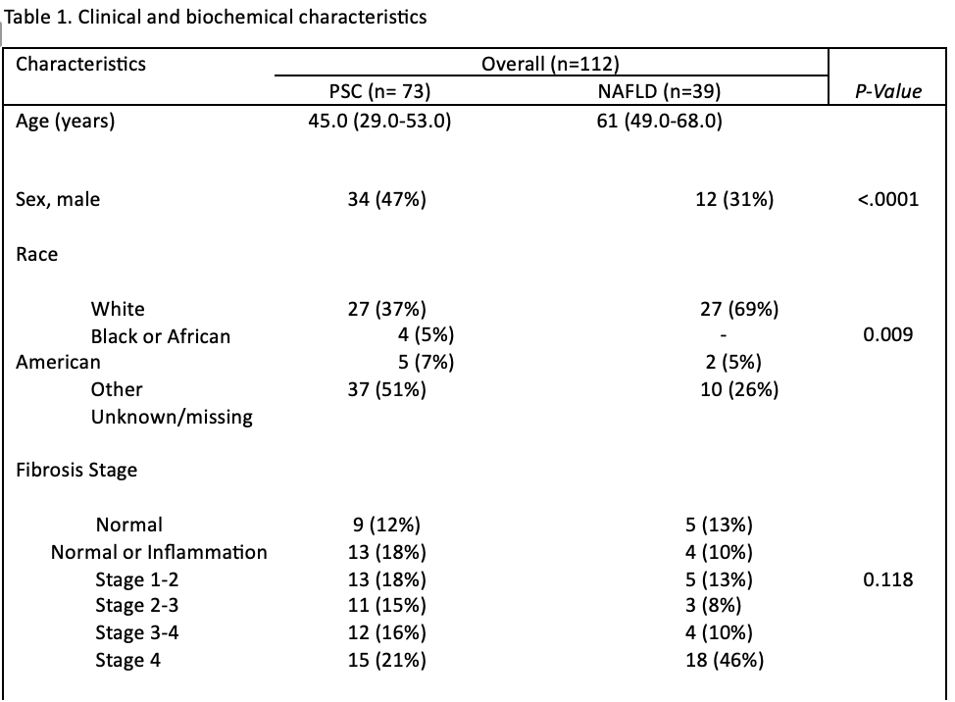
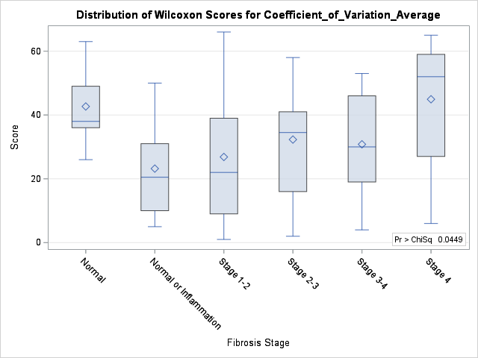
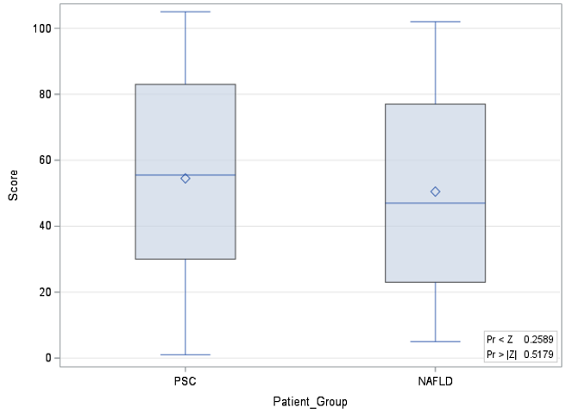
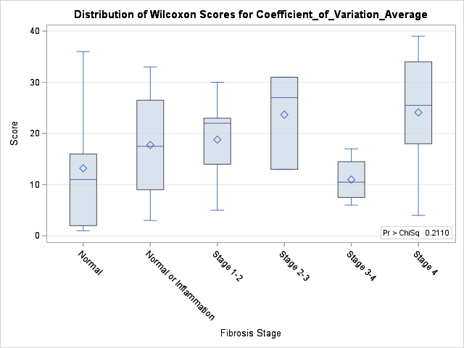
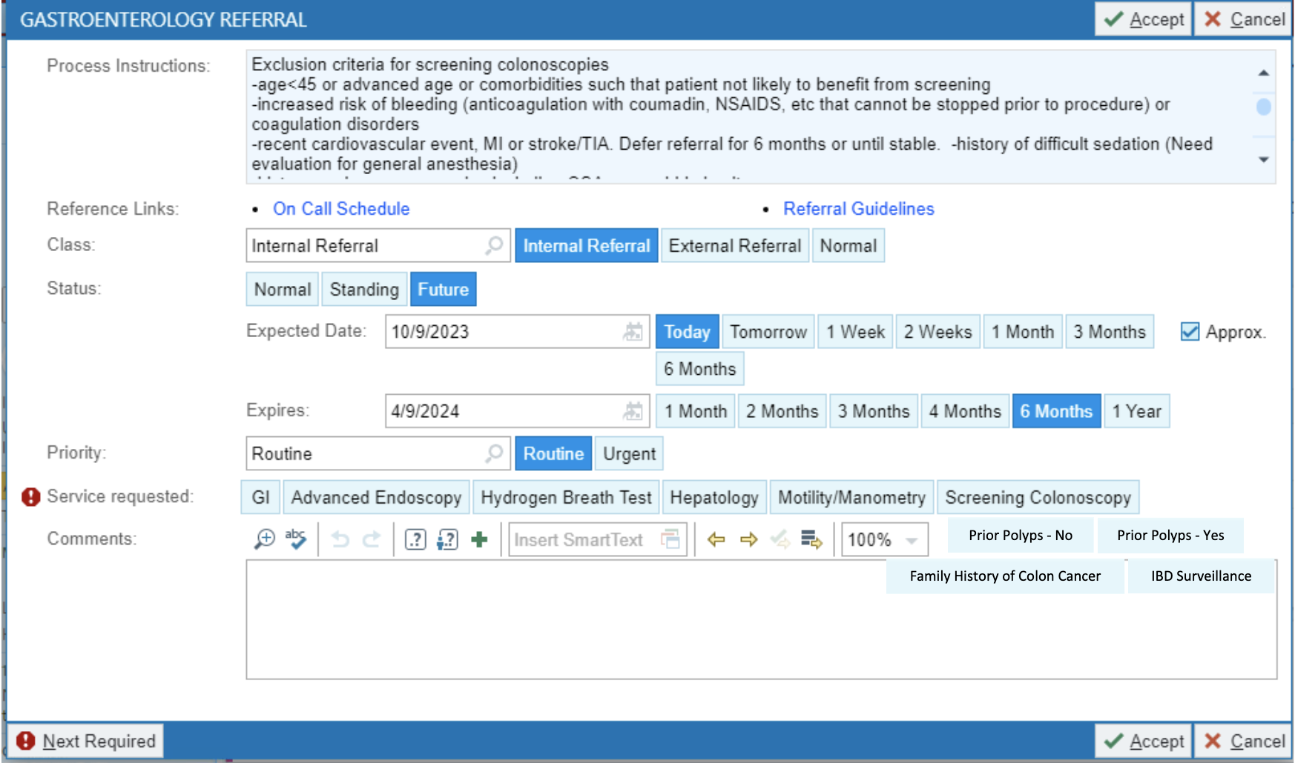

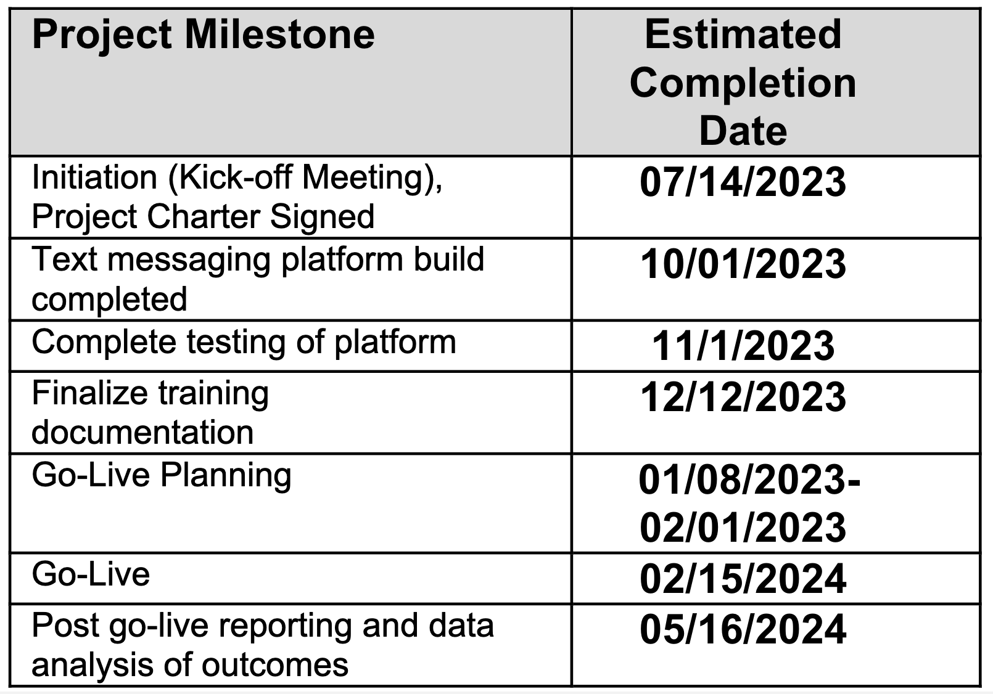
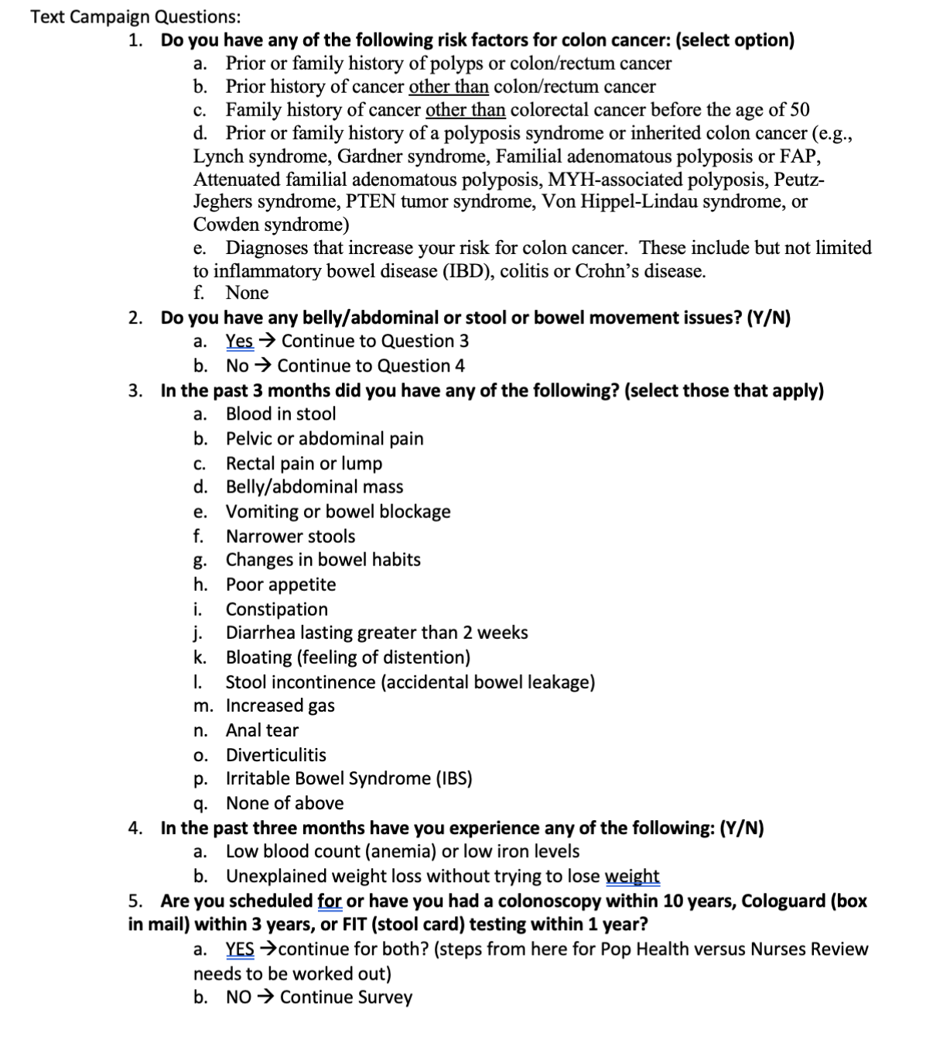

Prognostic value of liver stiffness heterogeneity on staging fibrosis in patients with primary sclerosis cholangitis
Erick Cruz Grave ¹, Connie Chan¹, Michael T. Corwin², Sandeep Dhaliwal¹, Maryam Yazdanfar¹, Christopher Bowlus¹
¹Division of Gastroenterology and Hepatology, University of California Davis School of Medicine; ²Department of Radiology, University of California Davis School of Medicine
OBJECTIVES
RESULTS
PATIENT CHARACTERISTICS
Is liver stiffness by MRE more variable in patients with PSC compared to NASH
Does liver stiffness variability increase with liver stiffness
Does liver stiffness variability predict transplant-free survival
Time-to-event analysis of transplant or death with liver stiffness, liver stiffness variability, total bilirubin, sex, albumin
Fibrosis Stage | NAFLD Heterogenous | PSC Heterogenous | P-Value
Normal | 1 | 6 | 0.05
Normal or Inflammation | 1 | 5
Stage 1-2 | 0 | 2
Stage 2-3 | 2 | 6
Stage 3-4 | 0 | 6
Stage 4 | 12 | 10
PSC Patients
BACKGROUND
Primary sclerosing cholangitis (PSC) is a chronic cholestatic liver disease with a median transplant survival of ~20 years.¹
PSC has been associated to be a heterogenous process in comparison to other chronic liver diseases².
Several models have used MRI features I to provide prognostic outcomes for PSC.
Kawamura et al., has demonstrated evidence of heterogeneity in the spatial severity of liver fibrosis as instrumental when there is a discordance between MRE-based staging and pathological staging in patients with NASH³.
Comparison of liver stiffness variability via MRE in patients with PSC compared to NASH has yet to be studied systematically.
CONCLUSION
MR Elastography provided accurate information about fibrosis stage for patients with PSC and patients with NAFLD
MRE demonstrated increased heterogeneity in liver fibrosis in patients with PSC as fibrosis severity increased
There was no difference in liver heterogeneity between different NAFLD fibrosis stages
In our limited retrospective analysis, there is no difference in liver heterogeneity between patients with PSC and advanced NAFLD fibrosis
METHODS
NAFLD Patients
SECTION HEADER PLACEHOLDER
Diagnosis of PSC including Large/Small/Overlap (AIH) PSC: (diagnosed according to accepted criteria, including cholangiography (good quality MRCP, ERCP, PTC) compatible with PSC)
Diagnosis of NASH including hepatic steatosis by imaging or biopsy
At least 1 MRE available for analysis
Minimum of 1 year of clinical follow up from index MRE
Liver stiffness heterogeneity was assessed via two methods:
Variability %: difference between max and minimum LS values / maximum value
Coefficient of variation in % = individual intrahepatic slice SD/ mean intrahepatic slice
Figure 1. Liver stiffness variability in PSC vs NAFLD patients
SECTION HEADER PLACEHOLDER
SECTION HEADER PLACEHOLDER
SECTION HEADER PLACEHOLDER
SECTION HEADER PLACEHOLDER
SECTION HEADER PLACEHOLDER
SECTION HEADER PLACEHOLDER
SECTION HEADER PLACEHOLDER
SECTION HEADER PLACEHOLDER
SECTION HEADER PLACEHOLDER
SECTION HEADER PLACEHOLDER
SECTION HEADER PLACEHOLDER
SECTION HEADER PLACEHOLDER
SECTION HEADER PLACEHOLDER
SECTION HEADER PLACEHOLDER
ACKNOWLEDGEMENTS / REFERENCES
TEXT PLACEHOLDER
TEXT PLACEHOLDER
TEXT PLACEHOLDER
TEXT PLACEHOLDER
TEXT PLACEHOLDER
TEXT PLACEHOLDER
TEXT PLACEHOLDER
TEXT PLACEHOLDER
TEXT PLACEHOLDER
TEXT PLACEHOLDER
TEXT PLACEHOLDER
Thank you to Dr. Christopher Bowlus and his lab group for their continued guidance and mentorship during the completion of this project.
Reiter R, Shahryari M, Tzschätzsch H, Klatt D, Siegmund B, Hamm B, Braun J, Sack I, Asbach P. Spatial heterogeneity of hepatic fibrosis in primary sclerosing cholangitis vs. viral hepatitis assessed by MR elastography. Sci Rep. 2021 May 10;11(1):9820. doi: 10.1038/s41598-021-89372-4. PMID: 33972639; PMCID: PMC8110576.
Kawamura N, Imajo K, Kalutkiewicz KJ, Nagai K, Iwaki M, Kobayashi T, Nogami A, Honda Y, Kessoku T, Ogawa Y, Higurashi T, Hosono K, Takahashi H, Yoneda M, Saito S, Aishima S, Toyoda H, Hayashi H, Sumida Y, Ehman RL, Nakajima A. Influence of liver stiffness heterogeneity on staging fibrosis in patients with nonalcoholic fatty liver disease. Hepatology.
Yimam KK, Bowlus CL. Diagnosis and classification of primary sclerosing cholangitis. Autoimmunity reviews. 2014;13(4-5):445-50. Epub 2014/01/16. doi: 10.1016/j.autrev.2014.01.040. PubMed PMID: 24424180. 2. Sarkar S, Bowlus CL. Primary Sclerosing Cholangitis: Multiple Phenotypes, Multiple Approaches. Clin Liver Dis. 2016;20(1):67-77. doi: 10.1016/j.cld.2015.08.005. PubMed PMID: 26593291; PMCID: PMC4662051
Toy E, Balasubramanian S, Selmi C, Li CS, Bowlus CL. The prevalence, incidence and natural history of primary sclerosing cholangitis in an ethnically diverse population. BMC gastroenterology. 2011;11:83. Epub 2011/07/20. doi: 10.1186/1471-230X-11-83. PubMed PMID: 21767410; PMCID: 3160402.
Grigoriadis, A., Ringe, K.I., Andersson, M., Kartalis, N. and Bergquist, A., 2021. Assessment of prognostic value and interreader agreement of ANALI scores in patients with primary sclerosing cholangitis. European Journal of Radiology, 142, p.109884.
Ponsioen, C.Y., Vrouenraets, S.M.E., Prawirodirdjo, W., Rajaram, R., Rauws, E.A.J., Mulder, C.J.J., Reitsma, J.B., Heisterkamp, S.H. and Tytgat, G.N.J., 2002. Natural history of primary sclerosing cholangitis and prognostic value of cholangiography in a Dutch population. Gut, 51(4), pp.562-566.
Ruiz, A., Lemoinne, S., Carrat, F., Corpechot, C., Chazouillères, O. and Arrivé, L., 2014. Radiologic course of primary sclerosing cholangitis: assessment by three‐dimensional magnetic resonance cholangiography and predictive features of progression. Hepatology, 59(1), pp.242-250.
Rajaram, R., Ponsioen, C.Y., Majoie, C.B.L.M., Reeders, J.W.A.J. and Lameris, J.S., 2001. Evaluation of a modified cholangiographic classification system for primary sclerosing cholangitis. Abdominal imaging, 26(1), pp.43-47.
125
PSC
n=85
PSC
n=73
NAFLD
n=40
NAFLD n=39
Total Number of Pattients
Number of patients per group
Final Enrolled patients (Excluded Patients with missing all values in our dataset)
PICTURE PLACEHOLDER
PSC Patients
PICTURE PLACEHOLDER
PICTURE PLACEHOLDER
PICTURE PLACEHOLDER
PICTURE PLACEHOLDER
PICTURE PLACEHOLDER
PICTURE PLACEHOLDER
Figure 2. Correlation between kPa and variability % in PSC patients
Figure 3 & 4. Comparison of Coefficient of Variation Avg by fibrosis stage in PSC vs NAFLD patients

