Slide 1
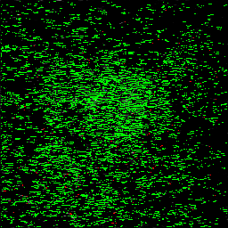
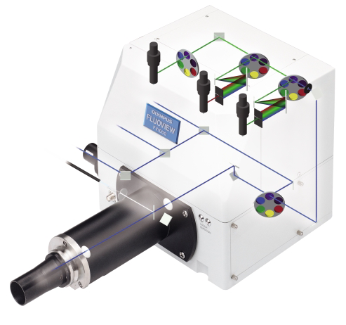
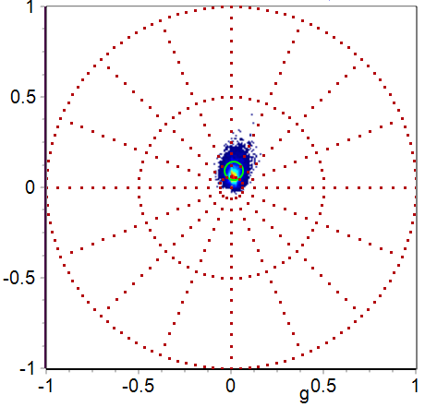
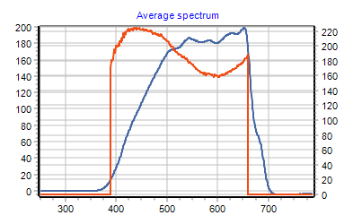
Spectral-Phasor via EMCCD
Deepsea
AOM
Mai Tai
30 µm
EMCCD
IR
UV
FV1000 Microscope
VIS
Short
Phasor
Long
Spectral correction
Figure 1

Slide 2
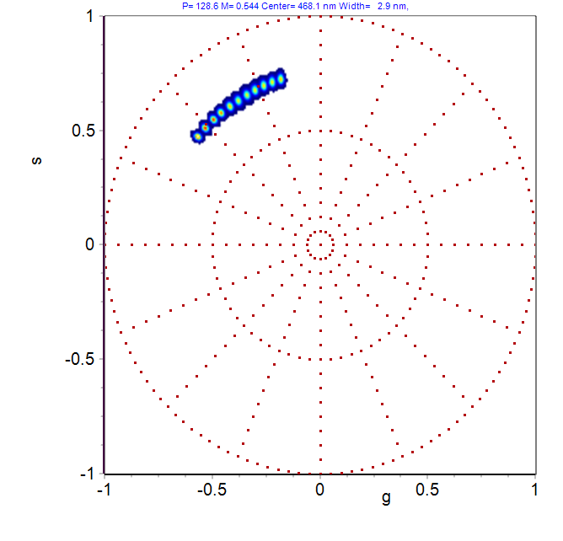
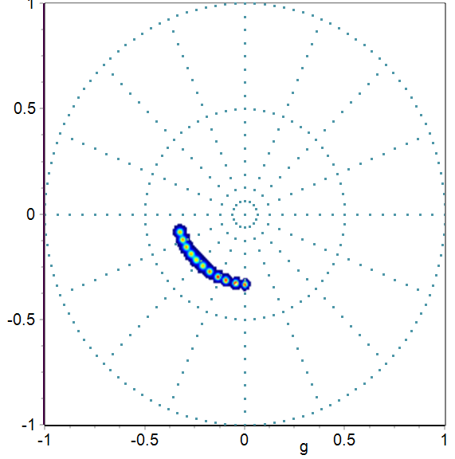
Spectral fingerprint by Spectral-Phasor
A. Spectra 0.5nm step
B. 1st Harmonic
C. 2nd Harmonic
SHG
Figure 2

Slide 3
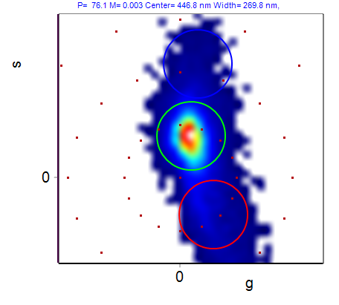
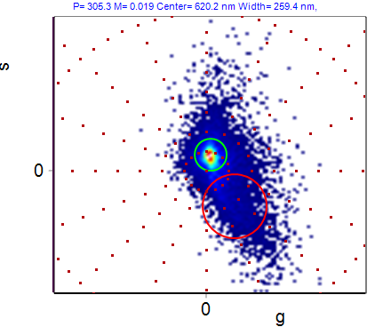
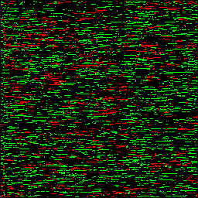
A. 840nm excitation
B. Phasor plot
C. Color-coded images
0.25 mW
0.5 mW
10 µm
0.75 mW
1 mW
D. 0.5 mW excitation
E. Color-coded image
F. Average spectra of AOI
454nm\620nm
a
b
10 µm
Figure 3

Slide 4
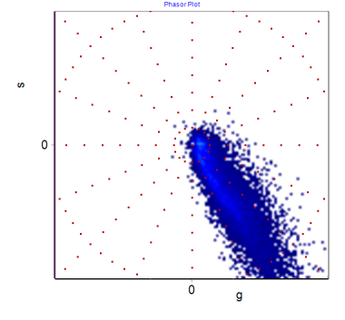
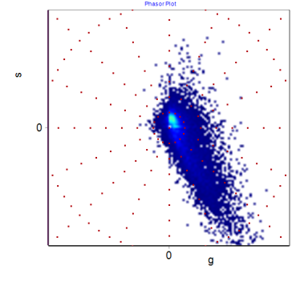
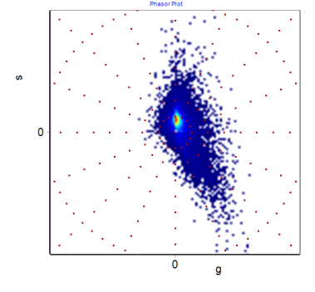
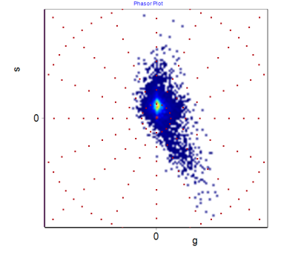
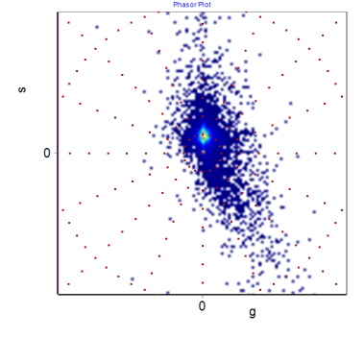
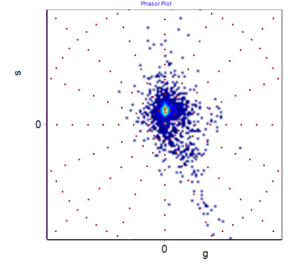
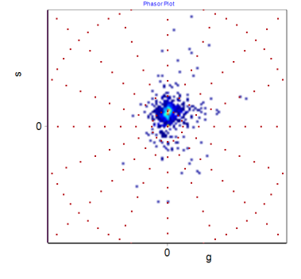
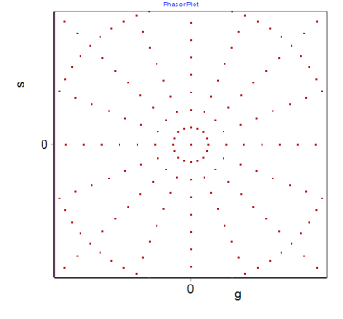
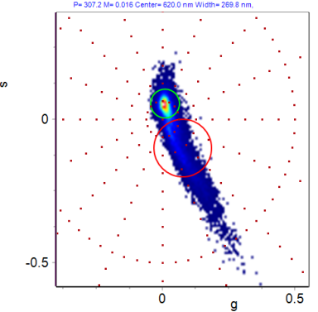
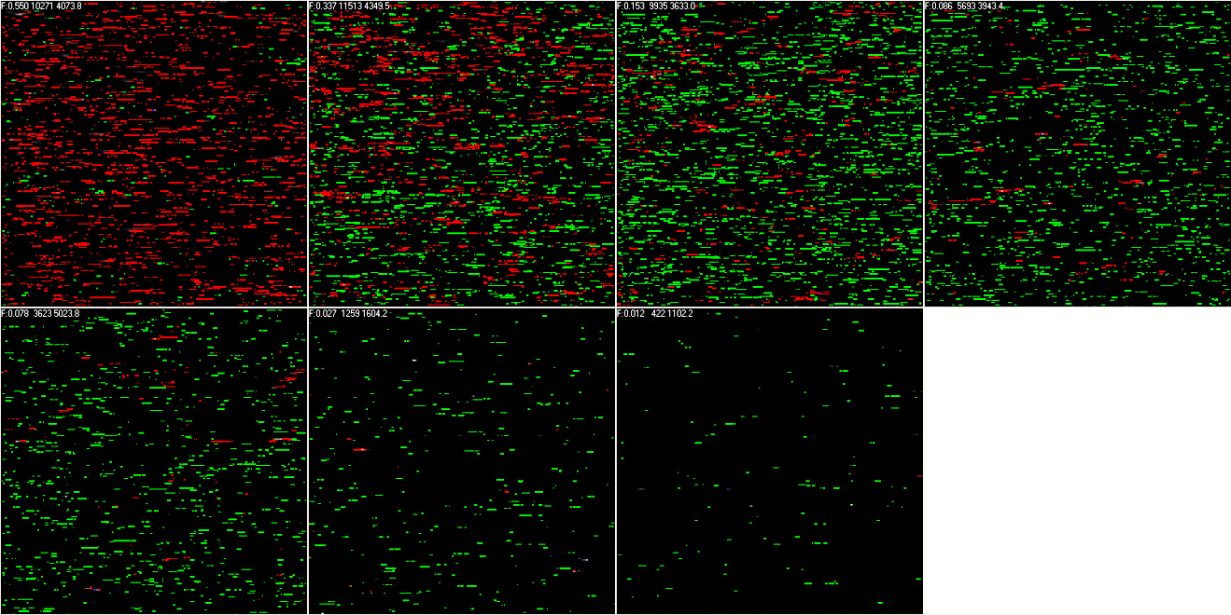
A. Spectra vs λ_{ex}
B. Phasor plot vs λ_{ex}
740 nm
800 nm
840 nm
900 nm
940 nm
1000 nm
1040 nm
390nm
670nm
C. Phasor plot and corresponding color-coded images
450nm/620nm
740 nm
800 nm
840 nm
900 nm
10 µm
940 nm
1000 nm
1040 nm
Figure 4

Slide 5
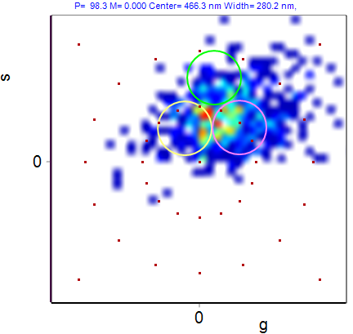
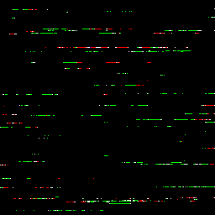
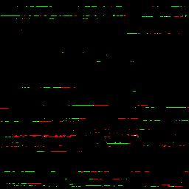
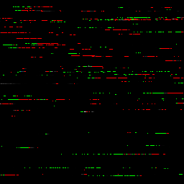
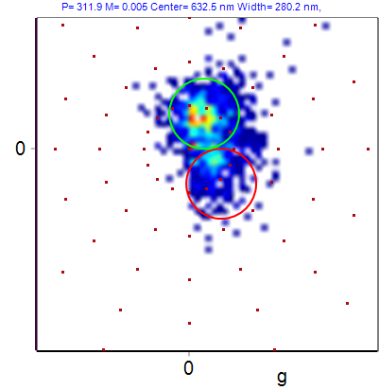
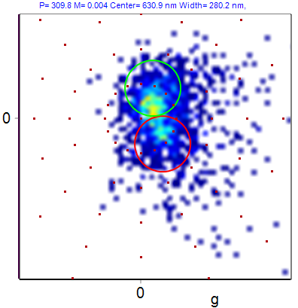
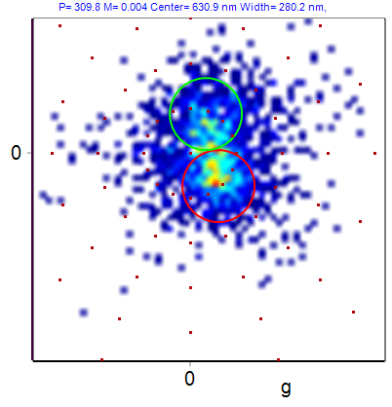
A. 1mW color-coded
B. 1mW phasor
C. Optical trapping of NRs
30 ms
D. 5mW color-coded
E. 10mW color-coded
F. 15mW color-coded
Figure 5

Slide 6
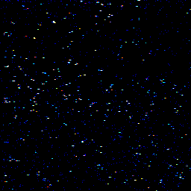
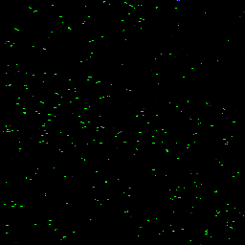
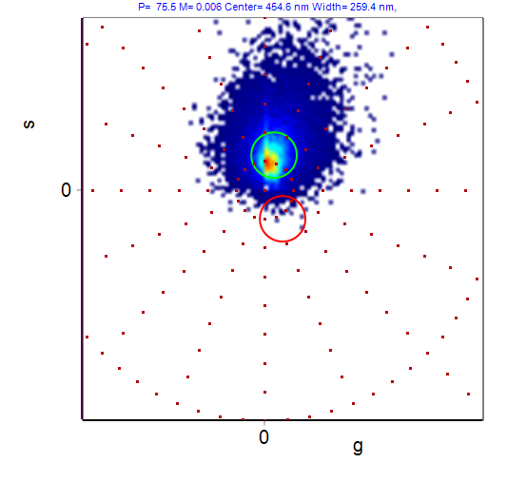
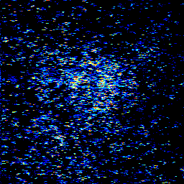
A. 0.5mW, Intensity
B. 0.5mW, color-coded
30 µm
E. Phasor plot
3 mins illumination with 15 mW laser at the center
C. 15mW, Intensity
D. 15mW, color-coded
Figure 6

Slide 7
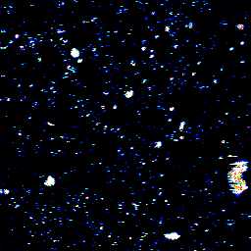
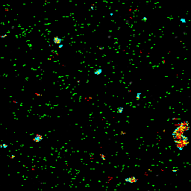
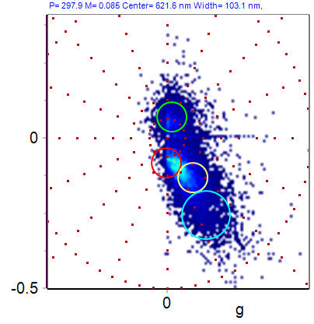
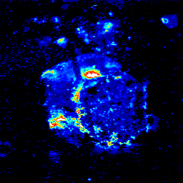
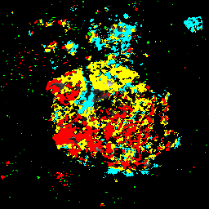
A. 0.5mW, Intensity
B. 0.5mW, color-coded
E. Phasor plot
30 µm
3 mins illumination with 60 mW laser at the center
C. 0.5mW, Intensity
D. 0.5mW, color-coded
Figure 7

