Slide 1
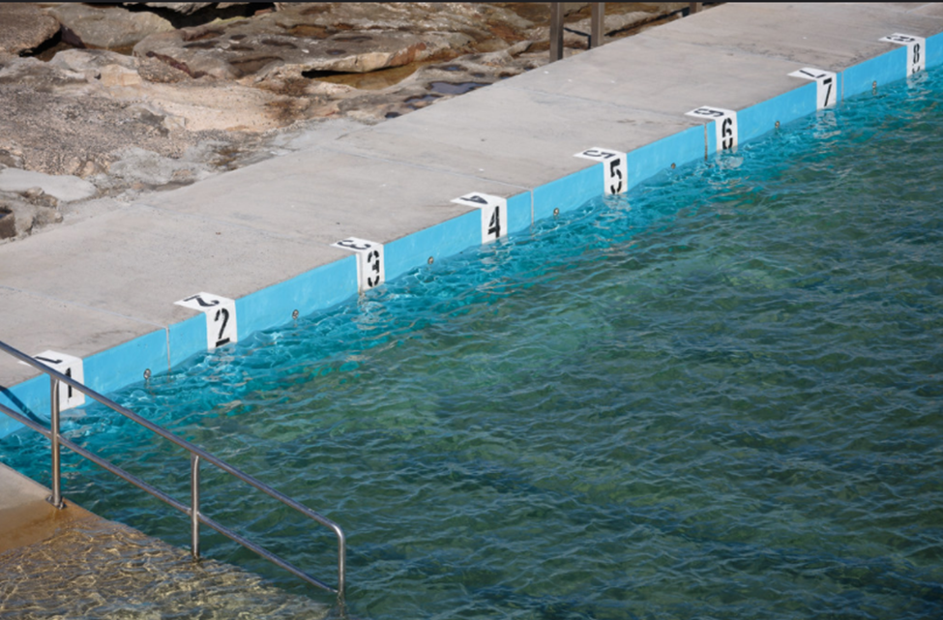
Data Engagement for THE Data-hesitant Librarian
Credit: Alex Proimos
Or, How I Learned to Stop Worrying and Love the Data

Slide 2
Today’s Session
Why data, why now?
Critical data literacy
Expecting universal data savvy: Can we? Must we? Should we?
Who and what is a data librarian anyway?
Empowering librarians to choose their own approaches
Engaging data-hesitant librarians in training and other activities
Training approaches and availability (including training within a training!)
Creating your plan of action for future data activities
Credit: _namtaf_

Slide 3
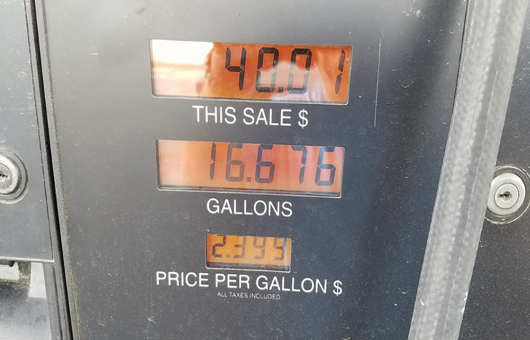
ONLINE LIFE BEING WHAT IT IS:
What’s with the pictures? Data in Real Life! ☺
The slides:
https://is.gd/DataEngage_Slides
My email:
Glusker@berkeley.edu
Collaborative notes document:
https://is.gd/DataEngage_CollabNotes
And, all sessions are being recorded!
Credit: ..Russ..

Slide 4
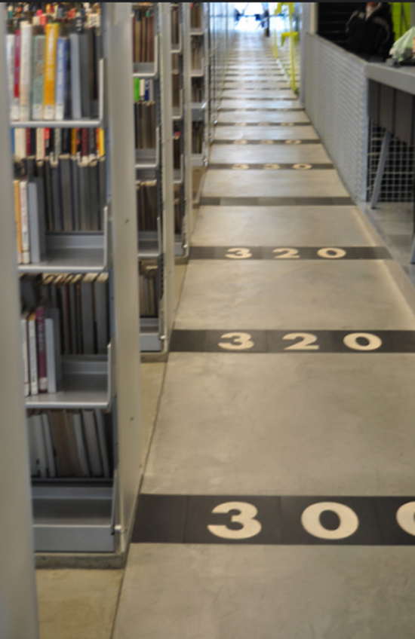
ABOUT ME
I’m the UC Berkeley Library’s liaison to sociology and demography, and also contribute to quantitative research activities on campus
I’ve also worked as:
a public health epidemiologist (for Public Health – Seattle & King County)
the medical librarian for Group Health (now Kaiser Permanente – Washington)
a public library consumer health librarian (at The Seattle Public Library)
a research and data outreach librarian (for the National Network of Libraries of Medicine at the University of Washington)
Credit: Susan Smith

Slide 5
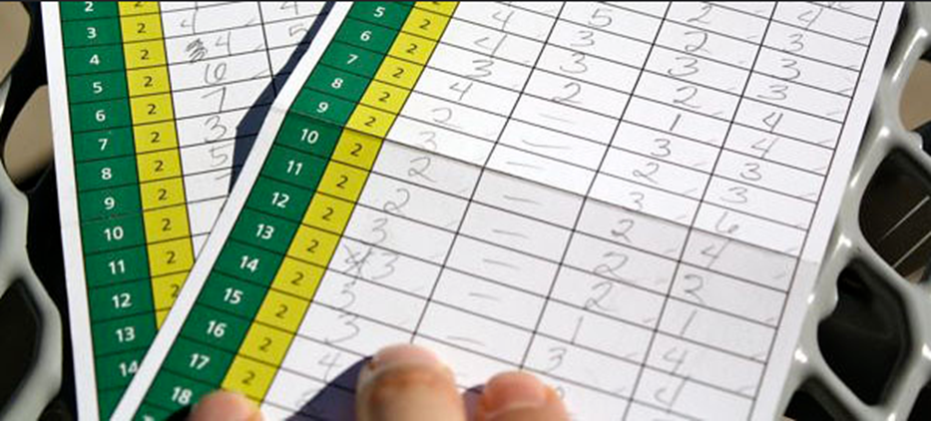
WHY DATA, WHY NOW?
Credit:
Julie Rybarczyk
Increasingly, we encounter data in everyday/real life (we need it for understanding the news, engaging in public discourse, assessing information about weather patterns, etc.)
Many data publishers, governments in particular, are making their data open and accessible
With more accessibility and more encounters come more user requests for help in understanding and using data for a wide range of purposes
Libraries are increasingly involved in providing research data management services to their settings, purchasing and hosting data, etc.
Increased need for fact-checking in public discourse

Slide 6
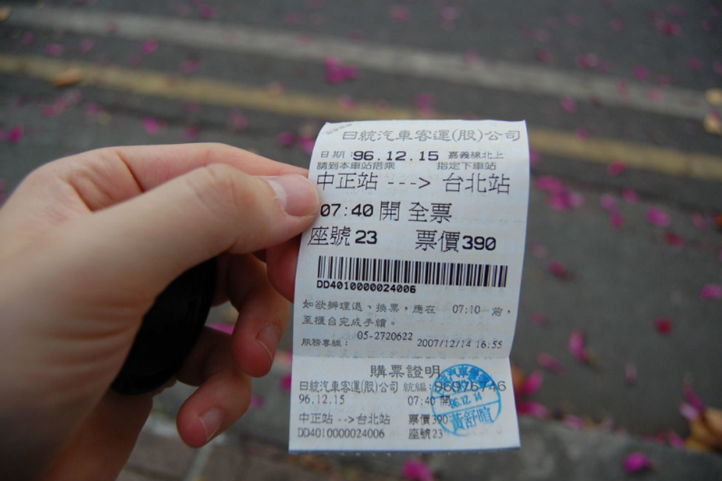
CRITICAL DATA LITERACY: THE GOAL IS SKILL IN CALLING BULL
“The world is awash in bull. Politicians are unconstrained by facts. Science is conducted by press release. Higher education rewards bull over analytic thought. Startup culture elevates bull to high art. Advertisers wink conspiratorially and invite us to join them in seeing through all the bull — and take advantage of our lowered guard to bombard us with bull of the second order. The majority of administrative activity, whether in private business or the public sphere, seems to be little more than a sophisticated exercise in the combinatorial reassembly of bull.
We're sick of it. It's time to do something, and as educators, one constructive thing we know how to do is to teach people. So, the aim of this course is to help students navigate the bull-rich modern environment by identifying bull, seeing through it, and combating it with effective analysis and argument.”
--Carl Bergstrom and Jevin West, CallingBull.org

Slide 7
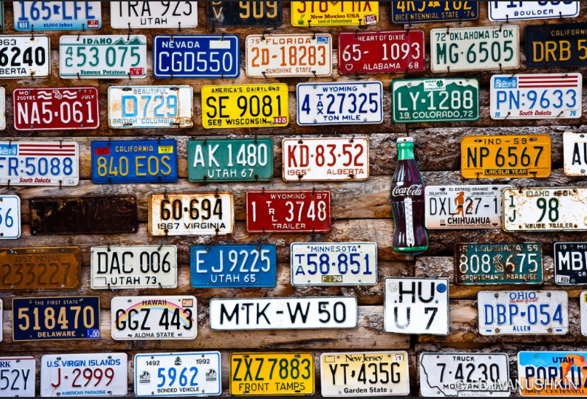
CRITICAL DATA LITERACY: STARTS WITH DATA LITERACY
Credit: Ed Ivanushkin
“We adopt a multifaceted definition of data literacy. For our purposes, data literacy includes the ability to read, work with, analyze and argue with data.
Reading data involves understanding what data is, and what aspects of the world it represents.
Working with data involves creating, acquiring, cleaning, and managing it.
Analyzing data involves filtering, sorting, aggregating, comparing, and performing other such analytic operations on it.
Arguing with data involves using data to support a larger narrative intended to communicate some message to a particular audience.”
--Catherine d’Ignazio and Rahul Bhargava, “Designing Tools and Activities for Data Literacy Learners”

Slide 8
CRITICAL DATA LITERACY: DeFINED
Credit: Harry McGregor
Data literacy and calling bull go together!
“I rarely talk now about just “data literacy”, and instead, I now frame it more clearly as critical data literacy. The skills needed to copy and paste your spreadsheet into a great tool like Datawrapper or RAW seem far less urgent to me than being able to critically assess the limitations of your data and what it might make your viewer think; about who can access and understand that data, and what you want them to do once they have understood, to name just a few of those skills.”
--Zara Rahman, “Getting Critical with Data Literacy”

Slide 9
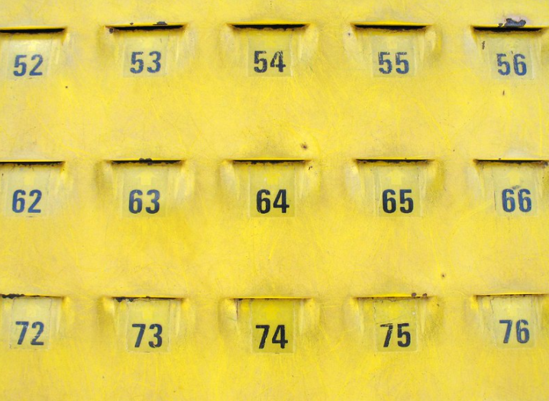
EXPECTING UNIVERSAL DATA SAVVY…
Credit: Matt Karp
Can we?
We CAN… but only with a broad definition of data and of savvy, with respect for persons and their varying connections to and experiences of data
Must we?
IMHO: In some settings, we may need to expect that people can step up to changes in their roles, and can help patrons in basic ways which may have a data component; if that changes the fit of the job to the person, supportively address that!
Should we?
IT DEPENDS! Improving skills in our data-driven world can give a sense of control, but if we push or rush, we risk losing more than we gain
DISCUSS– Amongst yourselves? Or, with me! I’m happy to hear other perspectives—it’s all a work in progress.

Slide 10
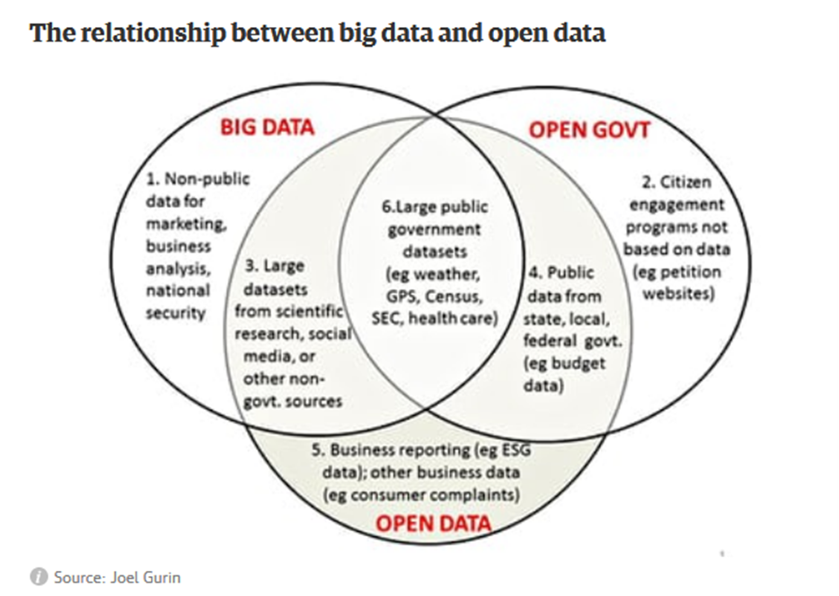
WHO/WHAT IS A DATA LIBRARIAN ANYWAY?
“A data librarian is not necessarily someone who collects data and puts on a shelf or on a server (although that certainly can be done by data librarians). For me, the central role of data librarians (as compared to data archivists, data curators, data analysts, data scientists, and other professions with the data-prefix) is that of data navigator or data guide. We help people find and use the data they need, using the librarian side of our skills to understand our user communities and craft solutions to their particular needs. That requires knowing the data landscape, having the hard skills to crunch the data itself, and having the soft skills to adapt our services to our environment.” –Ryan Womack
Deeper dive: “Defining data librarianship: a survey of competencies, skills, and training” by Lisa Federer
This presentation is NOT about becoming a data librarian! It’s about how we can all connect in a more present and powerful way with the data that’s all around us anyway, in our professional and personal lives! Even the geekiest of data geeks have lots to learn.
Credit: Joel Gurin

Slide 11
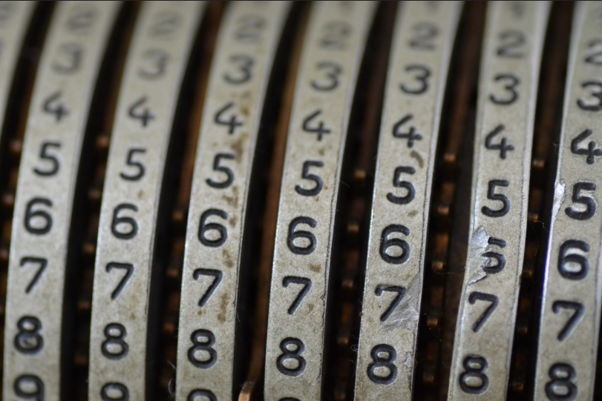
EMPOWERING LIBRARIANS: CHALLENGING THE STATUS QUO
“A challenge for any librarian in this area is intimidation, as well as data mystification. “Data” is seen as having special power in Western academic settings, and as something that can be interpreted only by experts in a given field. Although librarians work to enable access to information of all types, there is a growing divide between “data librarians” and “non-data librarians” in academic libraries today.”
--Pappas, Emmelhainz and Seale, “Critical Data Literacy Using Remittances”
Credit: Eye/See

Slide 12
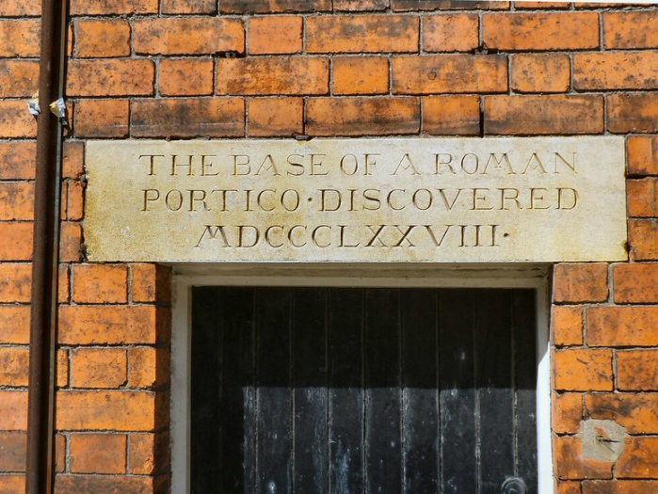
EMPOWERMENT: ADDRESSING EMOTIONAL ASPECTS
Shame: The Emotional Basis of Library Anxiety
Author: Erin L. McAfee
Journal: College and Research Libraries
Access: https://doi.org/10.5860/crl.79.2.237
Summary: In order to explore the emotional causes of shame and library anxiety, McAfee coded participant comments from studies across LIS literature and survey work to find evidence of hidden shame. In a piece that is both a comprehensive overview of the literature on library anxiety and shame, and an interesting demonstration of research method, the author has written a piece that well connects theory to real-world examples. McAfee shares the wisdom that:
“The key to locating destructive shame is to look for institutional behaviors that alienate users. For example, what kind of attitude does an institution communicate to its users? Does the library terminology alienate users or does it bring them closer to the library resources and librarians? Do policies embrace a belief that library users are trying to improve their lives, or do the policies punish users for trying to take advantage of the system?”
Credit: John McLinden

Slide 13
EMPOWERMENT: REMIND OURSELVES, WE ALREADY KNOW HOW TO DO THIS!
We already answer questions using data! Many tools on the internet that deliver answers are doing data analysis behind the scenes
We are comfortable with classification and ordering of information—this is a fundamental data skill
The ways we attack problems can translate neatly to data questions:
We do a careful reference interview
We evaluate sources for currency, bias, authority and reliability
We know how to search to find out what’s already been done rather than recreating the wheel
Author/Copyright holder: Imperial College London. Copyright terms and license: All rights reserved.

Slide 14
EMPOWERMENT: Choosing our own approaches
Credit: Marc Biarnès
In our workplaces:
Do you feel there is a good fit between your data competencies and your position?
If not, do you need enhanced competencies, or are you being underutilized?
Is there flexibility and support for professional development, and collaborative projects you could use to shift focus?
Are there data-related initiatives or processes that you would like to be part of but aren’t yet?
Could you infuse data concepts and evidence-based decision making explicitly in your work? In instruction and programming if you are involved in those?
Are there learning opportunities you feel drawn to?
Are there like minded colleagues who might want to have regular meetings (they can be short!)?
In our careers:
Understand yourself– how connected do and interested in data are you, really?
Do you want to improve your data skills in your current position?
If you aren’t already, do you see yourself becoming a data-focused librarian some day? (or, even, leaving librarianship for data)
Do you feel ready/motivated to stay abreast of changing trends which are increasingly data-driven?
Depending on the answers to these questions, what professional development opportunities, mentors, continuing education, etc. might you want to commit to?

Slide 15
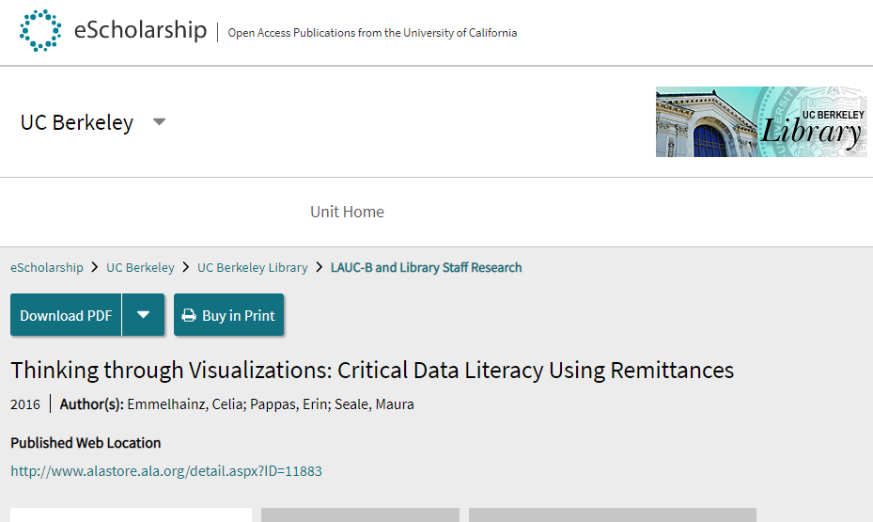
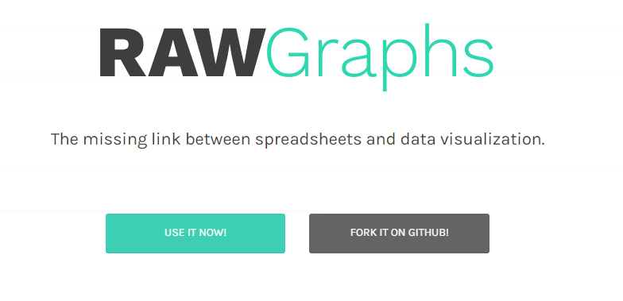
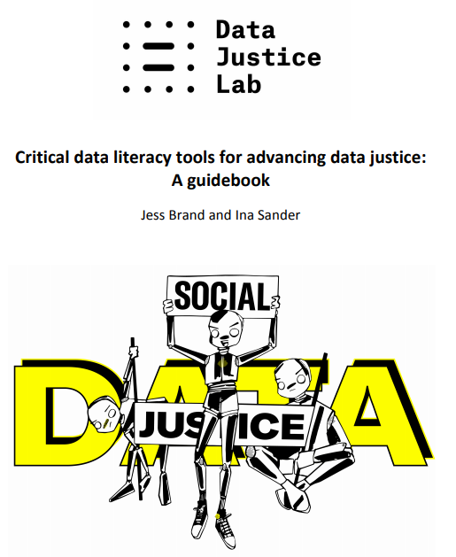
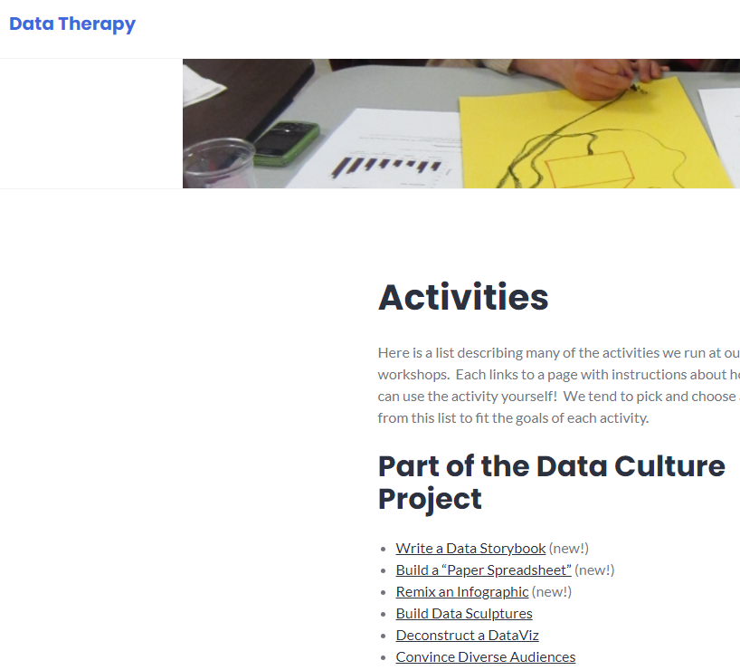
EMPOWERMENT: NO REINVENTING NEEDED
CallingBull.org
AND OF COURSE, ICPSR!!!

Slide 16
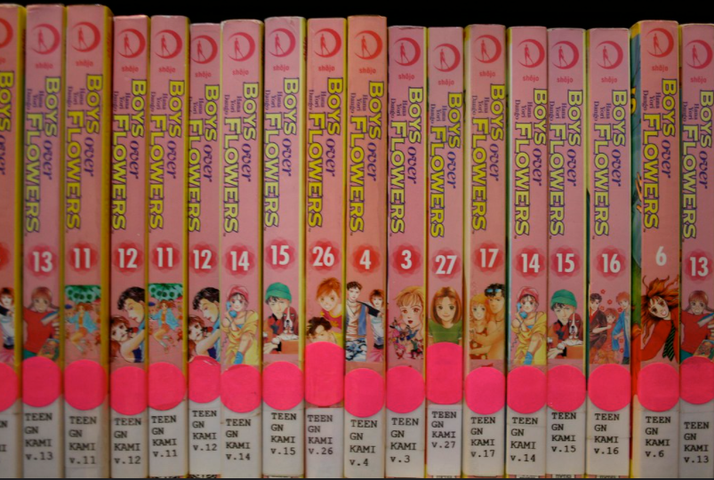
EMPOWERMENT: CONNECTIONS TO EXPLORE (PROGRAM IDEAS?)
Between data and numeracy
Between data and fake news
Between data and advocacy
Between data and coding
Between data and business reference
Between data and intellectual freedom/privacy
Between your library assessment data and available open data
Between the data you wanted (but isn’t available) and other data sources you can use (finding data is easier for large areas!)
Credit: Neal Patel

Slide 17
EMPOWERMENT: ON MY MUST READ LIST (WHAT’s ON YOURS?)
“Data Feminism the book comes from a simple motivation. In the popular press and TED talks, data has been heralded as “new oil,” but there’s been pushback on the idea that data and tech are all for the good. Some of the most significant pushback led by women, POC, indigenous people, LGBTQ people in academic papers, journalism, etc.: nothing new about impacts of this, it’s the same old oppression and social stratification.”
From: MIT Civic Media Center

Slide 18
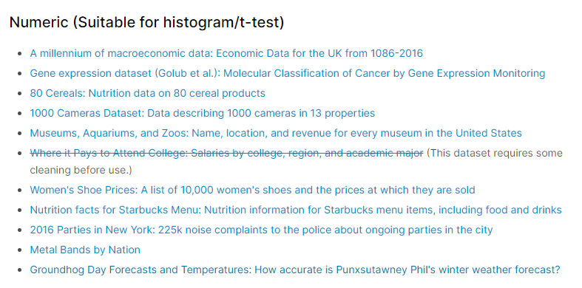
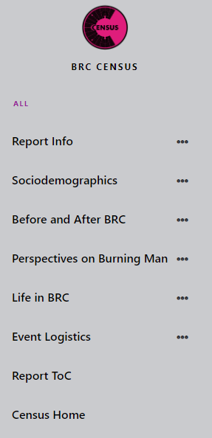
ENGAGING: ”It don’t mean a thing..”
Maybe the most fun data thing I have ever done:
https://is.gd/CloughHouseData
MLB Stats
Credit: Wsquared Photography
Burning Man Census

Slide 19
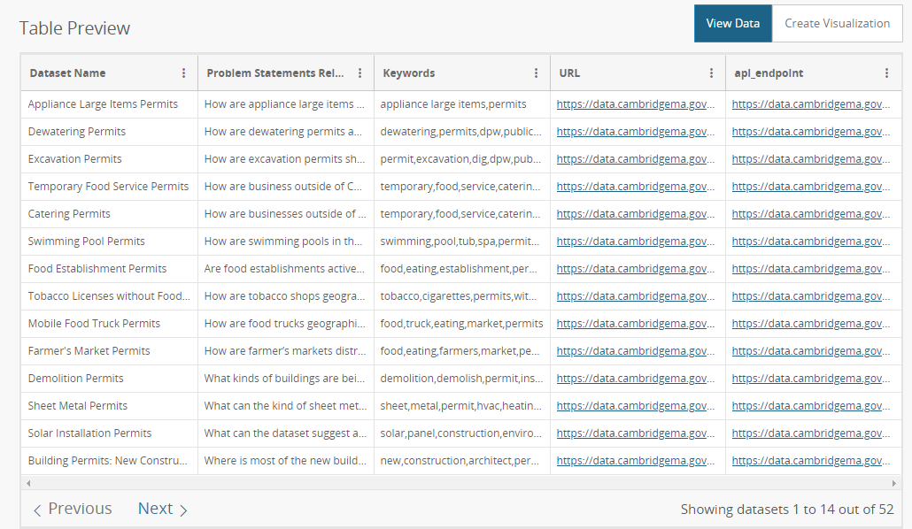
ENGAGING: CIVIC DATA IS A GREAT PLACE TO START

Slide 20
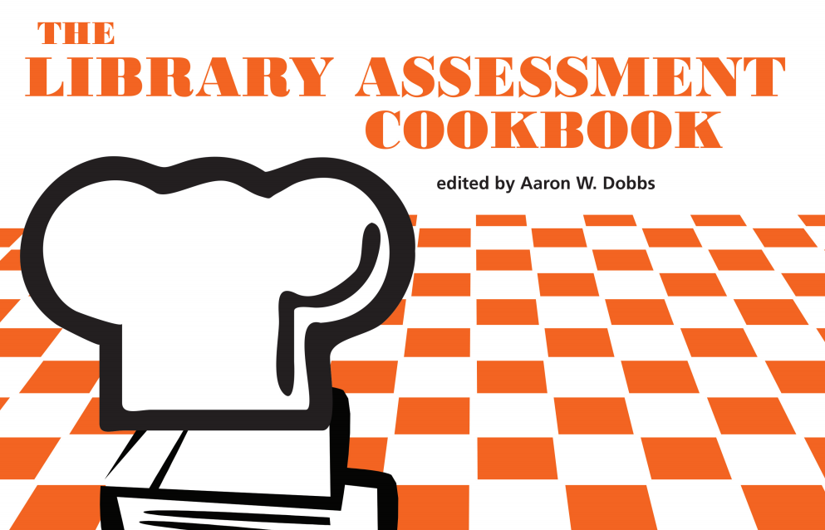
ENGAGING: THERE’S NO PLACE LIKE HOME

Slide 21
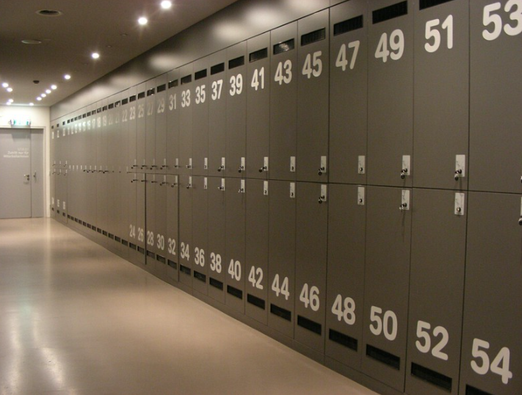
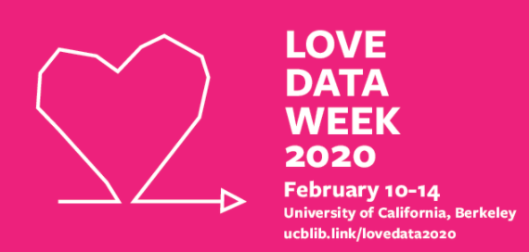
ENGAGING: PICK AND CHOOSE
Credit: Willard
Online learning
Forums (fora?) and listservs
Collaboration/networks
Mentors
Events
Data Day
Love Data Week
Reading Groups
Live Watch Sessions

Slide 22
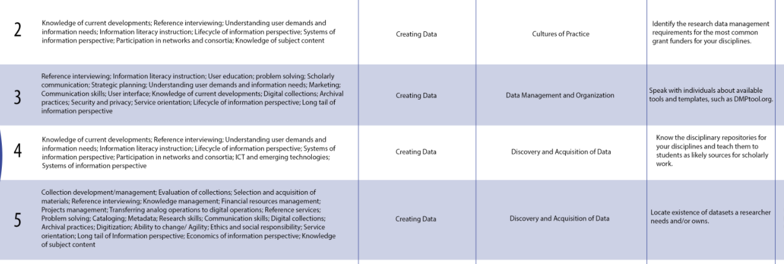
ENGAGING: A THING OF BEAUTY (in 26 ROWS)
Credit: Megan Sapp Nelson and Abigail Goben,
ACRL RDM Road Show

Slide 23
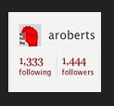
TRAINING: FOR THE DATA BEGINNER
Data Equity for Main Street https://data-equity.org/
Coursera, edX and other MOOCs (the levels may vary!)
Lynda.com if available through your library (or local public library)
May work best to find basic statistics or even numeracy/math courses rather than starting with data, such as https://onlinecourses.science.psu.edu/statprogram/review_of_basic_statistics or https://www.ipracticemath.com/learn/basicmath
Or look for resources for specific topic areas, such as Basic Data Analysis for Health Programs https://www.measureevaluation.org/resources/training/capacity-building-resources/basic-data-analysis-for-health-programs
Credit: Andy Roberts

Slide 24
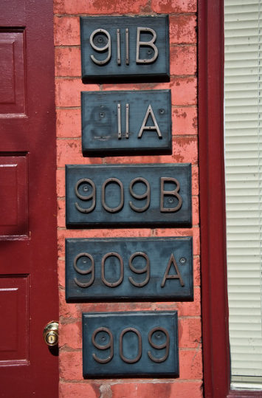
TRAINING: AN EXCITING EXAMPLE:
Credit: Dave Herholz
How the NYT did data training with journalists:
https://open.nytimes.com/how-we-helped-our-reporters-learn-to-love-spreadsheets-adc43a93b919
A drive with all their files! (link from article)
https://drive.google.com/drive/u/0/folders/1ZS57_40tWuIB7tV4APVMmTZ-5PXDwX9w
“The training is rigorous. Based in Google Sheets, it starts with beginner skills like sorting, searching and filtering; progresses to pivot tables; and ends with advanced data cleaning skills such as if and then statements and vlookup. Along the way, we discuss data-friendly story structures, data ethics and how to bulletproof data stories. We also invite speakers from around The Times, including the CAR team, Graphics and the Interactive News team, to talk about how they report with data.”

Slide 25
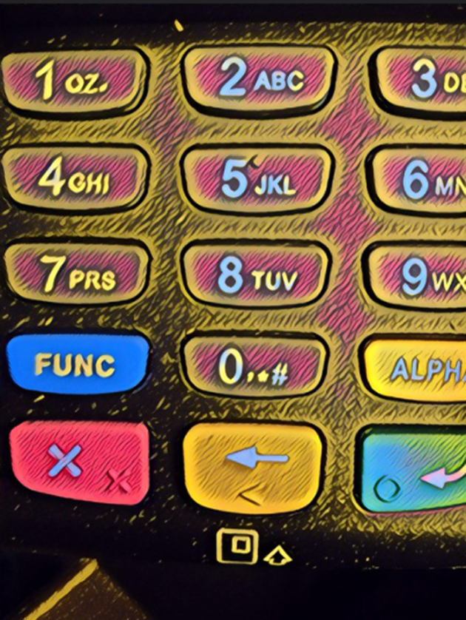
TRAINING FOR THE DATA-SAVVIER
School of Data https://schoolofdata.org/
Data Journalism Handbook http://datajournalismhandbook.org/1.0/en/index.html
Open Data Institute https://theodi.org/courses
Open Data Handbook http://opendatahandbook.org/resources/
Data 101 https://www.neighborhoodindicators.org/data-tech/course-catalog/data-101-data-visualization-data-literacy-and-storytelling
Also, check out offerings on your own campus! AND ICPSR!!
And, there are many online courses related to research data management—contact me if you want to know more
Credit: Damian Gadal

Slide 26
LIBRARY CARPENTRY
https://librarycarpentry.org/ and coming soon to the NNLM!
Library Carpentry speaks to those working with information and data:
Who want to explore this material to determine if it is helpful or relevant to their work
Who face new challenges surrounding data such as learning new tools and practices
Who want to improve their workflows and reduce time consuming tasks
Who need to gain familiarity and comfort with language surrounding data
Who would like to collaboratively develop lesson material around information and data
Who are generally interested in data scholarship
Who are looking for a community where they can discuss data related challenges
Library Carpentry can help you to…
Manipulate, transform, and analyze data
Make data-driven decisions
Have better conversations about research data
Automate repetitive tasks
Promote use of data and services
Learn computational approaches
Support open research and data scholarship
Foster cultural change within organizations
Comply with new strategic plans and mission statements
Create new opportunities and to reach out to new communities
Credit: Bill Smith

Slide 27
TRAINING WITHIN A TRAINING!
The next 14 slides comprise the structure and much of the content of a proposed data training session for librarians
This was first presented (in somewhat different form) to mostly public librarians at a Washington Library Association conference; attendees said, “I didn’t know I already knew so much” (music to my ears!)
With some interactivity, it can be a one-hour session, or modified to be discipline-specific, or… let your imagination go wild!
THE BASICS DON’T HAVE TO BE BORING.

Slide 28
TRAINING CONTENT: DATA VS. STATISTICS
Data is the raw information (such as, an Excel file with the information from all the birth certificates).
Statistics are what comes out when an analysis/data interpretation has been done (such as, a report on birth weights by county, perhaps in a visualization such as a bar chart)
Consider whether you and/or your user really need to mess around with the data, or, can you find reports or tables online that are ready-made?
This relates to the question of primary and secondary data—it’s just like primary and secondary sources! Do you really have to collect data yourself, or has someone done it already?

Slide 29
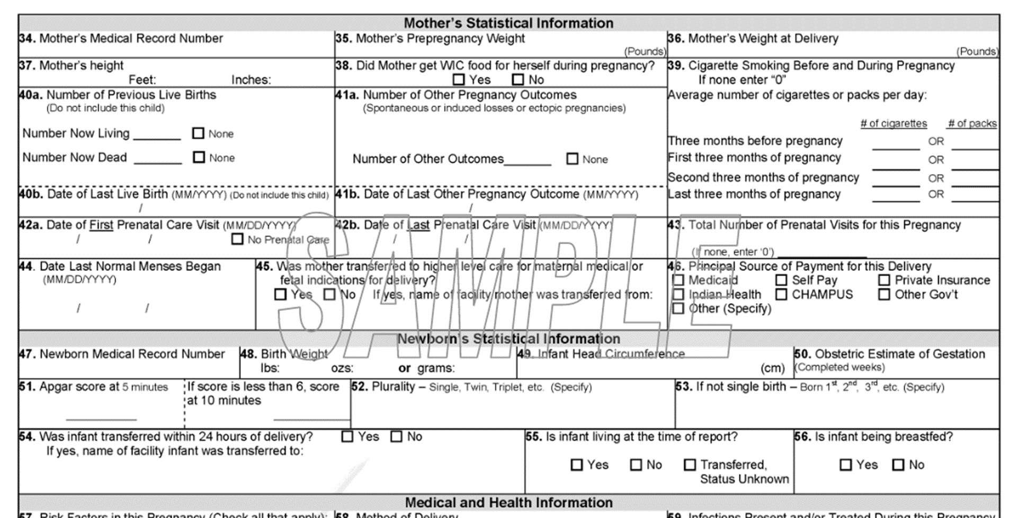
TRAINING CONTENT: How are data cREATED? Case STUDY: Birth Certificate
In Washington State, almost every birth has a certificate filled out. So, this can be considered a data source that covers an entire population (newborns). However, the data aren’t always the best quality… what can go wrong?
http://www.doh.wa.gov/Portals/1/Documents/Pubs/422-078-AnnSum2006.pdf

Slide 30
TRAINING CONTENT: POTENTIAL DATA ISSUES with DATA ON prenatal care
NOT SURPRISINGLY PEOPLE ARE…
Misremembering dates
Not wanting to look like they started too late, so, fudging dates
Filling out dates incompletely
Skipping the question even if they remember month and year, since they can’t remember the day
Prone to human error if using medical record
Living within cultural differences (European dates reported differently)
Wanting to be positive! No one wants to fill out the “No” box
Also, if the hospital doesn’t insist on good quality data for that item, hospital staff may ignore it
WHO FILLS OUT THE FORM?
Nurse at mom’s bedside?
Hospital registrar using mom’s medical record?
Midwife after home birth?
Mom herself?
Dad or relative?
AND…
Can any of them remember the exact dates of things like prenatal visits?
Does the hospital insist on completion of that field/other fields?
AND THEN WHAT?
Data has to be entered into a machine readable format—data entry errors?
Data are vulnerable to technical glitches and file corruption
Data must be “cleaned”—what to do with a record where mom’s age is 199?
Coding errors must be fixed—human race is not the same as other race
Certificates have to be traded across borders
ALL THESE THINGS TAKE TIME

Slide 31
TRAINING CONTENT: DATA CREATION AND MAINTENANCE
Data don’t come out of nowhere—they represent a phenomenon, and have to be collected! (either by humans or machines, and machines aren’t perfect)
There are many points at which the data can be “compromised”– there’s no perfect source, you just have to know the caveats!
This is why documentation is so important! Also, user forums, and hands-on experience
Maintenance is a big deal too—most users want data at regular intervals, in consistent formats, and with consistent fields (questions). This takes time and money and the will to continue!
Often older data sets are not offered online, but usually the owner can supply them (at least in government)

Slide 32
TRAINING CONTENT: QuANTITATIVE vs QUALITATIVE*
Check out this public health report that uses quant and qual together!
The two work together- qualitative can inform quantitative
Qualitative data is stronger than anecdote, and can help you persuade someone that an anecdote is true
Can be directed at specific groups and questions
Can get at issues that quantitative data doesn’t
Can incorporate cultural difference
Combining stories with quantitative data gives a human face to the issue
Qualitative data analysis methods are very sophisticated!
*Can also talk about primary data collection vs. secondary data

Slide 33
TRAINING CONTENT: Population Data ARE IDEAL, but What about surveys?
Surveys let us use a sample of the population to represent the whole---
This saves money!
Data can be collected more quickly!
Since time and money are saved, can ask more detailed questions
Often can be more customized (languages, geographic areas covered, etc.)
Data can be collected about questions of immediate interest, trends
BUT—Survey data analysis is REALLY complex; you can’t just throw it in Excel! For large data sets, you pretty much need training and data savvy to use it in its raw form

Slide 34
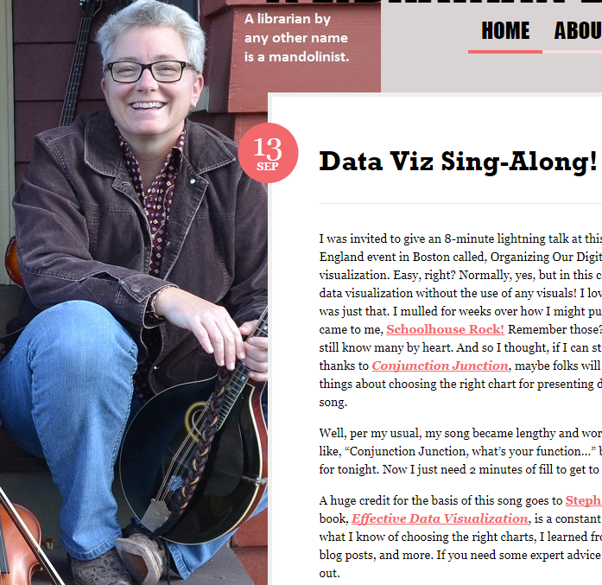
TRAINING CONTENT: DATA VISUALIZATION
Check out this site: https://eazybi.com/blog/data_visualization_and_chart_types/
Check out the work of Edward Tufte, if you haven’t already
Check out some of the sites that let you make infographics, like Piktochart—you can combine different visualizations to make a story
Pay attention to visualizations in publications that are great at them—the New York Times, the Wall Street Journal, and others
LISTEN TO SALLY GORE! http://tinyurl.com/sallygoredataviz
Image from: https://librarianhats.net

Slide 35
TRAINING CONTENT: DATA PITFALLS, OR, HOW TO BE AN INFORMED DATA CONSUMER
Look for limitations; for example, there may be bias if not everyone is represented and the lack of representation might be systematic:
People of color
People whose first language is not English
Low income people
Homeless people
People without landlines (at least in the olden days)
It can be hard to get enough respondents to look at small geographic areas (the “small numbers” issue; some statistical methods can help, but not totally!)
Geographies can be tricky (zip codes don’t match census tracts, and more!)

Slide 36
TRAINING CONTENT: MORE PITFALLS TO AVOID!
(NOTE: THESE ARE FOR SOCIAL SCIENCE DATA, BUT THE SAME CRITICAL EYE IS NEEDED FOR ANY DATA!)
Look at the survey instrument
Wording of questions makes a big difference
Order of questions makes a big difference
Certain types of questions are problematic (example—”recall bias”)
Also survey administration—land line calling is a no-go these days!
Remember the birth certificate example about how people answer questions
They want to please the interviewer
They don’t like sharing sensitive information
Women and older people are more likely to say yes/be positive even among randomly chosen people
Many people are not comfortable answering questions online

Slide 37
TRAINING CONTENT: FINDING THE PERFECT DATA SET (OR NOT?)
Look for published statistics and/or secondary data
Ask “who cares?” What organization might have already collected data?
Have a sense of which data are open and which are proprietary
Look in the literature for similar instances of dealing with the topic; what data sets did they use?
Check out LibGuides, user forums, listservs, and other places data might be discussed
Consider data archives and repositories like ICPSR (if you are game to analyze data once you get it)
Ask another data-engaged librarian! ☺

Slide 38
TRAINING CONTENT: WHAT IF YOU AREN’T FINDING DATA ON THE TOPIC?
Give data for the larger area, then show proportions that apply to your neighborhood/city/smaller area
Use data for a larger group, and then compare your group to the larger group
Use substitutions (such as, teen births if teen pregnancies aren’t available
Internet (start with Google, but don’t stop there!)
Advocate for better collection of data sources of interest
Consider gathering qualitative data (using rigorous methodology)
Consult experts (in fact, they may do a special data run for you!)

Slide 39
TRAINING CONTENT: BEST PRACTICES AS YOU USE DATA (WITH userS OR NOT!)
ALWAYS look at the documentation!
Compare what you find to published sources where possible
Consult with others who have used the source, or the software
Consult an expert (data requests!)
Prioritizing— try to focus on 2 or 3 crucial facts to make an argument
Comparing—consistent units, correct frame of reference, eliminate bias
Use maps and graphics AS APPROPRIATE (it isn’t always!)
Build a case with several data points—tell a story (infographics can be good here)
Watch out for technical aspects such as size of files (open data files can get BIG)

Slide 40
TRAINING CONTENT: BEST PRACTICES FOR ENGAGING userS
Narrate your process as you work
Explain why you need each piece of information from them
Emphasize that you are exploring together
Explain why some data are not available openly
Suggest adjustments to their question that may make data easier to find (warning—this often does not go over well!)
See if they can use estimates (may be easier to find in other sources online!)
Encourage them to follow best practices such as consulting the data dictionary, comparing with published sources
Suggest tutorials as a refresher if it’s been a while since they’ve done data work
Know when to refer to an expert

Slide 41
TRAINING CONTENT: WHAT ABOUT numeracy, challenges of complex data analyses?
There’s no way to make this easy. Data can be tough to work with, no matter what your level. The main goal is avoiding shaming, and offering support as possible
You can’t assume the user’s level of competency or understanding– just keep checking in on how they are receiving the information; are they repeating it back to you or sitting silently? Asking for clarification? Etc.
Suggest other library or online classes that may be helpful either before or while they delve into the data; Excel can be an important tool, but many others are easier and freely available
Offer ongoing assistance, as possible
Offer options for professional assistance (This also does not go over well! But if someone wants a complex analysis of raw data for market research, and they can’t perform it, they may have to pay for it!)

Slide 42
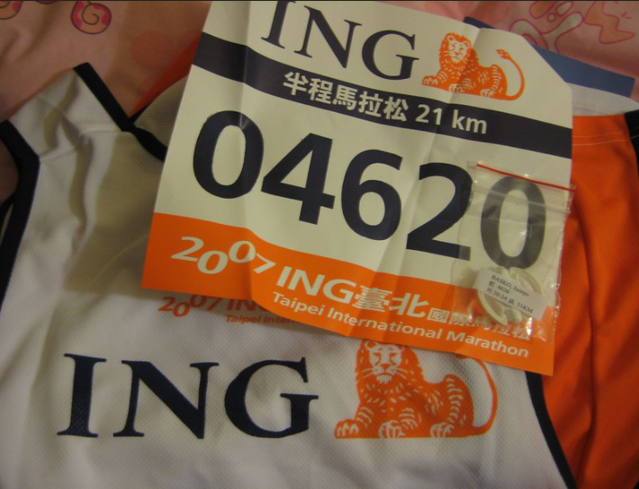
CREATING YOUR PLAN OF ACTION: IT’s UP TO YOU!
Not making a plan is a valid choice! But…
If you’ve had even one “I’ll check out that link later” moment during this talk, that one thing may lead to another! Consider:
What is realistic for your setting and job, or personal life?
Who would be natural collaborators?
What appeals to you? (at work or not)
Then– set goals! 1, 3 and 6 months…???
Credit: Zilupe
MINE:
1: Read Data Feminism book
3: Take a class, “Power Pivot Data Modeling in Excel”
6: Create my own template of library assessment data relating to my departments, that I can update yearly

Slide 43
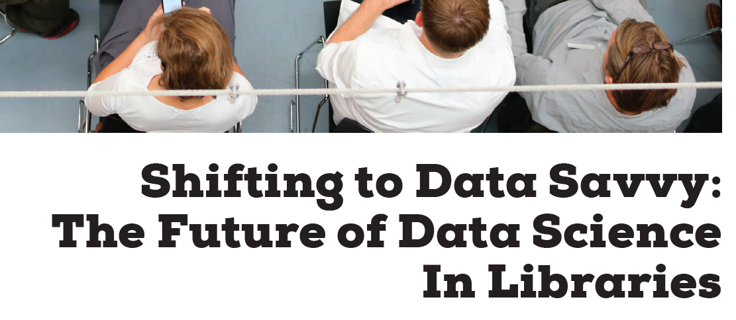
READING (in addition to the Above Links)

Slide 44
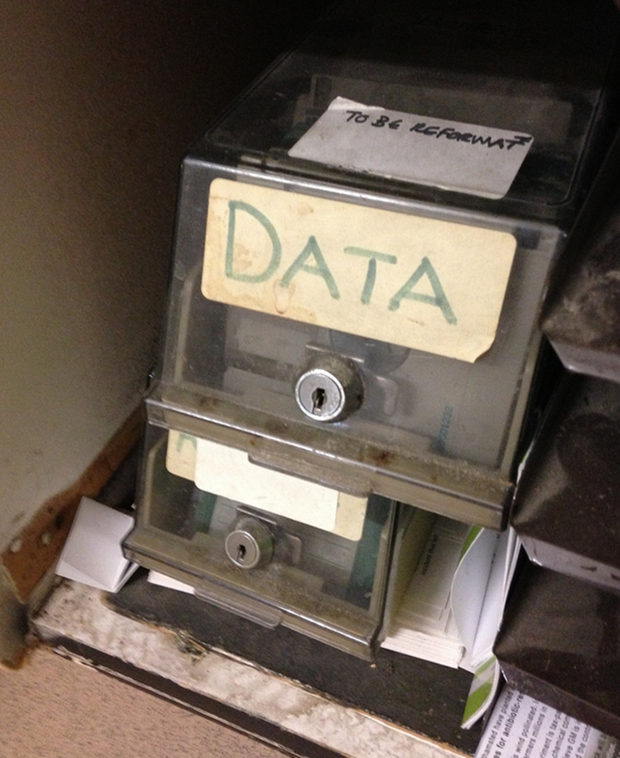
QUESTIONS?
The slides:
https://is.gd/DataEngage_Slides
My email:
Glusker@berkeley.edu
Collaborative notes document:
https://is.gd/DataEngage_CollabNotes
Credit: Janet McKnight

